Slide 1
PSCI Webinar: Environmental survey on the Link
PSCI Environment Team
15 April 2021

Slide 2

Speaker
Alejandro Fiocco
Partner, Carnstone
Secretariat for the PSCI Environment Team

Slide 3
AGENDA
Background and objectives
Data captured by the survey
How to access the PSCI platform
Responding to requests from PSCI companies
Survey run-through and technical aspects (live demo)
Q&A

Slide 4
AGENDA
➔ Background and objectives
Data captured by the survey
How to access the PSCI platform
Responding to requests from PSCI companies
Survey run-through and technical aspects (live demo)
Q&A

Slide 5
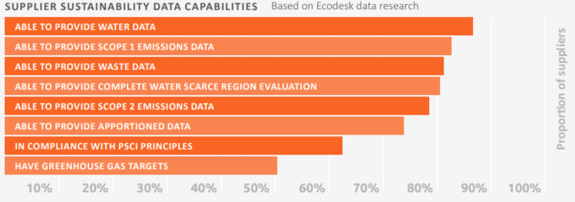
The environmental questionnaire
Since 2016, a group of PSCI members have been working together to standardize their Environmental data request to suppliers through a common set of questions, known as the PSCI Environmental Survey. For the past few years, this survey has been available for members in the form of an Excel file, with some of them running it on a third-party platform.
In 2020, 7 PSCI members used the survey.
The survey has, in the past, been useful for determining areas (on a high level) where capability needs to be built.
The development of the survey was led by the PSCI Environment Team, which originated in late 2019 as a fusion between the Sustainability Data and Environment Team.

Slide 6

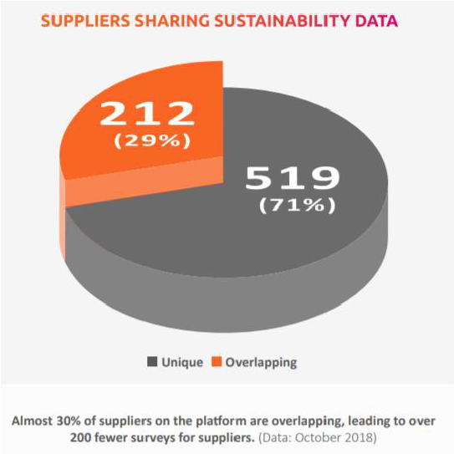
The opportunity
Harnessing our growing supplier community on the Link:
  Launched for suppliers in 2020.
  With more data there is great potential to better assess supplier maturity and target capability building efforts.
Widening the offer to all members:
  37 members are not currently running the PSCI survey on a platform; cost tends to be a limitation
  PSCI’s best interest to improve the offer to all members
  No additional cost to members and their suppliers for using the platform.
Remembering our original goal to reduce burden on suppliers:
  Allow sharing of the survey (many requests, one survey)
  Same set of questions on its core; all data requests are, in essence, the same
Notes:
Harnessing our growing supplier community: The Link, launched its portal for suppliers in 2020, with numbers steadily growing (currently over 1,000 supplier sites registered). With more data there is great potential to better assess supplier maturity and target capability building efforts.
Widening the offer to all members:
37 members are not currently running the PSCI survey on a platform (although they have the option to send an Excel file). Reasons for not using Ecodesk are diverse, but commonly associated with the significant cost it represents.
It is in the PSCI’s best interest to improve the offer to all members and provide a hub for different functionalities on the Link.
No additional cost to members for using the platform.
Remembering our original goal to reduce burden on suppliers: The questionnaire built into the Link would be the PSCI environmental questionnaire, the same questions as on the Ecodesk platform. This means that the risk of increasing the burden of the request to suppliers is minimal (all data requests are, in essence, the same).

Slide 7

The objectives for 2021
Three main objectives for this year:
Allowing members to run the PSCI environmental questionnaire on a free online platform
Giving members more control over the survey and data collected
Reduce burden on suppliers by allowing the sharing of responses

Slide 8




The bigger picture: beyond 2021
Foster industry collaboration in collecting data (improve efficiency and quality) and taking action.
Analyse Scope 3 data, identifying industry-wide trends and improvements (e.g. PSCI members’ suppliers reducing GHG emissions in x% y-y).
Hotspots for emissions/energy reduction easily identified for members to take action collectively. The same could be replicated for water, waste…

Slide 9
AGENDA
Background and objectives
➔ Data captured by the survey
How to access the PSCI platform
Responding to requests from PSCI companies
Survey run-through and technical aspects (live demo)
Q&A

Slide 10
The survey: categories for scoring and maturity
General supplier information
Core survey
Data visualisation and summary
Establish programme
  Environmental sustainability programmes and the PSCI code of conduct/principles.
Manage Impacts
  Energy, GHG, Waste and Water.
Reduce Emissions
  Questions on GHG emissions reduction targets (SBTi included) and progress to meet them. Also covers energy, water and waste reduction targets/programmes.
Apportion Emissions

Slide 11
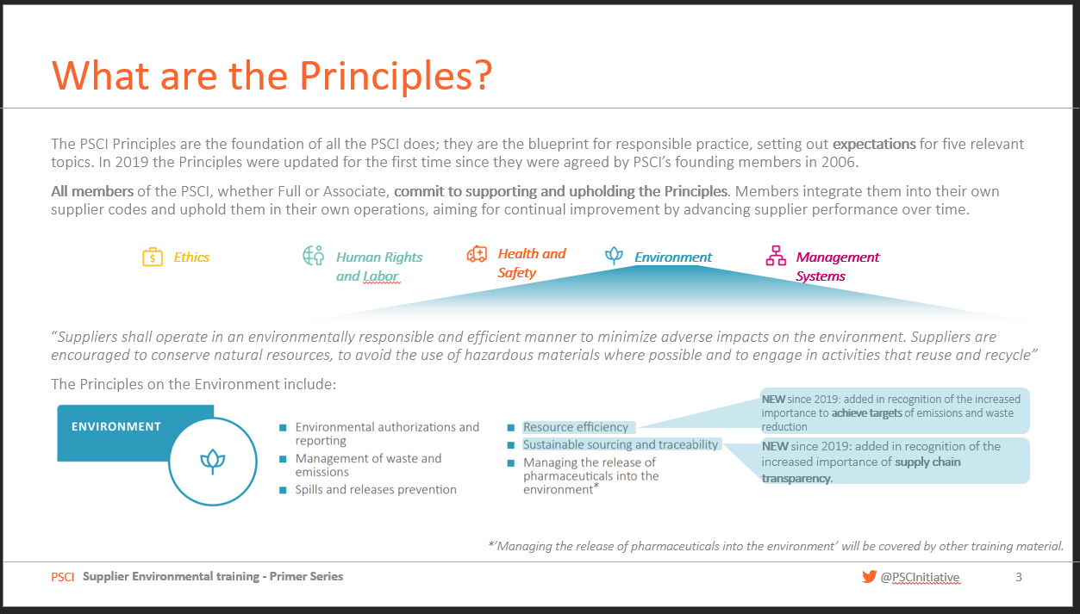
General information and Management systems
General
  Reporting period
  Scope of operation: Group/Site
  FTE
  Revenue
  Country (from site information page)
Management systems:
  Sustainability program maturity
  Compliance with codes of conduct
  PSCI Principles
  Environmental certifications
See training module on PSCI Principles on the Environment

Slide 12

Energy
Fossil Fuels
Purchased energy: electricity, heat and steam, cooling
Renewable energy generated
Energy reduction programmes and targets

Slide 13

GHG emissions
Scope 1 emissions
Scope 2 emissions
  Location/Market?
Scope 3 emissions: breakdown by GHG Protocol categories
GHG emissions reduction programmes and targets
  Scope 1 and/or 2
    Absolute/Intensity for Scope
  Scope 3
  Are they SBT?

Slide 14

Water
Water input
  Volume
  Water scarcity
  Water usage reduction program
Water output
  Volume
  API

Slide 15

Waste
Total waste generated
Hazardous waste
  Breakdown by landfill/reused/recycled/incinerated/other
Non-Hazardous waste
  Breakdown by landfill/reused/recycled/incinerated/other
Waste reduction programs
Recycling programs

Slide 16
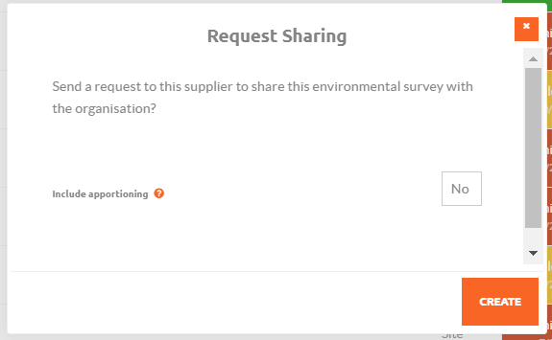
Apportioning emissions
Additional and member-specific
  % of energy (basis for calculation: financial, output, other)
  % of GHG (basis for calculation: financial, output, other)
  % of water (basis for calculation: financial, output, other)
  % of waste (basis for calculation: financial, output, other)
Support for member Code of conduct (member-specific)

Slide 17
AGENDA
Background and objectives
Data captured by the survey
➔ How to access the PSCI platform
Responding to requests from PSCI companies
Survey run-through and technical aspects (live demo)
Q&A

Slide 18
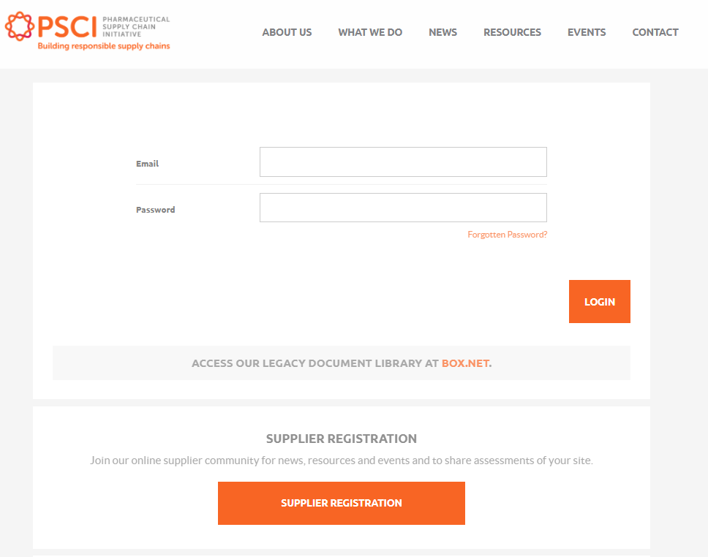
Registering on the PSCI platform
Before starting the registration process, please make sure to coordinate with the relevant functions at your company to check whether they have already registered.
  Contact info@pscinitiative.org to find out if your company/site has already been registered, and which of your colleagues are what we call Lead contacts.
No registration fees or cost associated to the use of the platform.
Site details
  Site name
  Company
  Country where the site is located
  PSCI Member Referral
Your details:
  Your name
  Email: Please use your company email address.
  Password
Go to: https://pscinitiative.org/registerSupplier

Slide 19
AGENDA
Background and objectives
Data captured by the survey
How to access the PSCI platform
➔ Responding to requests from PSCI companies
Survey run-through and technical aspects (live demo)
Q&A

Slide 20




Environmental survey process
Step 1
Requesting suppliers to join the Link (External)
Step 2
Requesting suppliers to share a survey (External/Internal)
Step 3
Validating the data and checking responses
Step 4
Accessing the data

Slide 21
Yes
Yes
Data visible in dashboard/download file (live update)
Supplier is on the Platform?
No
Has the survey been filled before?
Request via platform
Yes
PSCI Member
No
Review data in survey
Is the survey data consistent?
No
Invite to join the Link
Leave comment and action for supplier to correct data
List of suppliers
Send email request
Notification for comments to members/suppliers
Survey “locked” 3 months after survey is started
System automated functionalities and support
Guidance on filling the survey
Automated reminder to fill the survey
Basic data validation and flags raised
Register on the Link
Reply comment on the Link
Revise data
Supplier
Fill the survey
Share survey data with PSCI member
Action/step
Decision
Support available (optional)
Base process
Optional

Slide 22
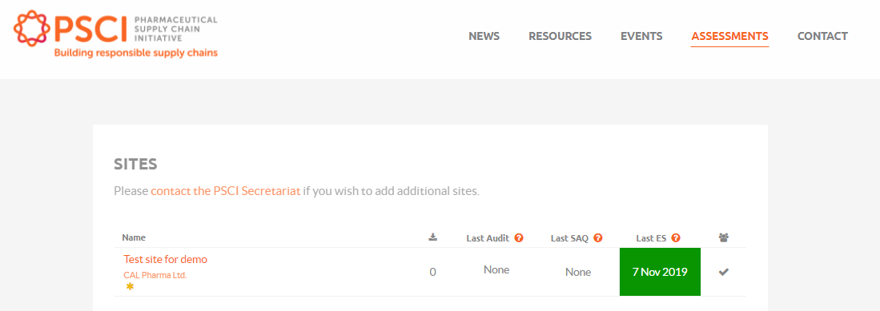
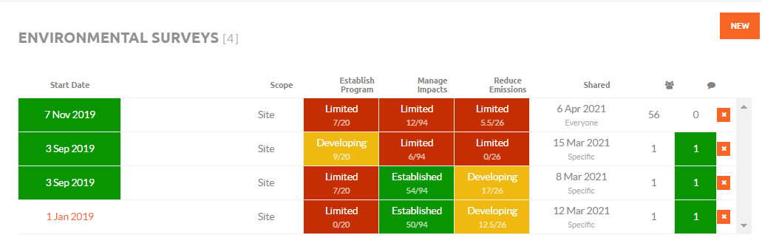
Accessing the survey
You can access your surveys through your sites/assessments pages once logged in.

Slide 23
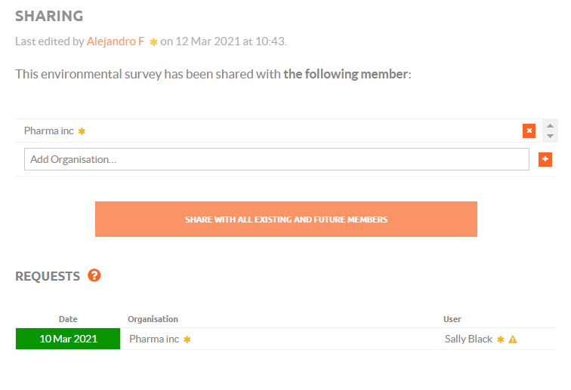
Sharing the survey
Choose which members you are sharing your data with
Open your survey to be shared with all
Manage requests to share data

Slide 24
AGENDA
Background and objectives
Data captured by the survey
How to access the PSCI platform
Responding to requests from PSCI companies
➔ Survey run-through and technical aspects (live demo)
Q&A

Slide 25
AGENDA
Background and objectives
Data captured by the survey
How to access the PSCI platform
Responding to requests from PSCI companies
Survey run-through and technical aspects (live demo)
➔ Q&A
To ask questions, please use the ‘Chat’ or ‘Q&A’ function on the right-hand side of your screen

