Slide 1
Wastewater Treatment Technologies for Controlling Discharges From Pharmaceuticals Manufacturing
Presented by the PiE/AMR Sub-Team

Slide 2

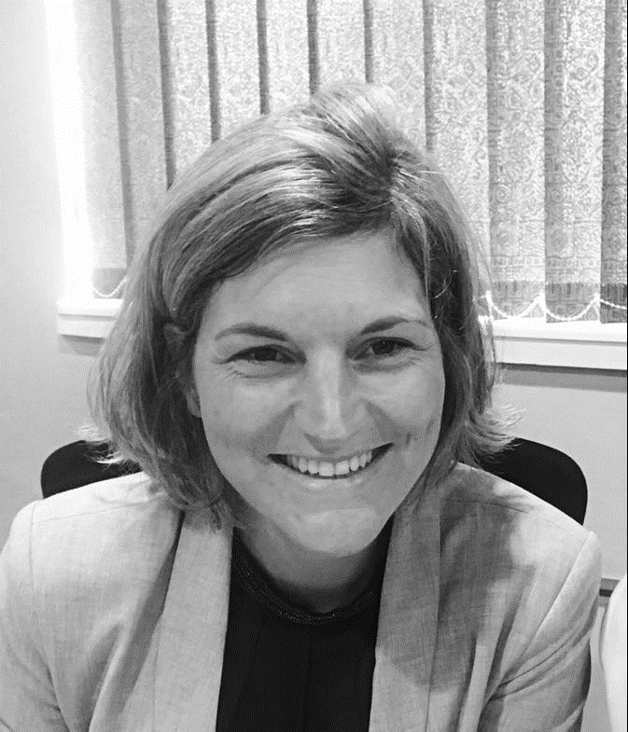

SPEAKERS
Jonathan Rhone
Axine Water Technologies
CEO
Birgit Mertens
Johnson & Johnson
Global Subject Matter Expert Environment
Jeffrey Brenchley
MSD Global Safety & Environment
Director – Water Center of Excellence

Slide 3
Agenda
Introduction
Vacuum evaporation
Ozone as pretreatment
Electrochemical oxidation
Q&A

Slide 4
Agenda
Introduction
Vacuum evaporation
Ozone as pretreatment
Electrochemical oxidation
Q&A

Slide 5
Technology Overview – Vacuum Evaporator
Concentrating API contaminated wastewater and producing a clean distillate via evaporation under vacuum
Operating temperatures are less than conventional evaporation (as low as 40°C) due to vacuum operation
Energy consumption is reduced compared to conventional evaporation
  Evaporator feed preheated with distillate
  Vacuum reduces boiling temperature
Generally produced as skid mounted units, commercially available from many reputable vendors globally
  Multiple units in parallel are utilized to increase capacity
  Engineering minimized due to availability of pre-manufactured skid
Skid mounted unit coupled with engineered system
Confidential and Proprietary Information

Slide 6
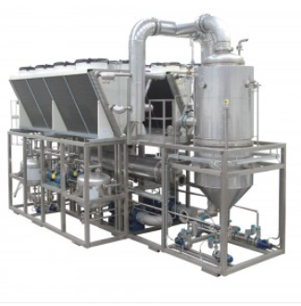
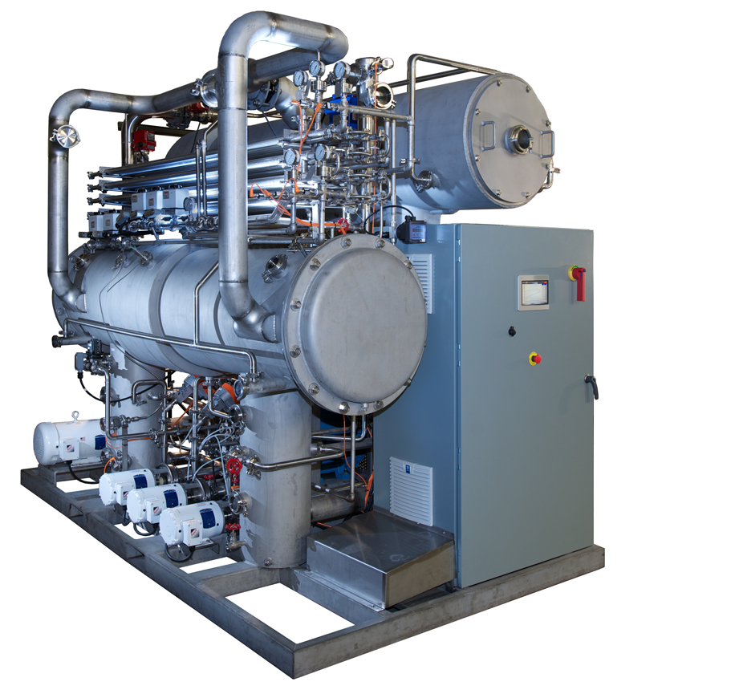
Technology Overview – Vacuum Evaporator
Major Skid Components
  Vacuum Pump
  Heat Source
    Steam
    Electric
    Heat Pump
    Hot Water
  Demister Pad
    Efficiency affects API Carry over rate
  Heat recovery system
    Feed pre-heat
Confidential and Proprietary Information

Slide 7
API Removal - Vacuum Evaporator
Mode of operation is based on volatility
  API’s are not volatile
  Evaporator is indiscriminate and can be used for all API’s
  Other technologies (Ozone, Fenton’s Reagent) are dependent on the oxidation potential of the API
Greater than 99% of the API in the feed stream is conveyed to the concentrate stream
  Concentrate generally is liquid, this technology does not produce a sludge
Efficient system will reduce concentrate volume 95% when compared to feed volume
Confidential and Proprietary Information

Slide 8
Case Study – Reduction in Waste Disposal Costs
Facility Background
Facility burdened by waste disposal costs due to segregation of first and second rinse streams from production process
Generation of 30 m3/day of API contaminated wastewater
Wide variety of products produced at the site with a wide range of PNECs
Facility located in relatively small catchment, dilution flow rate for chronic PEC calculation < 20,000 m3/day
Based on mass balance, 99.8% API removal required for multiple APIs to meet PEC/PNEC ratio of <1.0
Confidential and Proprietary Information

Slide 9
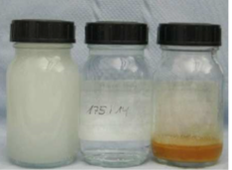
Case Study – Reduction in Waste Disposal Costs
Technology Options Evaluated
  Ozone
  Vacuum Evaporation
  Fenton’s Reagent
Pilot testing performed for worst case API
  Ozone removal rate 96%
  Vacuum evaporator
    Removal rate >99.9%
    >95% reduction in in volume (30 m3/day reduced to 1.5 m3/day)
Vacuum evaporator selected because ozonation could not meet the desired PEC/PNEC ratio
  Images of evaporator feed, distillate, and condensate during pilot testing
Confidential and Proprietary Information

Slide 10
Case Study- Reduction in Waste Disposal Costs
System Implemented
At source wastewater segregation
  Piping System
  Lift Stations
CIP System
Antifoam Feed
Evaporator Skid
Concentrate Tank
Distillate Tank
Antifoam
Distillate Tank
CIP
Discharge or Reuse
Equalization Tank
Evaporator Skid
At Source Wastewater Segregation
Concentrate Tank
Offsite Disposal
Confidential and Proprietary Information

Slide 11
Implementation Lessons Learned – Vacuum Evaporator
Always perform treatability testing prior to implementation
  Determination of API removal rates to validate expected removal
  Determination of separation efficiency for sizing of tanks
Validate at-source segregation strategy
  Thorough evaluation of processes to determine the presence of API discharges
  Determine number of equipment rinses that require capture (often more than first rinse)
  Generally requires API sampling to validate segregation
Ensure that the evaporator skid is equipped with a CIP system
Consider methodology to validate performance on an on-going basis
  Periodic API sampling
  Monitoring of distillate conductivity as a surrogate
Ensure that presence of organic solvents is carefully considered in the design, including cleaners and disinfectants
Consider re-use of the distillate stream (ZLD)
Consider maintenance and service contracts with the evaporator skid vendor
Confidential and Proprietary Information

Slide 12
Technology Comparison – Vacuum Evaporator
Item | Vacuum Evaporator | Ozone Treatment | Fenton’s Reagent Treatment
Waste Disposal Costs
API Removal Efficiency
Capable of Zero Liquid Discharge (ZLD)
Requires at Source Segregation
End of Pipe Treatment Capability
Confidential and Proprietary Information

Slide 13
Agenda
Introduction
Vacuum evaporation
Ozone as pretreatment
Electrochemical oxidation
Q&A

Slide 14
Project drivers
Next to being in full compliance with laws, regulations and environmental permits , take a pro-active approach to define & meet internal API specific discharge standards set by science-based risk assessments
This project identified an efficient multi-purpose technology to meet these internal standards
  Able to treat multiple APIs
  Suited for future product portfolio
Confidential and Proprietary Information

Slide 15


Scope: the obvious yet difficult part
We treat the streams of tomorrow
‘What is that exactly?’
Historical data
Prognoses
Worst case scenario selected for artificial wastewater
daily volumes known
all CIP liquids at daily average
all APIs at max daily production
Confidential and Proprietary Information

Slide 16
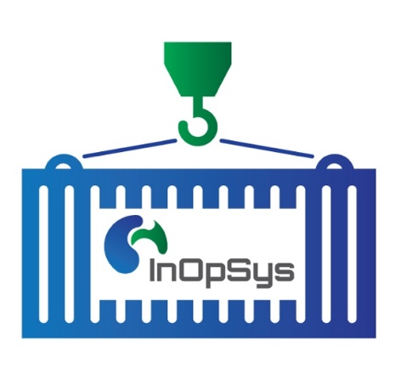
Scope: the obvious yet difficult part
‘Where will we treat?’
Logistics and feasibility
Several reactors and points of entry
surface
water
existing biological
treatment
10 m³
/d
10 m³
/d
15 m³
/d
15 m³
/d
2 collectors
20 m³
/d
20 m³
/d
10 m³
/d
10 m³
/d
150 m³/d
1500 m³/d
> 20 APIs
5 CIP liquids containing 15 surfactants
Formulation aids: 150 different chemicals
Removal requirement: 99,997 %
Temperature: 40 – 80°C
Confidential and Proprietary Information

Slide 17
Technology Selection
Destructive method required - No concentrated side-streams
  No membranes – no adsorption – no extraction
  Advanced Oxidation Processes
General principle
  Convert initiator into OH radicals using a catalyst
  High effectivity in reaction with/removal of organic pollutants
Confidential and Proprietary Information

Slide 18
Technology Selection – Ozonation
Special type of advanced oxidation due to influence of pH on oxidation pathway - Direct or indirect reaction
  pH > 9: indirect reaction is promoted (production hydroxyl radicals)
  pH < 4: direct reaction with ozone is promoted
  4 < pH < 9: both reaction pathways occur at the same time
Parameter | Direct ozonation | Indirect ozonation
Selectivity | ++ | -
Overall COD removal | - | +
Oxidation power | + | ++
Effectivity for micropollutant removal | + | ++
Impact of wastewater matrix on efficiency | - | +
Confidential and Proprietary Information

Slide 19
Technology Selection : need for pre-treatment step
Use 03 energy for APIs not for other matrix components
  remove these components
  many surfactants present
  physico-chemistry as pretreatment
  Coagulation – Flocculation identified as best option
Confidential and Proprietary Information

Slide 20
R&D results
Artificial wastewater
Real wastewater
 | Sample 1 | Sample 2 | Sample 3
# APIs | 8 | 7 | 11
Post phys. chem. API-load removed (%) | 75 | 86 | 80
Post O₃ API-load removed (%) | >99,997 | >99,997 | >99,997
Rel. O₃ dose required [g/L] | 0.35 | 0.6 | 0.6
Above target concentration
Below target concentration
Rel. O₃ dose required for removal of all API’s: 1 – 2 g O₃/L
Most APIs removed at lower O₃ doses
Confidential and Proprietary Information

Slide 21
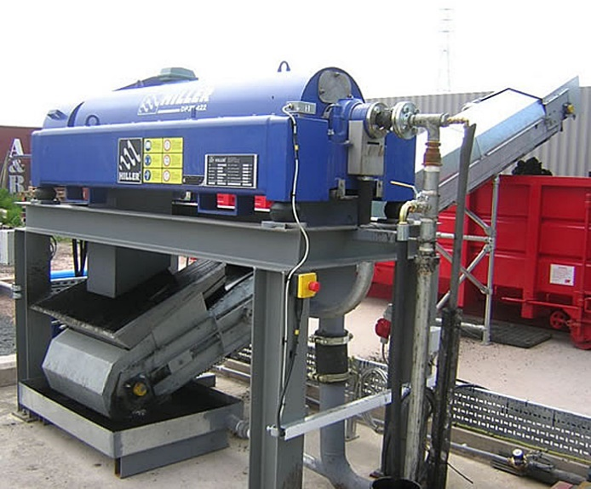
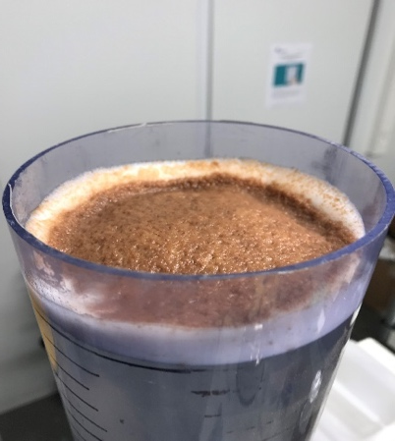
Pilot experiments
Goal
  Evaluate operational hazards
  Determine operational parameters
  Identify potential issues
Identified need for
  Flotation step to clarify the wastewater
  Need for ‘polishing’ step for rate-limiting APIs
Confidential and Proprietary Information

Slide 22

Final treatment train
Selective oxidation targets mostly complex molecules
Physico-chemical treatment
Removal of undissolved material
&
Removal of hydrophobic molecules
Additives
Ozonation
Removal of complex organic molecules
AOP
Existing biological
treatment
Surfactants
APIs
Activated carbon adsorption
Polishing
Removal of undissolved micropollutants which destabilise the oxidation process.
Removal of components which are insensitive to oxidation
Polishing with adsorption can significantly reduce required pressure, contact time, oxidant dose
Confidential and Proprietary Information

Slide 23
Implementation
Each treatment unit fits into a flexible modular scalable system
Flexible/modular system
Plug and play coupling of multiple technologies on independent skid systems
Technologies can be added/ removed or switched ON/OFF based on variation in API production.
Scalable
Technology skids available in multiple sizes/possibility to put identical skids in parallel
From 1m3/day to 100m3/h
Confidential and Proprietary Information

Slide 24
Agenda
Introduction
Vacuum evaporation
Ozone as pretreatment
Electrochemical oxidation
Q&A

Slide 25
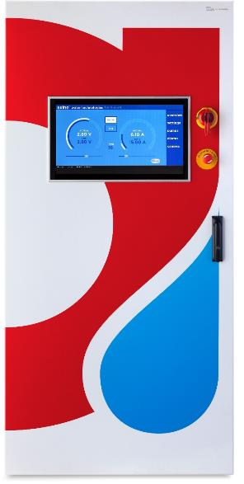
Treating APIs in Pharma Wastewater
Automated, On-Site Solutions for Rinse Water/Effluent
Axine specializes in on-site treatment of pharmaceutical wastewater contaminated with APIs and solvents
Our treatment systems are based on proprietary electrochemical oxidation technology which can treat the widest range of complex APIs to the most stringent PNEC requirements
Our service model enables pharmaceutical customers to achieve guaranteed treatment performance with minimal investment, operational disruption or technology risks
We have a proven track record of collaborating with customers to develop and implement projects from economic modelling, testing, verification, design and deployment
Confidential and Proprietary Information

Slide 26
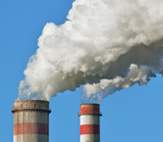
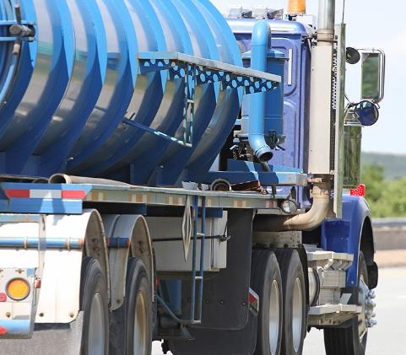
Pharma Problems We Address
Pharma plants discharge API-contaminated wastewater effluent
  Regulatory Risk – Emerging API regulations
  Environmental Risk – API impact on aquatic ecosystems
  Health Risk – AMR, endocrine disruption, etc.
  Reputational Risk – C-level attention, investors, NGOs
  Market Risk – Emerging regs; supply chain scrutiny
Pharma plants truck and incinerate segmented API-contaminated CIP Rinse Water
  Expensive – up to $1M+/year per plant
  Dirty – up to 5+ M lbs of waste incinerated
  Safety – Employee handling exposure risk
  Energy Intensive – trucking up to 100,000+ miles/yr
  Business Interruption – Loss of waste disposal outlets
Confidential and Proprietary Information

Slide 27
Pharma Streams & Pollutants We Treat
Problem Streams/Sources
CIP rinse water
Line and tank rinses
Fermentation waste
Biologics manufacturing waste
Off-spec disposal operations
Scrubber blowdown
Solvent extraction
Cleaning processes
Formulation operations
Problem Organic Pollutants
APIs – e.g. antibiotics, anti-parasitics, anti-fungal, anti-depressants, opioids, steroids, oncology, hormones, cardiovascular drugs, etc.
Solvents – e.g. acetone, isopropyl alcohol (IPA), ethanol, toluene, methylene chloride, methanol, acetonitrile, MTBE, MIBK etc.
Other Organics – e.g. chloroform, detergents (Triton X-100), surfactants, biocides, etc.
Axine technology is capable of treating a wide range of APIs and contaminants to meet PNEC requirements (i.e. < 1 ppb)
Complete mineralization of APIs in highly contaminated wastewater provides pharma manufacturers a robust tool to meet discharge criteria
Confidential and Proprietary Information

Slide 28
Electrochemical oxidation
Technology and Solutions

Slide 29
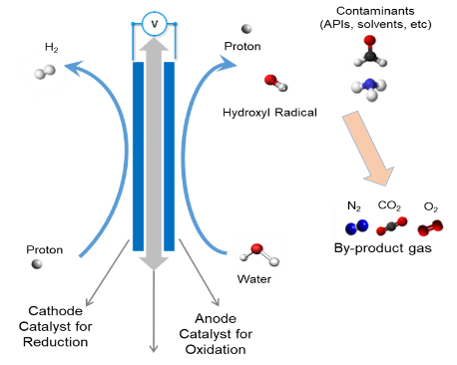
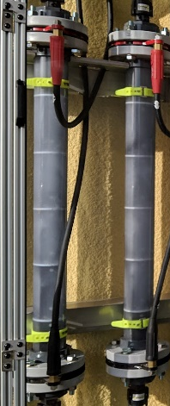
Electrochemical Technology
A New Standard for Treating APIs in Pharma Wastewater
Axine’s systems are based on its proprietary electrochemical oxidation technology (EOx)
Electricity is applied to advanced catalysts that generate hydroxyl (OH*) and other mixed oxidants
Direct and indirect oxidation breaks down pollutants to trace by-product gases N2, H2, O2 & CO2
Organic pollutants completely mineralized and destroyed unlike other AOP technologies
No hazardous chemicals required; no liquid or solid waste generated
Axine owns its technology, which is protected by an extensive IP portfolio
Unmatched Performance
Destroys virtually any organic pollutant or API to meet the most stringent treatment requirements down to ppb or non-detection levels
Operates in wide range of wastewater quality and pollutant concentrations
Confidential and Proprietary Information

Slide 30
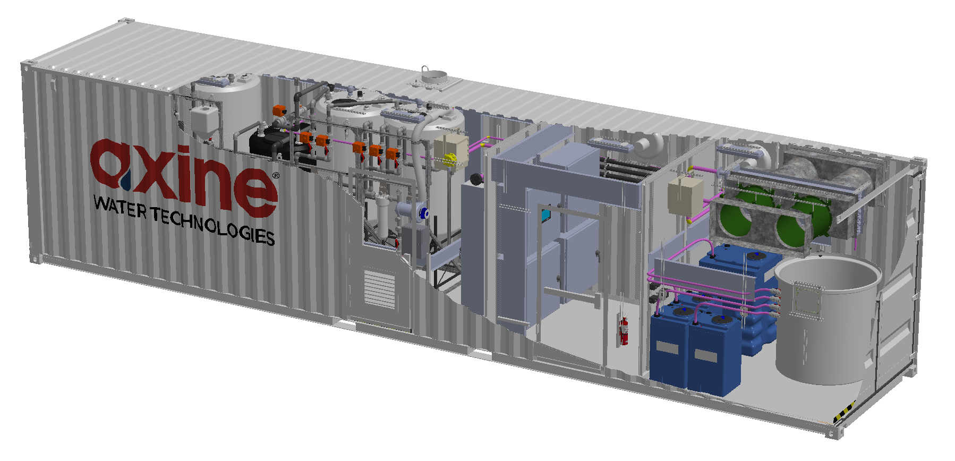

Axine Turnkey Treatment Systems
Equalization tanks
Pre-treatment and post-treatment (e.g. membranes, filters, etc.)
Electrochemical reactors, power supply, control system, control system interface, instrumentation
Electrolyte, electrolyte dosing, pumping & exhaust systems
Confidential and Proprietary Information

Slide 31
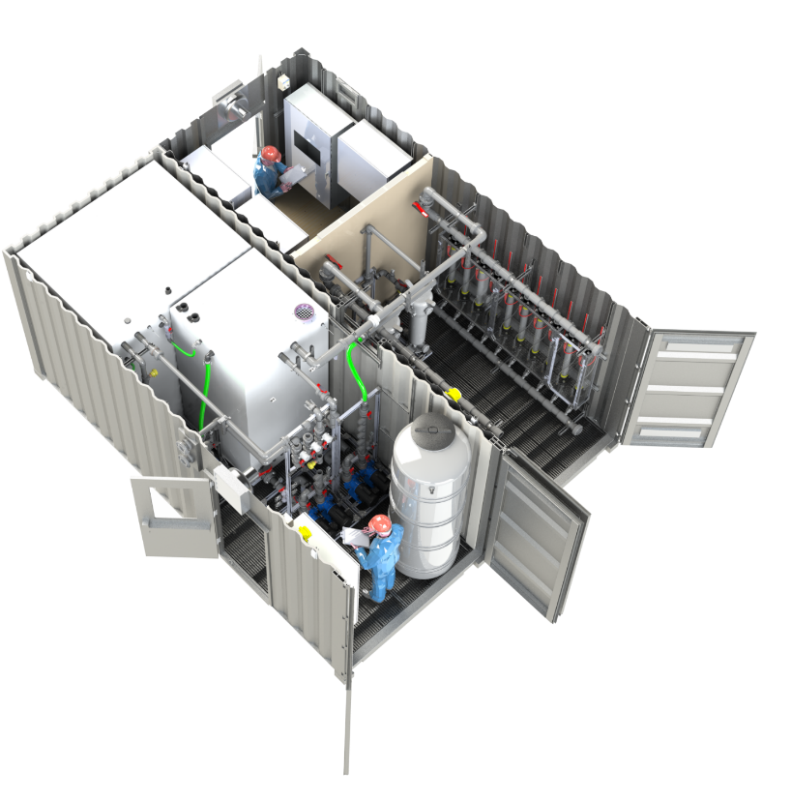

Wastewater Service Model
Customer
Delivers wastewater at specification
Provides site & energy to operate the Axine system
Axine
Treats wastewater-as-a-service under multi-year contract
Guarantees specified treatment performance
Axine Wastewater-as-a-Service
Axine designs, builds, owns, operates, maintains, services turnkey system at customer’s site
Systems based on Axine’s proprietary electrochemical oxidation technology; fully automated & remotely operated
Systems are assembled off-site for “plug-and-play” installation at customer sites and designed to be scaled as needed
Confidential and Proprietary Information

Slide 32
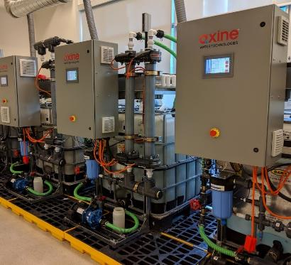
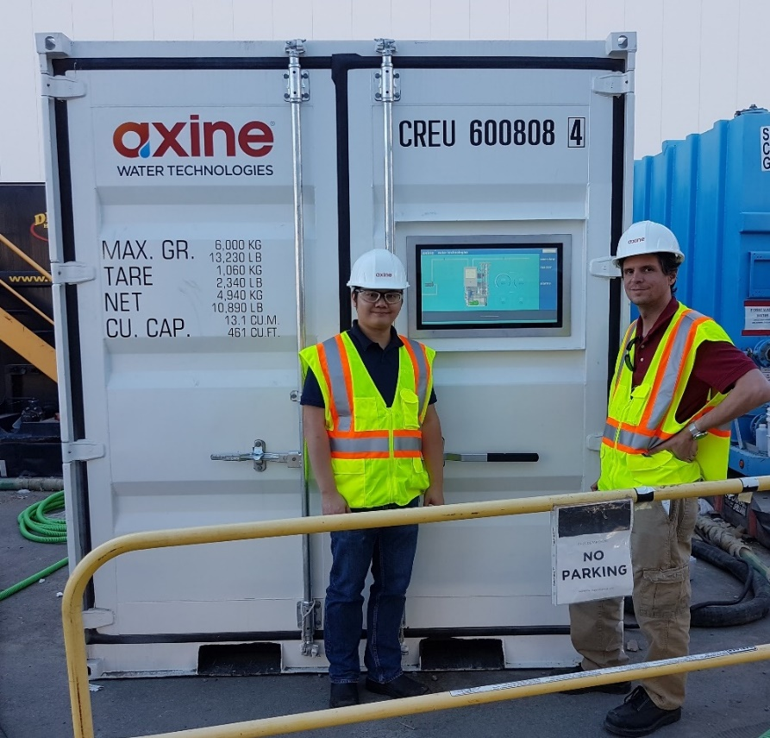
Axine Testing Services
Extensive in-house testing capabilities including full-scale commercial skids (left), full-scale pilots (right) & mini E-box pilots (not shown)
Dedicated technical services team including test engineers, technicians & full service analytical capabilities
Confidential and Proprietary Information

Slide 33
Electrochemical oxidation
Pharmaceutical Case Study #1:
API Destruction for Discharge to Sewer

Slide 34
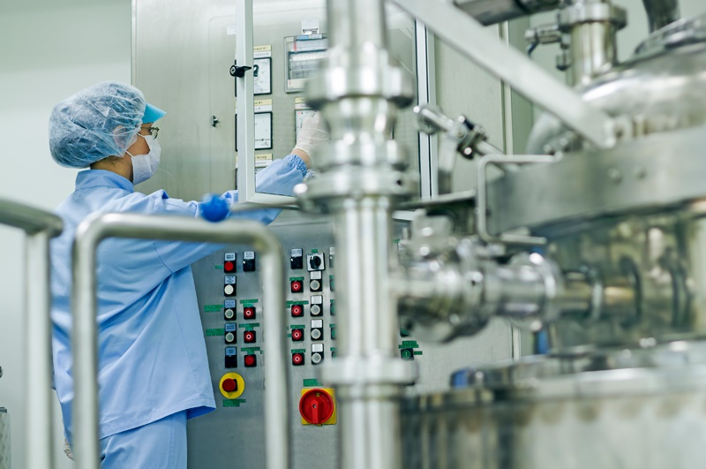
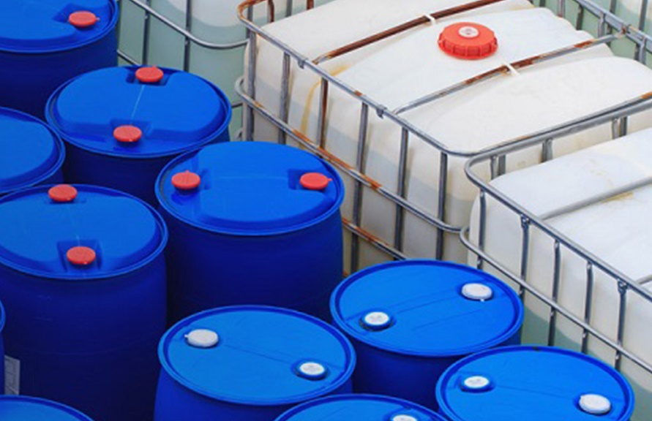
Project Background
A US pharma plant generates 200,000 gallons/year of CIP rinse water containing antimicrobial API
The rinse water was trucked off-site for incineration because the API exceeded the site discharge permit limit
The site historically incinerated >1.5 million lbs/year with trucking distance at >20,000 miles/year (>40 truck trips/year)
The customer wanted an on-site treatment solution to achieve the following:
  Lower opex; eliminate off-site trucking,
  Reduce supply chain risk,
  Automate & simplify waste operations,
  Improve safety and reduce costs
Confidential and Proprietary Information

Slide 35
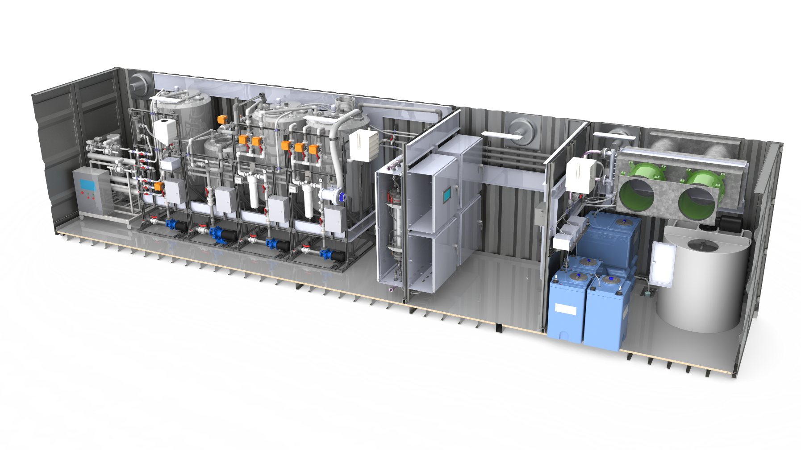
Axine On-Site Solution
Axine and the site completed a technical and commercial evaluation of Axine’s solution for treating API contaminated rinse water
Axine was selected and signed a multi-year service agreement to build, install, monitor, service and maintain a system on-site
The Axine system treats the rinse water to reduce API to non-detect so the treated water can be discharged to sewer
Confidential and Proprietary Information

Slide 36
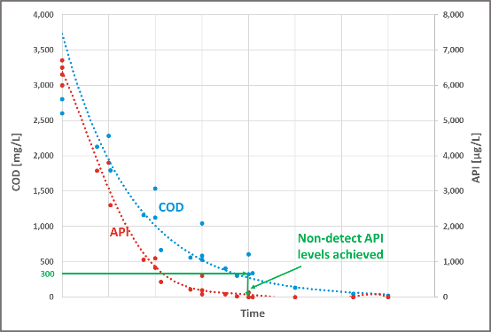
Treatment Performance & Verification
Eliminating antimicrobial API for safe discharge
The rinse water contains APIs, mixed solvents, TSS, TDS with COD of <4,000 mg/L
A sampling program verified the influent wastewater composition specification
Axine’s design spec is to reduce the API from 7,000 µg/L to <70 µg/L (>99%) to meet the permit
A test program (see chart) verified treatment performance and economics
Axine treated water subject to WET (Whole Effluent Toxicity) testing by the local municipality – successfully completed
Parameter | Before Treatment | Treatment Required | Axine Treated | % Reduction
API µg/L | <7,000 | 70 | < 50* | > 99.2%
COD mg/L | <4,000 | N/A | < 50* | > 98.4%
* Values indicate the analytical detection limit of these compounds
Confidential and Proprietary Information

Slide 37
Axine Simplified PFD
Confidential and Proprietary Information

Slide 38
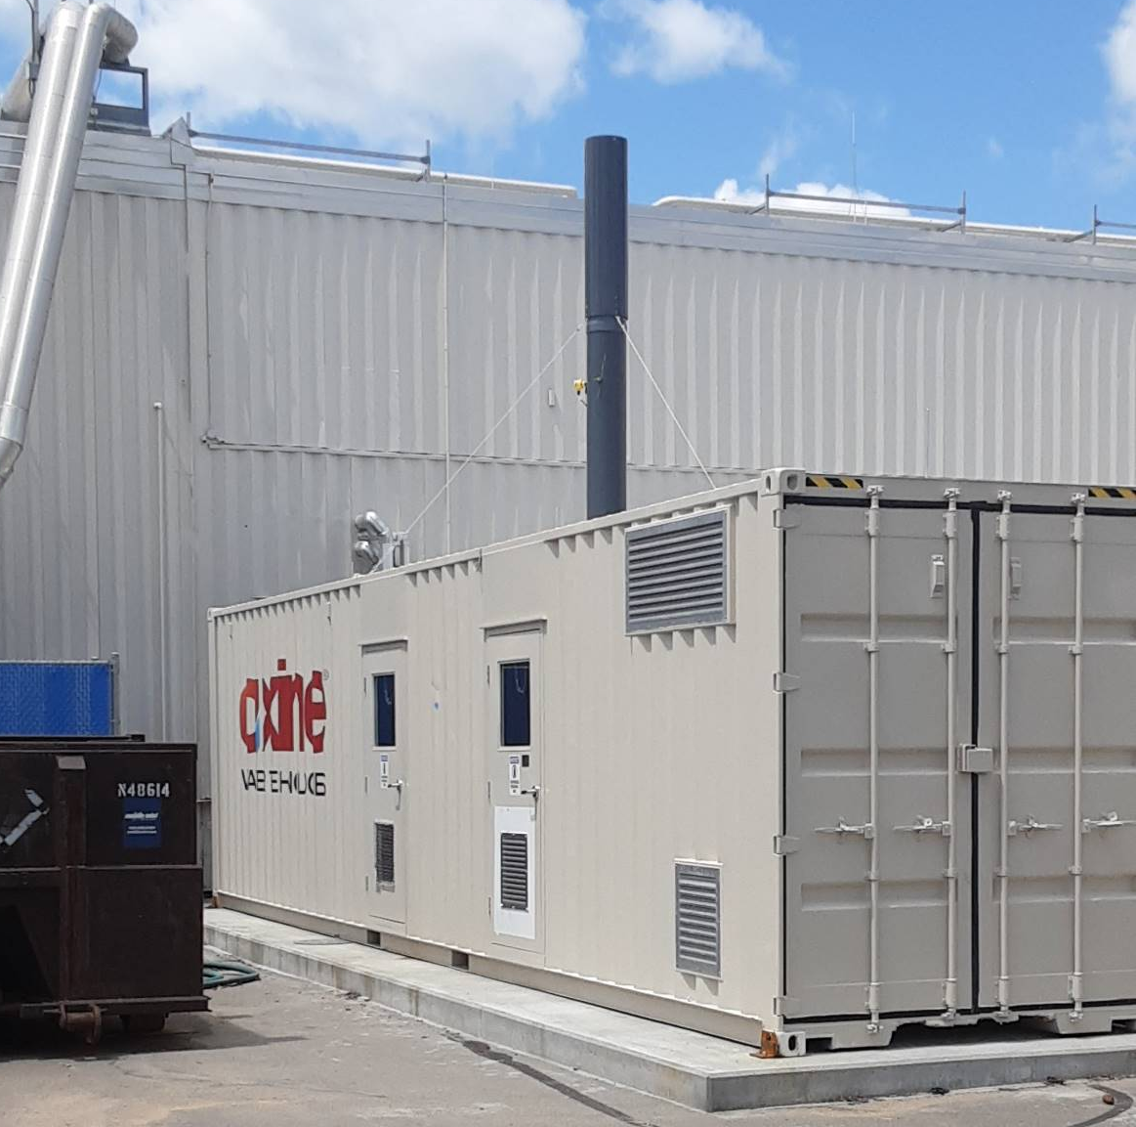
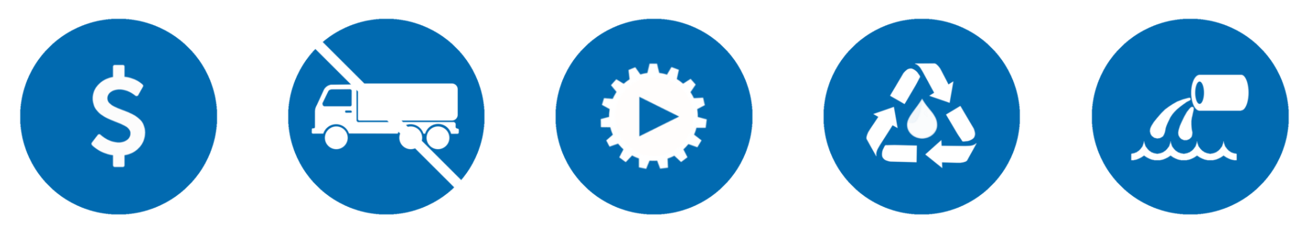
Project Benefits
Safely treats APIs on-site to meet discharge permit
Lowest cost solution generates site opex savings
Eliminated risk of disruption to waste supply chain
Eliminates 1.6 MM lbs/year of waste incinerated
Eliminates 20,000 miles/year of trucking
Service model minimized site capital investment
Improved site safety and environmental performance
Confidential and Proprietary Information

Slide 39
Electrochemical oxidation
Pharmaceutical Case Study #2
Solvent Treatment to Meet Compliance

Slide 40
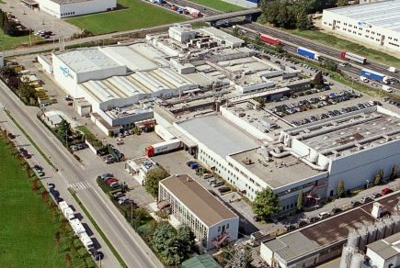
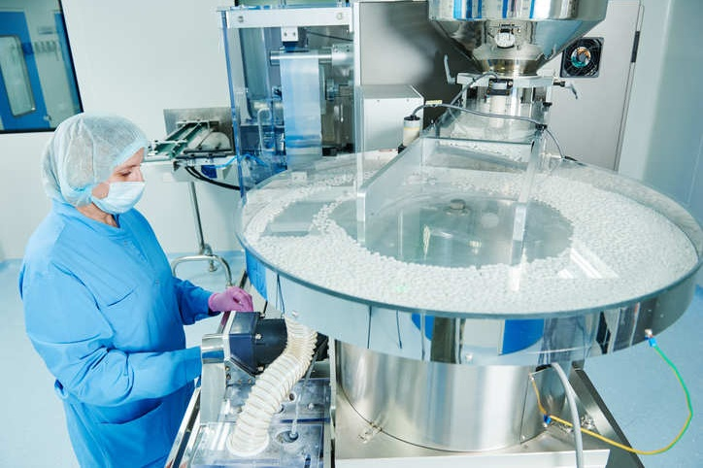
Project Background
A US pharma plant generates 750,000 gallons/year of process wastewater contaminated with a mixture of isopropyl alcohol (IPA) and acetone
The wastewater is discharged to sewer and the site has historical challenges meeting US EPA discharge limits for acetone (8.2 mg/L)
The site had evaluated numerous treatment options for removing acetone and IPA as a pre-treatment step prior to discharge to POTW
Confidential and Proprietary Information

Slide 41

Axine On-Site Solution
Axine and the site completed a technical and commercial evaluation of Axine’s solutions for treating IPA and acetone
Axine and the site and signed a multi-year service agreement to build, install, monitor, service and maintain a system on-site
The Axine system treats the wastewater to reduce IPA and acetone so the treated water can be safely discharged to POTW
Confidential and Proprietary Information

Slide 42
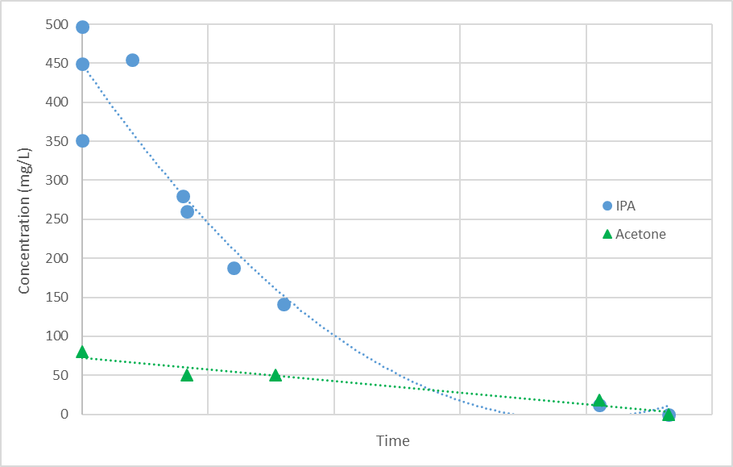
Treatment Performance & Verification
Eliminating acetone for safe discharge
The wastewater contains mixed COD, TDS, chlorides and hardness
A sampling program verified the influent wastewater composition
Axine’s design spec is to reduce the acetone from 75 mg/L to <2 mg/L to meet the permit
A test program (see chart) verified treatment performance and economics
Parameter | Before Treatment | Treatment Required | Axine Treated | % Reduction
COD mg/L | 1,300 | N/A | <10 | > 99.3%
IPA mg/L | 500 | <5 | <1 | > 99.2%
Acetone mg/L | 75 | <2 | <1 | > 99.3%
Confidential and Proprietary Information

Slide 43
Simplified PFD
Confidential and Proprietary Information

Slide 44
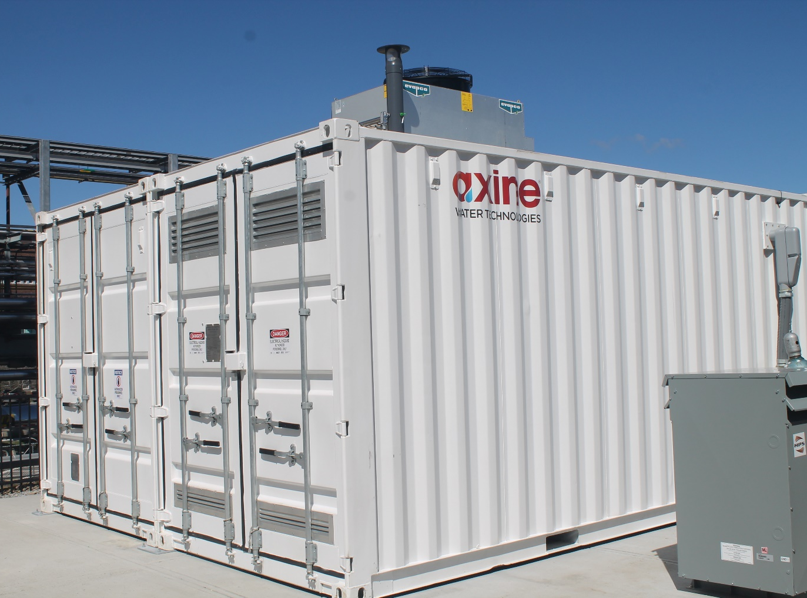
Project Benefits
Provides high performance solution for ensuring regulatory compliance
Lowest cost highest performing solution vs other options
No labour, no chemical handling, no equipment service or maintenance
Service model provides a stable, predictable cost without capex investment
Low risk of downstream contamination vs chemical alternatives
Confidential and Proprietary Information

Slide 45
Electrochemical oxidation
Other API Treatment Examples

Slide 46
Axine API Treatment Summary
API | Units | Before Treatment | PNEC/ Objective | Axine Treated | % Reduction
Antibiotic #1 | µg/L | 2,800 | 8.0 | 3.6 | > 99.87%
Antibiotic #2 | µg/L | 100,000 | 0.25 | < 0.1 | >99.99%
Antibiotic #3 | µg/L | 1,320,000 | 0.25 | < 0.2 | > 99.99%
Antibiotic #4 | µg/L | 75,000 | 1.0 | < 0.005 | > 99.99%
Antiparasitic #1 | µg/L | 4,000 | 3.0 | < 1.0 | > 99.97%
Antiparasitic #2 | µg/L | 6,700 | < 70 | < 70 | > 98.95%
Antiparasitic #3 | µg/L | 60 | 0.27 | < 0.1 | > 99.83%
Opioid #1 | µg/L | 54,000 | 32.0 | < 1.0 | > 99.99%
Opioid #2 | µg/L | 53,000 | 3.8 | < 2.2 | > 99.99%
Analgesic | µg/L | 102,000 | 95 | < 0.2 | > 99.99%
Cardiovascular | µg/L | 94,000 | 148.0 | < 0.05 | > 99.99%
Oncology | µg/L | 8,000 | n/a | 70 | > 99.1%
Statin | µg/L | 71,000 | 14 | < 0.005 | > 99.99%
Confidential and Proprietary Information

Slide 47
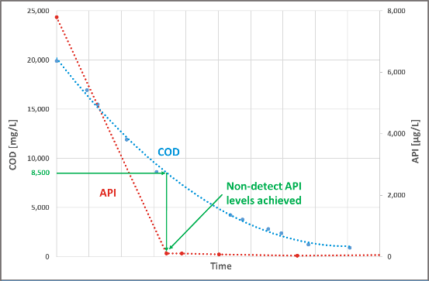
API Treatment Example #1
Eliminating Oncology API for a Pharma plant
Parameter | Before Treatment | Treatment Required | Axine Treated | % Reduction
API µg/L | 7,800 | 200 | < 50* | > 99.3%
Chloroform mg/L | 500 | 2 | < 0.001* | > 99.9%
COD mg/L | 19,920 | N/A | 920 | > 95.3%
Pharma site generates rinse water with an oncology API and chloroform
Axine as successfully achieved API destruction of >99.3%
  7,800 to < 50 µg/L
  Below 200 µg/L site target
Axine has also achieve chloroform destruction of > 99.999%
* Values indicate the analytical detection limit of these compounds
Confidential and Proprietary Information

Slide 48
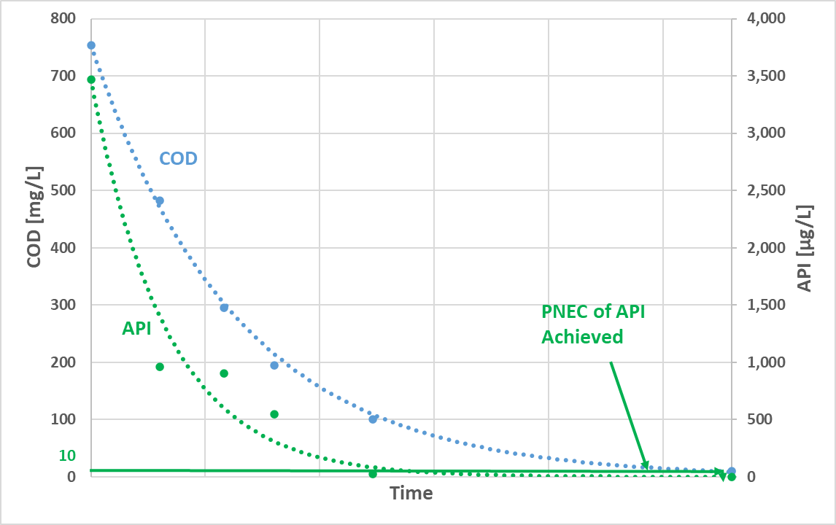
API Treatment Example #2
Eliminating Animal Health API for a Pharma plant
Parameter | Before Treatment | PNEC | Axine Treated | % Reduction
API µg/L | 3,500 | 1 | < 1* | > 99.97%
COD mg/L | 750 | N/A | < 10* | > 98.67%
Pharma site generates rinse water with antiparasitic API
Axine has successfully achieved API destruction by >99.97%
3,500 to < 1 µg/L
Below 1 µg/L PNEC
* Values indicate the analytical detection limit of these compounds
Confidential and Proprietary Information

Slide 49
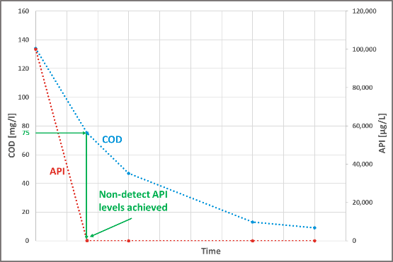
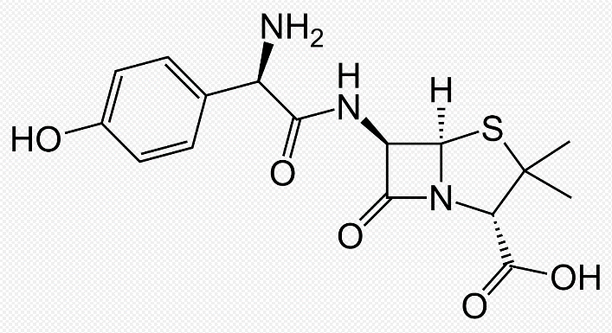
API Treatment Example #3
Amoxicillin Treatability Testing on Model Wastewater
Parameter | Before Treatment | PNEC | Axine Treated | % Reduction
API µg/L | 100,000 | 0.25^{A} | < 0.1* | > 99.9%
COD mg/L | 134 | N/A | < 10* | > 92.5%
Model testing on a single antibiotic API
API molecular weight is 365.4 g/mol
Axine has achieved API destruction of > 99.9999%
  100,000 to < 0.1 µg/L
  Below 0.25 µg/L PNEC level
Molecular structure:
^{A} Values per Temple University’s Water and Environmental Technology (WET) Center PNEC List, 2019
* Values indicate the analytical detection limit of these compounds
Confidential and Proprietary Information

Slide 50
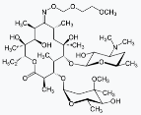


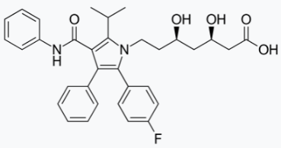

API Treatment Example #4
API Blend Treatability Testing
Parameter | Before Treatment | PNEC | Axine Treated | % Reduction
Acetaminophen µg/L | 102,000 | 95^{A} | < 0.2* | > 99.9998%
Ampicillin µg/L | 1,320,000 | 0.25^{B} | < 0.2* | > 99.9999%
Atenolol µg/L | 94,000 | 148^{A} | < 0.05* | > 99.9999%
Atorvastatin µg/L | 71,000 | 14^{A} | < 0.005* | > 99.9999%
Roxithromycin µg/L | 75,000 | 1^{B} | < 0.005* | > 99.9999%
^{A} Values per Temple University’s Water and Environmental Technology (WET) Center PNEC List, 2019
^{B} Values per AMR Industry Alliance’s recommendation, 2019
* Values indicate the analytical detection limit of these compounds
Acetaminophen | Ampicillin | Atenolol | Atorvastatin | Roxithromycin
MW: 151.16 g/mol | MW: 349.41 g/mol | MW: 266.34 g/mol | MW: 558.64 g/mol | MW: 837.05 g/mol
Confidential and Proprietary Information

Slide 51
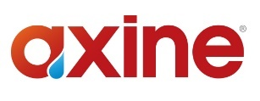
Axine vs. Other Solutions
 |  | Trucking & Incineration | Chemical AOP
Low capex
Low opex
API PNEC performance
Performance guarantee
Automated & digital
No hazardous chemicals
Water reuse
ESG Alignment
Confidential and Proprietary Information

Slide 52
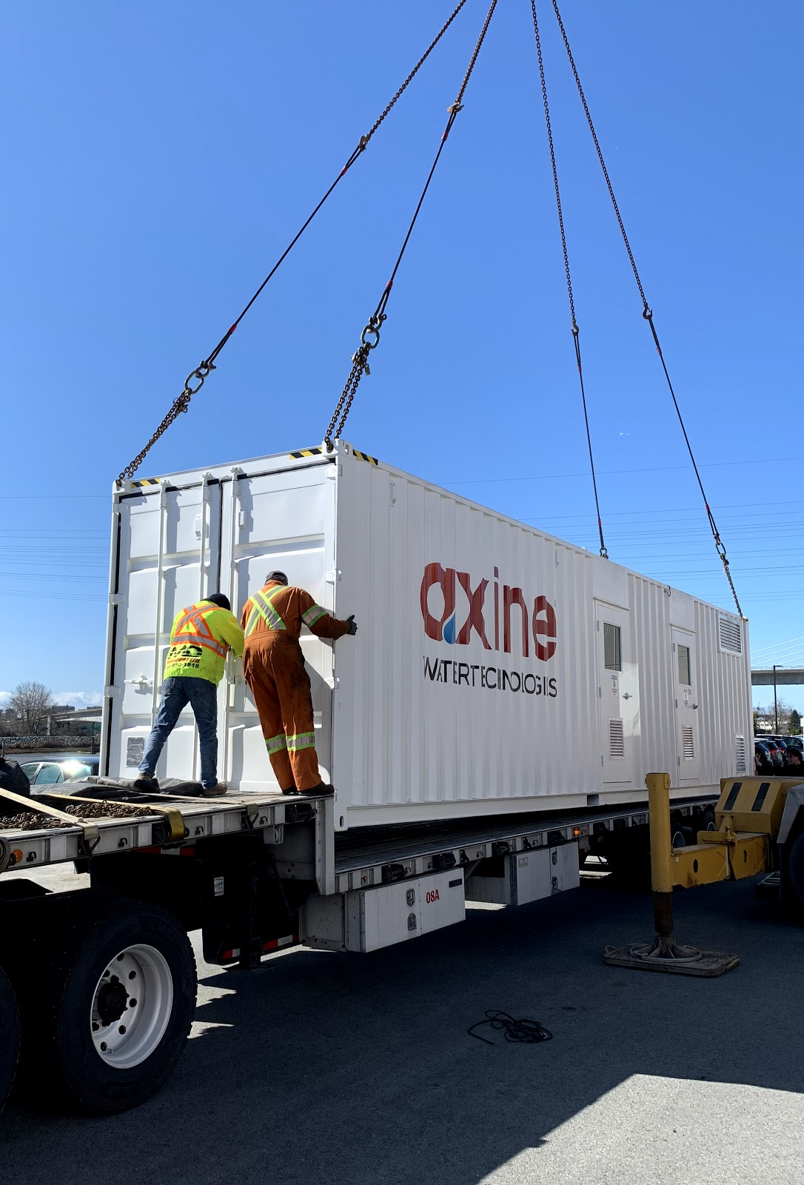
Axine Services & Capabilities
Project development services
  Wastewater analysis & testing
  Treatability & pilot studies
  API analytical testing & support
  Regulatory & permit support
Wastewater treatment services
  System design, build & installation
  Hazop review support
  Operation, service & maintenance
  24/7 remote monitoring & reporting
Confidential and Proprietary Information

Slide 53
Agenda
Introduction
Vacuum evaporation
Ozone as pretreatment
Electrochemical oxidation
Q&A

