Slide 1
PSCI Updated Audit Guidance
PSCI Audit Subteam “SAQ & Audit Guidance”
Gavin Loveday (Astra Zeneca), Gina Scott (Roche), Pekka Tallqvist (Orion), Edgar Flores Ruvalcaba (Novartis), Birgit Skuballa (Bayer)
Lydia Elliot (Carnstone), Maggie Zhang (Carnstone)
27 May 2020

Slide 2

Speaker
PSCI Audit Committee Co-chair
Birgit Skuballa
Bayer

Slide 3

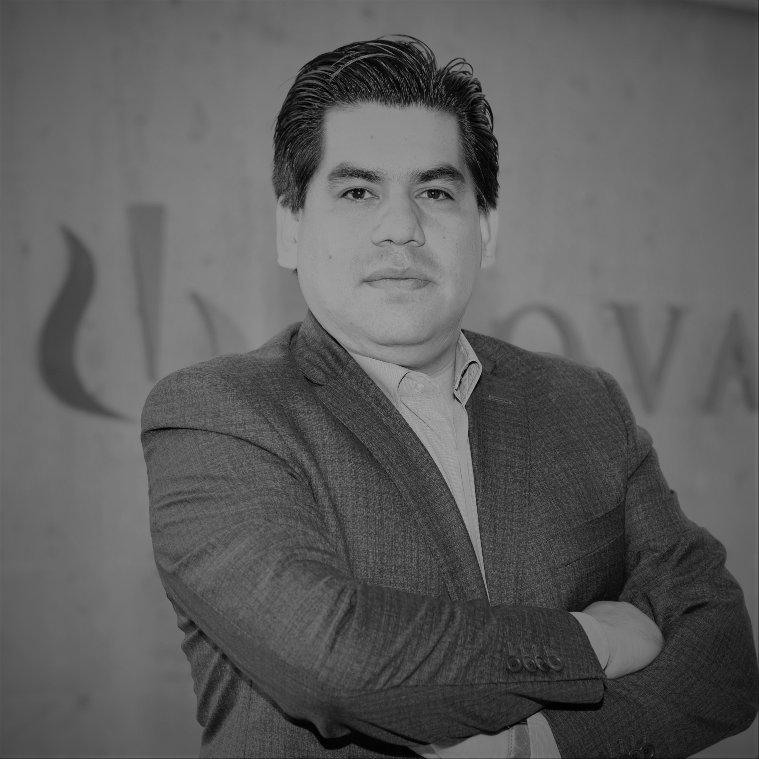


The Team
Gavin Loveday
Astra Zeneca
Edgar Flores Ruvalcaba
Novartis
Pekka Tallqvist
Orion
Gina Scott
Roche

Slide 4
Agenda
Introduction to Audit Guidance document and its history
Updates in version 5, April 2020
How members/auditors/suppliers can make use of the Audit Guidance document
Other useful resources
Q&A
4

Slide 5
Agenda
Introduction to Audit Guidance document and its history
Updates in version 5, April 2020
How members/auditors/suppliers can make use of the Audit Guidance document
Other useful resources
Q&A
5

Slide 6
About the PSCI Audit Program Guidance
Developed by the PSCI Audit Committee as an information source for PSCI members ,3rd Party Audit Firms, suppliers, and other interested stakeholders
The Audit Program Guidance explains and specifies the requirements and procedures for a credible, transparent, and consistent audit approach, together with three other documents:
  PSCI Principles
  PSCI Implementation Guidance
  PSCI SAQ /Audit Report templates (Full: Word & Excel; Abbreviated: Word & Excel)
Provides foundation for the PSCI audit program:
  Defined PSCI audit objectives and scope
  A defined methodology for the audit process from initiation, through execution to reporting
  A defined methodology for responding to audit findings/observations and corrective action tracking
  A defined mechanism for sharing of audit reports
  Clear requirements and defined minimum qualifications and experience for auditors conducting PSCI audits.

Slide 7
Update History
Version | Date | Status/Changes
1 | 2012 | First version.
2 | April 2013 | Light refresh.
3 | September 2015 | Re-arrangement of content to better reflect the audit process. Change of focus from joint audit to shared audits, also considering the different type of PSCI Audits (e.g. full Audit, PSCI HSE Audit, PSCI Social/Ethical Audit, PSCI audit conducted by 3rd parties and PSCI audits conducted by members). PSCI Pre-Audit Document checklist as Annex 1.
4 | June 2017 | Included supplier self-audit model.
5 | April 2020 | Included revised SAQ/Audit Protocols, replaced the term “PSCI Shared Audit Program” against “PSCI Audit Program”, updated understanding of PSCI Audit Scheme (chapter 3, removal of “no certification scheme”), provided more guidance and details on audit duration and audit process activities, added new external reference (AMR Alliance), added reference to pre-audit information resources (OSHA and IPE), updated qualification for social auditors; added language on option of suppliers to share PSCI SAQs/Audit Reports digitally and it being the preferred sharing method, revised audit findings classification (addition of “others/major”, “others/minor”), addition/update of links.

Slide 8
Agenda
Introduction to Audit Guidance document and its history
Updates in version 5, April 2020
How members/auditors/suppliers can make use of the Audit Guidance document
Other useful resources
Q&A
8

Slide 9
Key Changes (I)
Replacement of the term “PSCI Shared Audit Program” against “PSCI Audit Program”
Updated understanding of PSCI Audit Scheme
  Chapter 3, removal of “no certification scheme”
Included revised SAQ/Audit Protocols
  Auditor guidance embedded in the SAQ/Audit templates
Revised audit findings classification
  Addition of “others/major”, “others/minor”
Added new external reference (AMR Alliance) & reference to pre-audit information resources:
  OSHA
  IPE

Slide 10
Key Changes (II)
Updated qualification of social auditors
  Equivalent training to SA8000 Training, including an example of BSCI training
Provided more guidance and details on audit duration and audit process activities
  Risk-based audit approach in case of time-constraints i.e. cover questions where there are additional auditor guidance notes in SAQ/ Audit templates
  Audit duration for medium office: 1-2 days, same as large office
Added language on option of suppliers to share PSCI SAQs/Audit Reports digitally and it being the preferred sharing method
Addition/update of links to web pages & resources
Improve language in whole document

Slide 11
Agenda
Introduction to Audit Guidance document and its history
Updates in version 5, April 2020
How members/auditors/suppliers can make use of the Audit Guidance document
Other useful resources
Q&A
11

Slide 12
For Members
Understand audit scope and decide audit types for different types of suppliers (“A”, “B” and “C” )
Verification of qualifications of auditors and identify trainings for their own internal auditors and the 3rd-party audit partners
Understand audit process and where member companies’ actions are required in different steps e.g. initiate contact & communication
Reference to suggested length of audit for different types of supplier sites
Understand requirements and guidance on audit execution process
Understand requirements of audit reports and outputs
Reference to useful resources related to PSCI audit program e.g. slide deck for opening meeting

Slide 13
For Auditors
Understand PSCI audit objectives & audit scope for different types of suppliers
Understand the qualifications and minimum experience requirements for different types of auditors that conduct PSCI audits
Get familiar with audit process – audit preparation, audit duration for different types of audit sites, set up audit agenda
Fully understand requirements of audit execution steps and their requirements – opening meeting, site tour, management and worker interviews, document review, pre-closing meeting, closing meeting and summary of audit
Fully understand requirements of audit reports and output – audit report, classifications of audit findings, Corrective Action Plan
Reference to useful resources related to PSCI audit program e.g. latest SAQ/Audit templates

Slide 14
For Suppliers
Understand PSCI audit objectives
Reference to PSCI approved audit firms and auditor qualifications to carry out a self-paid audit with appropriately qualified auditors from these 3rd-party audit firms
Understand the PSCI audit process and how to prepare for a PSCI audit
Understand what to expect during the audit execution process and how to cooperate
Reference to useful resources e.g. PSCI Pre-Audit Document Checklist
Understand the requirements of Corrective Action Plan and regular status report until all audit findings are closed
Understand audit sharing process and how to manage sharing preferences digitally on the platform or by using the PSCI Data Sharing Agreement (DSA) form

Slide 15
Agenda
Introduction to Audit Guidance document and its history
Updates in version 5, April 2020
How members/auditors/suppliers can make use of the Audit Guidance document
Other useful resources
Q&A
15

Slide 16
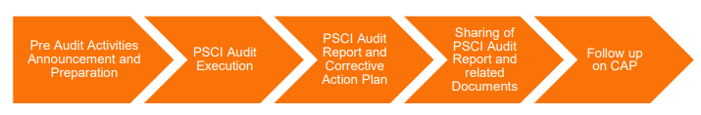
Lots of other PSCI audit tool resources
One pager - PSCI Member Audit Sharing Target
Pre-Audit Document Request List
PSCI Auditor Evaluation Tool
PSCI Shared Audit Program Brochure
Webinar giving background on the updates to the SAQ/Audit Report Templates - PSCI SAQ & Audit Report Template Update - 20th February 2019
Webinar on various audits tools and how to use them - PSCI audit tools – a refresh and how to use them (members only)
PSCI Introductory Training Webinar for Auditors and Slides
Previous auditor training packs are all available, here are links to the two most recent ones:
  PSCI Auditor Training 2019 China
  PSCI Auditor Training 2018 Vienna

Slide 17
Agenda
Introduction to Audit Guidance document and its history
Updates in version 5, April 2020
How members/auditors/suppliers can make use of the Audit Guidance document
Other useful resources
Q&A
17

Slide 18




PSCI audit committee key contacts
Audit Committee Co-chair
Birgit Skuballa
Bayer
Audit Committee Co-chair
Roy Agostini
Mallinckrodt
Audit Committee Board Liaison
Kelly Kappler
Johnson & Johnson
Audit Committee Secretariat Lead
Maggie Zhang
Carnstone
Audit Committee Secretariat
Quqing Huang
Carnstone

Slide 19
Audit Tools

