Slide 1
The Pharmaceutical
Supply Chain Initiative (PSCI)
PSCI Introductory Training for Auditors
PSCI Audit Committee
PSCI Webinar | 2018

Slide 2
ANTI TRUST STATEMENT
While some activities among competitors are both legal and beneficial to the industry, group activities of competitors are inherently suspect under the antitrust/anti-competition laws of the US, UK and other countries in which our companies do business. Agreements between or among competitors need not be formal to raise questions under antitrust laws, but may include any kind of understanding, formal or informal, secretive or public, under which each of the participants can reasonably expect that another will follow a particular course of action or conduct. Each of the participants in this meeting is responsible for seeing that topics which may give an appearance of an agreement that would violate the antitrust laws are not discussed. It is the responsibility of each participant in the first instance to avoid raising improper subjects for discussion, such as those identified below.
It is the sole purpose of this meeting to provide a forum for expression of various points of view on topics described in the agenda and participants should adhere to that agenda. Under no circumstances shall this meeting be used as a means for competing companies to reach any understanding, expressed or implied, which tends to restrict competition, or in any way to impair the ability of members to exercise independent business judgment regarding matters affecting competition.
Topics of discussion that should be specifically avoided are:
Price fixing
Product discounts, rebates, pricing policies, levels of production or sales and marketing terms customer and territorial allocation
Standards setting (when its purpose is to limit the availability and selection of products, limit competition, restrict entry into an industry, inhibit innovation or inhibit the ability of competitors to compete)
Codes of ethics administered in a way that could inhibit or restrict competition
Group boycotts
Validity of patents
On-going litigation
Specific R&D, sales or marketing activities or plans, or confidential product, product development, production or testing strategies or other proprietary knowledge or information

Slide 3
AGENDA
INTRODUCTION TO PSCI
GENERAL OVERVIEW ON PSCI AUDIT INFORMATION
PSCI SELF ASSESSMENT QUESTIONNAIRES AND AUDIT REPORT TEMPLATES
PSCI AUDIT PROCESS
  PRE AUDIT
  ON SITE AUDIT
  POST AUDIT
AUDIT SHARING

Slide 4

INTRODUCTION TO PSCI

Slide 5

PSCI: THE PURPOSE
Our PURPOSE is to bring together the pharmaceutical industry to formalize, implement, and champion responsible supply chain practices.

Slide 6

PSCI: THE VISION
Our VISION is to establish and promote responsible practices that will continuously improve ethics, labor, health, safety and environmentally sustainable outcomes for our supply chains.
Notes:
As per slide
The PSCI is a community committed to promoting responsible supply chains and better business conditions

Slide 7































THE MEMBERSHIP
30 member* companies already share the PSCI VISION and are committed to continuous improvement in the supply chain
*Full members have the following symbol: The rest are associate members.
Notes:
We have 30 member companies and are governed by an elected Board of Directors which is our primary decision making body.
The basic principle is inclusivity. PSCI welcomes all companies that are serious about embracing our vision in the pharma and healthcare supply chain.
Comment 2 level of Membership (Full and associate) :more details after in slide 16.

Slide 8

ADDRESSING THE ISSUES
GLOBAL
ISSUES
HEALTH & SAFETY
ENVIRONMENT
LABOR
ETHICS
BE TRUSTED BY OUR PATIENTS AND STAKEHOLDERS
ROLE OF
BUSINESS
DELIVER RELIABILITY ACROSS OUR SUPPLY CHAIN
SOURCE FROM COMPANIES WHO ARE RESPONSIBLE
BRING THE PSCI PRINCIPLES TO
LIFE THROUGH STANDARDISED PROCESSES
LEVERAGE COLLECTIVE VOICE
BUILD CAPABILITIES & DRIVE CONTINUOUS IMPROVEMENT
ROLE
OF PSCI
Notes:
PSCI believes that in order to responsibly address global issues such as heath & safety, environment, labor and ethics that business has a special role to play because want to remain trusted by our patients & stakeholders, to continue to deliver reliability across our supply chain and look to source from companies who are responsible. We see the role of PSCI is to bring the principles to life through standardized process, leverage our collective voice to make a bigger impact than our individual member companies would alone and continue to build capability and drive improvements in our collective supply chains.

Slide 9





THE PSCI PRINCIPLES AND THE IMPLEMTATION
GUIDANCE
The PSCI created Industry Principles for Responsible Supply Chain Management.
These five Principles outline our expectations for sustainable supply chains in our industry and provide descriptions of our expectations for pharmaceutical supply chain partners:
ETHICS
LABOR
HEALTH & SAFETY
ENVIRONMENT
MANAGEMENT SYSTEMS
To put these into practice simply, our comprehensive Implementation Guidance provides:
  Clarity about the Principles in each of the five areas
  A framework for improvement
  Examples of how to meet the PSCI expectations
www.pscinitative.org

Slide 10

GENERAL OVERVIEW
ON PSCI AUDITS

Slide 11
WHY DO WE AUDIT?
PSCI Audits are designed to assess a supplier's performance against the PSCI Principles as well as against international standards and agreements, and local regulatory requirements in the areas of: Ethics, Labor, Health & Safety, Environmental Protection and Management Systems.
The PSCI Shared Audit Program provides a framework and methodology to ensure PSCI Audits are carried out in accordance with PSCI Standards, thereby delivering a credible, transparent and consistent audit approach.
Our goal is to ensure that the PSCI auditing model and tools become the norm for our industry.
We encourage members to use the PSCI tools and their suppliers to share the results.

Slide 12
OVERVIEW ON PSCI GUIDANCE TOOLS
Collaborative auditing embeds the PSCI Principles in our supply chain. The PSCI has developed guidance tools tailored for our industry for assessing performance and risk. These include:
PSCI Principles
PSCI Implementation Guidance
PSCI Audit Guidance
Full PSCI SAQ & Audit Report Template for Core Suppliers, External Manufacturers, Component and Material Suppliers (word and excel)
Abbreviated PSCI SAQ & Audit Report Template for Service Providers & General Manufacturers (word and excel)
Pre-Audit Document Request List
Corrective Action Plan
Data Sharing Agreement
PSCI Audit Sharing Platform Supplier User Guide
PSCI Auditor Evaluation Tool

Slide 13

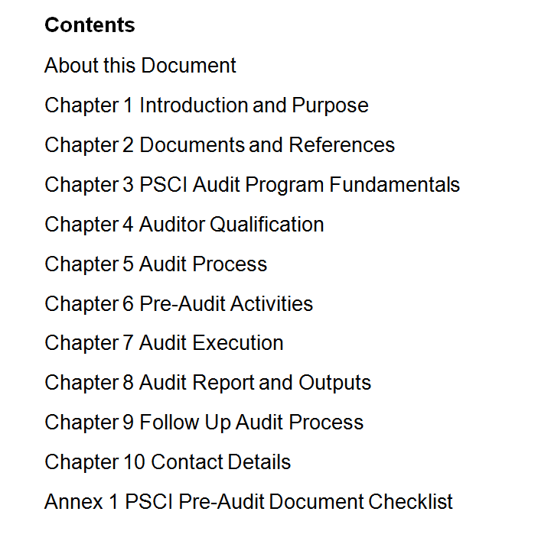
PSCI AUDIT PROGRAM GUIDANCE
Provides the methodology on how PSCI Audits are conducted and managed
Gives a detailed overview of the audit process
Clarifies auditor qualifications and roles/responsibilities

Slide 14

PSCI SELF ASSESSMENT QUESTIONNAIRES
AND AUDIT REPORT TEMPLATES

Slide 15
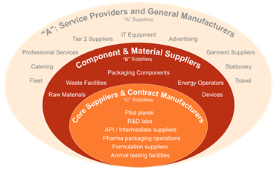
PSCI PROTOCOLS - BASED ON SUPPLIER
CATEGORIES
For auditing purposes, suppliers are categorized according to their activities:
  "A" - service providers
  "B" - component & material suppliers
  "C" - core suppliers & contract manufacturers

Slide 16
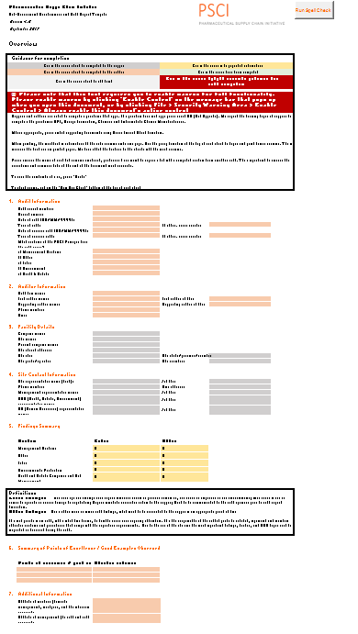
PSCI SAQS & AUDIT REPORT PROTOCOLS
USE FOR “A” SUPPLIERS!!
USE FOR “B” and “C” SUPPLIERS!!
Abbreviated PSCI Self Assessment Questionnaire (SAQ) & Audit Report Template for Service Providers & General Manufacturers
Full PSCI Self Assessment Questionnaire (SAQ) & Audit Report Template for Core Suppliers, External Manufacturers, Component and Material Suppliers
https://pscinitiative.org/resource?resource=31
https://pscinitiative.org/resource?resource=32

Slide 17
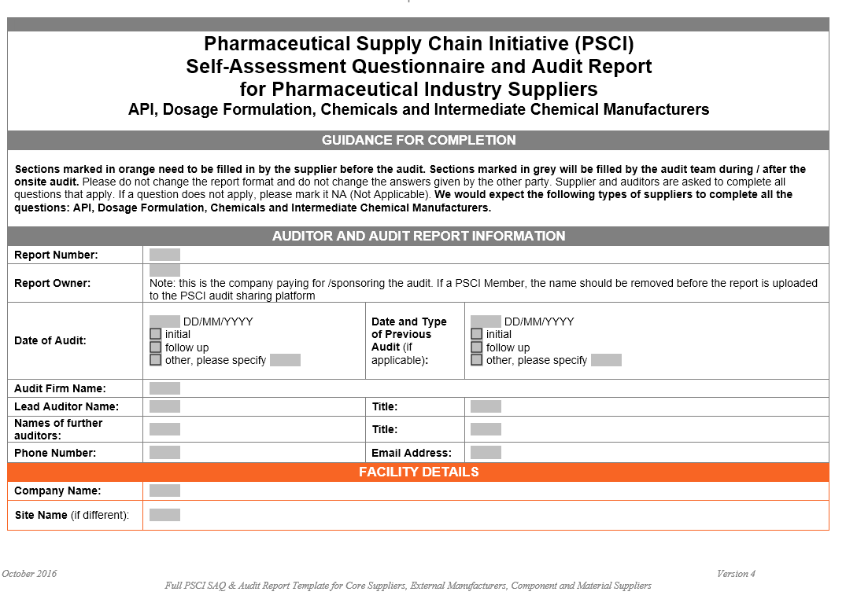
PSCI SAQ/AUDIT TEMPLATES (WORD AND EXCEL)
Notes:
We have two types of audit questionnaires
The full version for core manufacturers
The abbreviated version for service providers
The abbreviated template is based on the full version, but it’s a shorter – it has fewer question in environment and H&S sections
Both audits are now available in Word and Excel formats

Slide 18
COMPLETING THE PSCI PROTOCOLS IN WORD
Sections marked in orange need to be filled in by the supplier before the audit
Sections marked in grey will be filled by the audit team during / after the onsite audit
Please do not change the report format and do not change the answers given by the supplier in the SAQ section
Auditors are asked to complete all questions that apply. If a question does not apply, please mark it NA (Not Applicable)
Comments of the auditors should not be a simple copy and paste of the SAQ answer provided by the supplier or should not be a turn around of the audit question to an answer Comments should reflect auditors actual observations during onsite audit
Please insert photographs when applicable and feasible, following the instructions as mentioned in the audit protocol

Slide 19
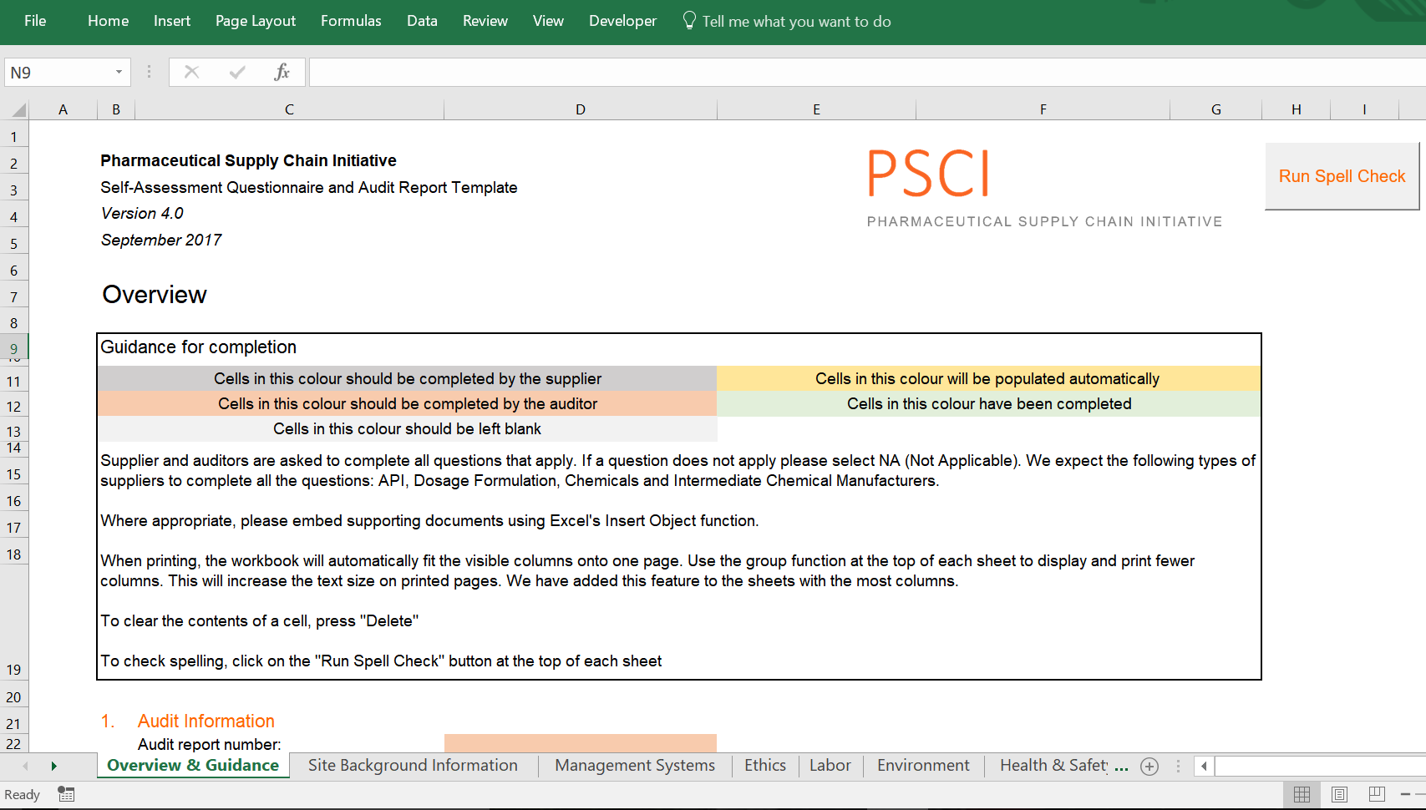
EXCEL TEMPLATE: KEY FEATURES
Separate tabs for the separate sections of PSCI Principles
Extra tab for company specific questions (which can be removed before sharing)
Colour coding to make obvious who should complete each section
Integrated spell check function
Green highlighting to track completed cells
Notes:
The template is split into 10 separate tabs
The first is an overview and guidance tab which contains instructions on how to complete the template, audit and auditor information, facility details, contact information, an automatically populated findings summary, and summary table for points of excellence
The second tab covers site background information including worker demographics (number of full time employees, part time workers etc)
The next 5 tabs are for the 5 areas of the PSCI Principles (management systems, ethics, labor, environment, and health & safety)
Then there is a tab for company specific questions – this is where member companies can add their own specific questions which aren’t already covered by the PSCI audit and it can be removed before sharing the audit report with PSCI
A tab for the photo report
And finally, the CAP report
Throughout the template the cells are colour coded to show who should complete each cell – cells in grey are the self-assessment answers for the supplier to complete, orange are for the auditor to complete, yellow are populated automatically, light grey should be left blank.
There is a spell check function
When cells have been completed the cell colour turns green, so, at a glance you can check which parts still need to be done

Slide 20
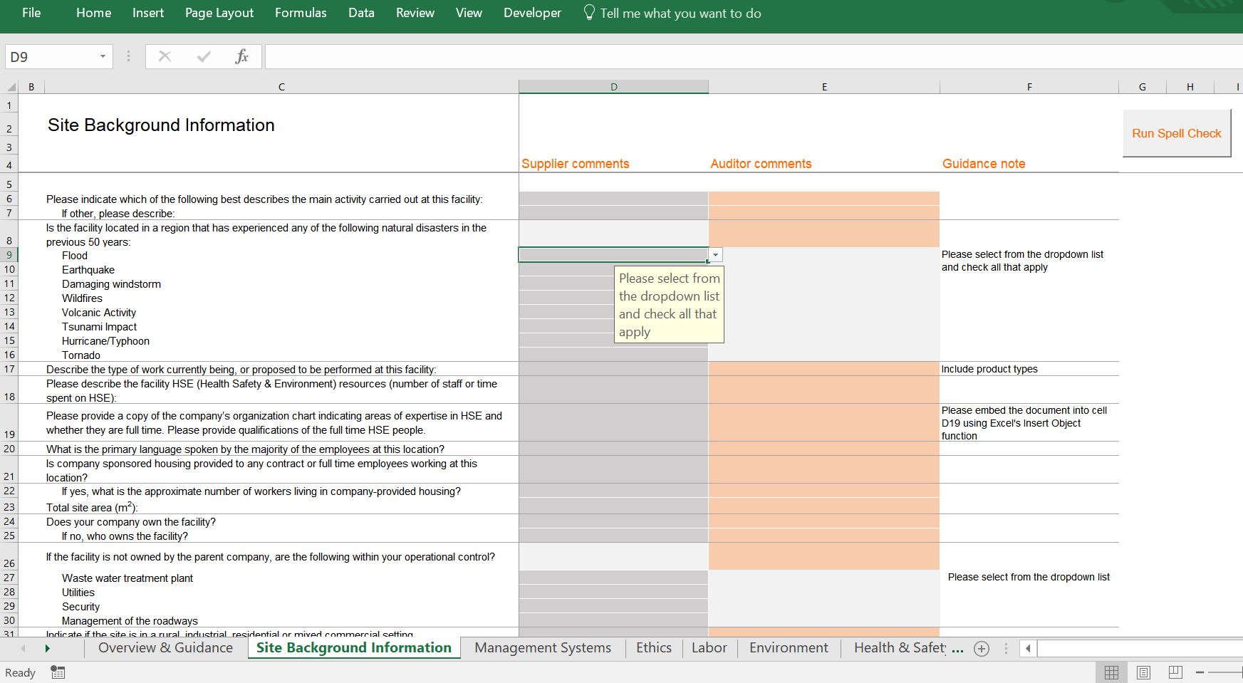
EXCEL TEMPLATE: KEY FEATURES
Guidance notes
Drop downs to standardise responses where appropriate
Notes:
There are guidance notes next to the questions to clarify how to answer the question
Many of the answers are drop downs – you select your answer from a pre set list which is quick and easy

Slide 21

PSCI AUDIT PROCESS
Step 1
Step 2
Step 3

Slide 22
GENERAL PSCI AUDIT PROCESS
AUDIT APPROACH
Three
Phases
Pre-Audit Activities
On-Site Activities
Post-Audit Activities

Slide 23
PSCI AUDIT PROCESS
AUDIT APPROACH
1st Phase
Pre-Audit Activities
On-Site Activities
Post-Audit Activities

Slide 24
PRE AUDIT ACTIVITIES OVERVIEW
Administrative
Schedule audit
Contact & coordinate with the facility
Distribute audit materials (SAQ, list of docs, audit plan)
Arrange for travel
Planning
Assemble & review background info & applicable regulations
Develop audit assignments & areas of focus
Review & discuss audit team responsibilities
Goal: efficient and effective use of time onsite
Notes:
Ensuring auditors are appropriately prepared allows them to use the time onsite during the audit efficiently and effectively

Slide 25
AUDIT PREPARATION: TIPS/HINTS
FOR AUDITORS
  Study the SAQ (and the provided documents)
  Ask for any additional information if needed from the supplier
  Check with the client if there are any special topics that need to be considered
  Provide the supplier with an agenda and a tailored PSCI Pre-Audit Document checklist
  Check the website of the auditee
  Carry out background research about the auditee,
  e.g. media reports about environmental issues, relevant databases or reports about fatalities, accidents, incidents, loss of primary containments, news about legal issues etc.
  Check if any special instructions upon arrival
  (be prepared to show identification if required, ask where to sign in, who to ask for upon arrival…)
  Check if any special personal protective equipment is required
Notes:
Study the SAQ (and the provided documents) carefully and prepare a plan on the topics that need more attention. This will enable the auditor to PRIORITIZE operations presenting a greater risk.
Provide the supplier with an agenda and a tailored PSCI Pre-Audit Document checklist which comprises documents/information which should be readily available during the audit.

Slide 26
EXAMPLE PRE AUDIT ACTIVITIES
Sends supplier nominations
for audits
Confirm the audit man-days and the number of auditors
PSCI member
Receives supplier nominations
Sends the SAQ*, DSA** and document list to the supplier
Reviews the SAQ and calculates the audit man-days and the number of auditors. Aligns with the PSCI client
Finalizes the audit dates with the supplier
Sends audit agenda to the supplier
Audit company
Completes the SAQ
Sends the completed SAQ along with supporting documents back to the audit company
Supplier
*SAQ – Self assessment questionnaire **DSA – Data sharing agreement
Notes:
Here you can find an example of pre audit activities of a PSCI member who uses 3rd party auditors for carrying out PSCI Audits on their behalf.
Member Companies may also choose to use their own auditors for PSCI Audits.
In this case the task of the audit company are carried out by the PSCI Member.

Slide 27
PSCI AUDIT PROCESS
AUDIT APPROACH
2nd Phase
Pre-Audit Activities
On-Site Activities
Post-Audit Activities

Slide 28
PSCI ON SITE AUDIT PROCESS (HSE PART)
Opening meeting by the auditor which would include the introduction of the auditor and the scope of the audit.
Involved parties: site/plant management, HSE(Q), engineering, production and others (as required)
Internal discussion among the auditors and preparation of the CAP (Corrective Action Plan)
Document check and discussion
Pre-closing meeting
Opening meeting
Site tour
Document check
Closing meeting
Covers production and other relevant infrastructure areas e.g. waste, waste water, technical areas, utilities. Exchange/discussions with employees and management
Document review e.g. as listed in the in the PSCI document list and discussions with technical experts and management (e.g. HSE(Q), engineering, production)
Presentation of best practices and points for improvement
Summary of the CAP and as a sign of agreement signing by both parties

Slide 29
AUDIT PREPARATION: TIPS/HINTS
FOR AUDITORS
  Dress appropriately for the audit
  (e.g. business/casual attire, no high heels or open toe shoes)
  Bring your own safety shoes (and other PPE if relevant)
  Respect company‘s opening and closing time/shift timings
  Most important: arrive on time!

Slide 30
OPENING MEETING: TIPS/HINTS
FOR AUDITORS
Be on time!
Thank the management for hosting the audit
Introduce yourself and audit team and ask the others participants to introduce themselves
(facilitated by business cards & list of attendees)
Provide a brief background about PSCI in case the company is unaware
Explain the purpose and the benefits of the PSCI Audit
Explain the audit plan (including areas to be inspected); be flexible if needed
Ask the auditee to provide an overview of their facility and processes
Ask if you may take photographs of selected areas (do not insist taking photographs if the auditee denies it)
Ask for safety instructions and evacuation plan if not provided by the company.

Slide 31
PHYSICAL INSPECTION OF THE FACILITY
POINTS TO CONSIDER (1)
Good time management is key, especially during site tours
Allow for sufficient time for the site tour, do not spend the majority of time with document review in the office
Ask for a site map for the tour to help you with the site orientation
Keep in mind that gowning procedures in pharmaceutical finishing plant may require a significant amount of time
Inspect main production areas, but be careful to reserve time for other areas
(e.g. warehouses, waste storage/treatment, waste water treatment units and other utilities are also important to visit)

Slide 32

PHYSICAL INSPECTION OF THE FACILITY
POINTS TO CONSIDER (2)
Try to inspect critical activities especially those with high risk potential e.g.
  Construction activities
  Inspection & sampling,
  Loading/unloading
  Material handling and transfer
  Waste packing and pick-up
  Confined space entry
Also try to inspect samples of remote areas, trailers, buildings etc.
  Are they truly free from hazardous materials?
  Do employees work in this building?
  Is there a ventilation system?
  Are there items like fire extinguishers, emergency showers etc. which need to be inspected?
  What about asbestos?
Observe the facility also from the outside

Slide 33
BEHAVIOR DURING AN AUDIT
What an auditor should do:
Look
Listen
Read
Write down
Ask questions
Recommend
Be friendly
Be vigilant
Don‘t criticize
Reach
agreements
Constructive
Objective
How an auditor should behave:
Positive
Helpful
Accessible
Patient
Notes:
PSCI member companies have a special partnership with their pharmaceutical suppliers and PSCI auditors should respect these parties as partners. We need these suppliers to deliver medicines to our patients!
Auditors from member companies and approved audit firms are a reflection of PSCI, as such your conduct should appropriately reflect this.

Slide 34
CLOSING MEETING (1)
Thank the management for their time, patience and openness and indicate how this contributes to fostering the mutual relationship and building trust;
Re-confirm the purpose of the audit;
Mention good working practices that have been observed during the audit;
Explain that the audit was based on a sample examination of their site and that it is the site’s responsibility to conduct a deeper investigation into their programs;
Explain which findings and improvement potentials have been observed during the audit, and discuss possible corrective actions;
Remind the supplier that they may challenge/discuss findings (or provide factual evidence that a finding was incorrect) in this meeting, but any issues they have agreed to will not be changed later;
Besides listing the findings, ensure that any agreements or disagreements are clearly recorded on the Preliminary Corrective Action Plan;

Slide 35

CLOSING MEETING (2)
If possible: Obtain the signature of the site management on this Preliminary Corrective Action Plan Report;
Explain the next steps; Drafting of PSCI Audit Report and PSCI Corrective Action Plan, Quality control of the audit report, finalization of the PSCI Audit Report and Corrective Action Plan Report and distribution to supplier and to the respective PSCI member;
Encourage the management of the site to allow for sharing of the PSCI Audit Report and Corrective Action Plan Report with other PSCI member companies
(either by signing the PSCI Data Sharing Agreement or by sharing online via the PSCI audit sharing platform)

Slide 36
PSCI AUDIT PROCESS
AUDIT APPROACH
3rd Phase
Pre-Audit Activities
On-Site Activities
Post-Audit Activities

Slide 37
EXAMPLE POST AUDIT ACTIVITIES
Reviews the draft audit report/CAPR
Sends feedback to the Audit company
Receives the final Audit Report /CAPR
PSCI member
Prepares the draft audit report
Internal quality check of audit report and CAP
Sends the draft audit report/CAPR to PSCI member for review
Makes necessary corrections if any
Sends the Final audit report/CAPR
Audit company
Supplier
Receives Audit Report and takes necessary action
Notes:
In general, the auditor should not send the draft audit report directly to the supplier without prior internal quality review (by the audit company) and approval by the client (the PSCI member).

Slide 38

AUDIT REPORT WRITING STARTS DURING
THE AUDIT….
Ensure that notes are accurate (all are potentially “discoverable”)
Document all evidence reviewed (even if it is not a finding)
Take photos of documents & situations, if allowed
Document where a photo was taken
Note title/job description/area of interviewees
(but never give names in the audit report)
Note specific ID # for the SOP, other documents, equipment etc.
Give # reviewed of total # available
Notes:
Following this methodology will lend better credibility to audit reports, which enables further sharing and uptake by other PSCI member companies. All documents shared on the PSCI platform must be of high quality to ensure value to our fellow PSCI members and be fair to suppliers that their operations were appropriately reviewed.

Slide 39

WRITING AUDIT FINDINGS
TIPS AND HINTS FOR AUDITORS
Keep sentences short, to the point
Report facts, not opinions
Define all acronyms when used the first time
Do not make legal conclusions (e.g., “not compliant…”)
Limit the use of adjectives (e.g. “always,” “every,” “any,” “none”)
Do not exaggerate or overstate
Use everyday language, avoid technical jargon
Consider language like “was not available,” “no evidence of,” versus “there was no…”
Use “active voice”
OK: wastewater operator performs weekly wastewater sampling at the outfall point for criteria A, B, & C. The results are shared monthly with the local authority as per permit.
Not OK: sampling was performed of the wastewater
Notes:
Be accurate. Do not overstate or understate.

Slide 40
AUDIT SHARING

Slide 41
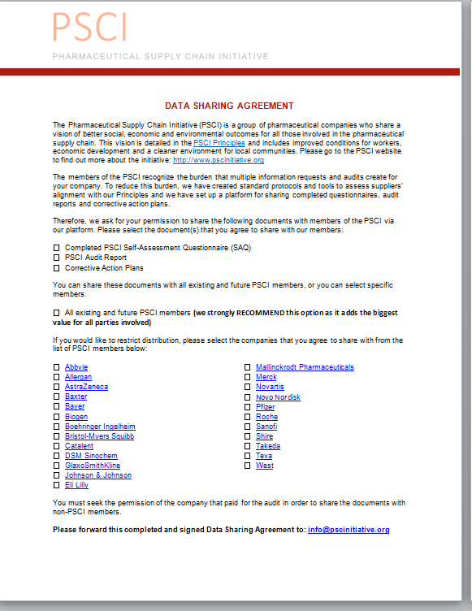
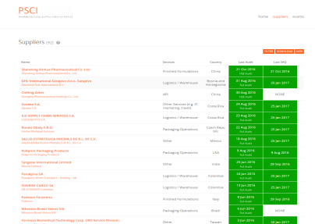

ENCOURAGING SUPPLIERS TO SHARE AUDITS
Two ways of sharing PSCI Audit Reports
PSCI Data Sharing Agreement
Available on the PSCI website
To be physically signed by the supplier at the end of the audit or at a later stage
A scanned copy to be provided to the PSCI Secretariat along with the audit documents
PSCI Audit Sharing Online Platform
Suppliers can directly share the audit documents/SAQ by registering and logging into the PSCI audit platform
A Supplier User Guide on how to share audit reports is available on the PSCI audit sharing platform

Slide 42

THANK YOU!
Notes:
Thank you for completing PSCI auditor introduction training and for your support to PSCI’s mission to improve our supply chain.

Slide 43

For more information about the PSCI please contact:
PSCI Secretariat
Carnstone Partners LLP
Durham House
Durham House Street
London
WC2N 6HG
info@pscinitiative.org
Annabel Buchan +55 (11) 94486 6315
© 2017 PSCI | Version 2.0 June 2017 | Deck design: nineteenseventyone.co.uk

