Slide 1
Antimicrobial Resistance

Slide 2


SPEAKERS
Dan Caldwell, Johnson & Johnson
Global Director, Environmental and Occupational Toxicology
Neil J. Parke, Lilly
Global Health Safety and Environmental Senior Consultant

Slide 3
AGENDEA
ANTIBIOTIC MANUFACTURERS’ COMMITMENTS
DAN CALDWELL
PSCI’S PEC:PNEC CALCULATOR TOOL
NEIL J. PARKE

Slide 4
Antibiotic Manufacturers’ Commitments:
Supporting measures to reduce concentrations of antibiotics in manufacturing waste discharges
Daniel J. Caldwell
EHS&S Johnson & Johnson
on behalf of the:
Industry AMR Alliance Manufacturing Group

Slide 5
AMR - Manufacturing Environmental Matters
Affordable, accessible, antibiotics are essential to public health, bring huge societal benefits
Industry supply chain for antibiotics is global with significant footprint in emerging markets including India and China.
Reports of environmental pollution from drug manufacturing plants notably in some emerging markets.
Key reports (e.g., O’Neill) assert linkage to AMR, state better control of manufacturing effluent needed
Academic, media, investor reports highlight high levels of antimicrobials in environmental samples, for example, in India
Recognized concern for many stakeholders, including industry and calls for governments to act
Several potential sources of antibiotics in the environment, manufacturing being one
The AMR Industry Alliance is the life sciences industry response to the call for action on AMR, including manufacturing matters
Notes:
Member of the Alliance Manufacturing group include:
Allergan
AstraZeneca
Centrient Pharmaceuticals
Cipla
GlaxoSmithKline
Johnson & Johnson
Merck & Co
Mylan
Pfizer
Roche
Sanofi
Shionogi
Teva
Novartis
Wockhardt

Slide 6
Role of AMR Industry Alliance
The AMR Industry Alliance is commited to addressing its part. In 2016, we agreed to the following commitments on manufacturing and the environment:
We support measures to reduce environmental impact from production of antibiotics, and will:
Review our own manufacturing and supply chains to assess good practice in controlling releases of antibiotics into the environment.
Establish a common framework for managing antibiotic discharge, building on existing work such as PSCI*, and start to apply it across our own manufacturing and supply chain by 2018.
Work with stakeholders to develop a practical mechanism to transparently demonstrate that our supply chains meet the standards in the framework.
Work with independent technical experts to establish science-driven, risk-based targets for discharge concentrations for antibiotics and good practice methods to reduce environmental impact of manufacturing discharges, by 2020.
*Pharmaceutical Supply Chain Initiative

Slide 7
AMR Industry Alliance: Common Antibiotic Manufacturing Framework
Companies in the biopharmaceutical industry, through the Alliance, have been actively implementing improvements within their manufacturing networks and based on experience gained:
Developed and published Common Antibiotic Manufacturing Framework in early 2018
  Provides methodology and requirements to conduct risk evaluation of controls in place at Member sites and their suppliers’ sites to effectively manage and minimise potential release of antibiotics from manufacturing processes into the environment
  Is designed to ensure that manufacturing sites (and especially third party supplier sites) are, and are seen to be, managing antibiotic production and associated waste streams responsibly
  Codifies what should be regarded as good practice
  Adherence to framework will drive selection and use of appropriate suppliers
Notes:
Framework Recognizes:
There are concerns about concentration of antibiotics in the environment in proximity to some manufacturing locations
Importance of effective control of manufacturing waste streams
Framework Provides:
Methodology and minimum requirements needed to conduct a site risk evaluation of controls in place to ensure effective management of antibiotics waste streams at manufacturing sites
Framework Minimum Expectations
Compliance with:
Local laws and regulations
Environmental permits
Company standards, Codes of conduct
Pharmaceutical Supply Chain Initiative’s (PSCI) Pharmaceutical Industry Principles
No untreated discharge of manufacturing waste containing antibiotic*
*with the potential to adversely affect human or environmental health
On site audits at least once every 5 years
against defined protocol (e.g. own, PSCI)
identification of any non-compliance/gaps
monitor suppliers progress vs action plans to close
determine on-going appropriateness of supplier efficacy
Appropriate training is completed in line with industry best practice
Exercise appropriate duty of care for all discharges and waste streams containing antibiotics
Allow / facilitate audits as requested, develop and execute plans to address audit findings
Follow-up conducted for assessments and audits conducted
Include (examples):
Regulatory compliance assessment
Operating permit compliance verification
Focus on environmental management
Facility tour – e.g. waste water treatment, waste storage, waste water collection, facility exterior
The Common Antibiotic Manufacturing Framework can be found: https://www.amrindustryalliance.org/wp-content/uploads/2018/02/AMR_Industry_Alliance_Manufacturing_Framework.pdf

Slide 8
Establish a common framework for managing antibiotic discharge, building on existing work such as PSCI
Framework developed and published in the AMR Industry Alliance report 2018 (www.amrindustryalliance.org)
  Align around expectations
  Set minimum expectations (compliance, PSCI Principles)
Some details
  No untreated discharge of manufacturing waste (i.e. wastewater&sludge) containing antibiotics
  Quantify antibiotic load in effluent
  Effective wastewater treatment
  Sludge/biosolids from fermentation processes management, including risk assessment in case of application to land
Detailed and regular Audits
Applicable to any wastewater or wastewater sludge from on-site wastewater treatment operations with the potential to adversely impact human health or environmental health is managed, controlled, and treated prior to release to the environment

Slide 9
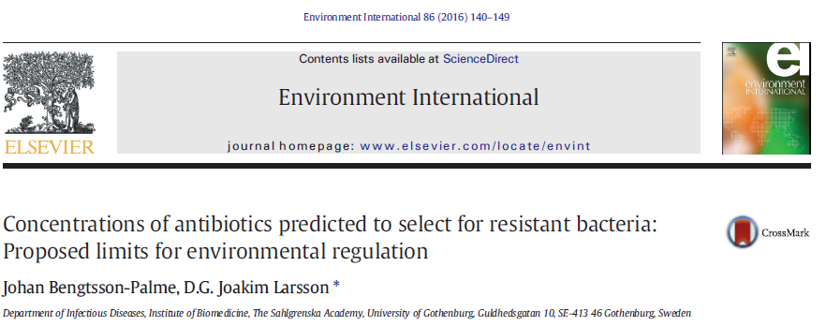
Source for PNEC-AMR
Science team of AMR Alliance Manufacturing Group
  Environmental risk assessors
Data sharing / leveraging additional information
  Focus initially on environmental toxicity
  Ensure at least cyanobacteria tested
  Literature and partnerships
    Bengtsson-Palme and Larsson, 2016 novel approach
Leverage microbiology within companies
  Ways to improve upon MIC/MSC data
Develop consistent terms of reference

Slide 10
Source for PNEC-Environmental

Slide 11
AMR Industry Alliance Antibiotic Discharge Targets
Recognizing, with a few specific exceptions, concentrations of active pharmaceutical ingredients (APIs), including antibiotics, in discharge from manufacturing sites or municipal wastewater treatment systems are generally not regulated (globally).
The Alliance published (2018) an approach to establishing targets for antibiotic manufacturing referred to as Predicted No-Effect Concentrations (PNECs) for use in environmental risk assessment of antibiotics,
  PNEC‐Environment (PNEC‐ENV) values are based on eco-toxicology data - intended to be protective of ecological species
  PNEC‐Minimum Inhibitory Concentration (PNEC‐MIC) values are based on clinical data - intended to be protective of resistance promotion
AMR Industry Alliance approach - target the lower of the two values (when available) for assessing manufacturing site discharges under a risk‐based framework.
Targets represent exceedingly low concentrations; meeting such targets may take time/add cost.
Notes:
PNEC‐Environment (PNEC‐ENV) values are based on eco-toxicology data generated by Alliance member companies. These values are intended to be protective of ecological species and incorporate assessment factors consistent with standard environmental risk methodologies (Brandt et al., 2015 ²; Le Page et al., 2017 ³).
The PNEC‐Minimum Inhibitory Concentration (PNEC‐MIC) values are based on the approach published in Bengtsson‐Palme and Larsson (2016)⁴ and are intended to be protective of resistance promotion.
The AMR Industry Alliance recommendation is that companies target the lower of these two values (when available) for assessing manufacturing site discharges under a risk‐based framework. This table will be updated periodically as new reliable and robust data become available.
The PNEC table can be found: https://www.amrindustryalliance.org/wp-content/uploads/2018/09/AMR_Industry_Alliance_List-of-Predicted-No-Effect-Concentrations-PNECs.pdf
² Brandt, et al., 2015. Ecotoxicological assessment of antibiotics: A call for improved consideration of microorganisms. Environment International, 85: 189‐205.
³ Le Page, et al., 2017. Integrating human and environmental health in antibiotic risk assessment: A critical analysis of protection goals, species sensitivity and antimicrobial resistance. Environment International, 109: 155‐169.
⁴ Bengtsson‐Palme & Larsson, 2016. Concentrations of antibiotics predicted to select for resistant bacteria: Proposed limits for environmental regulation, Environment International 86: 140–149.
Directive 2000/60/EC of the European Parliament and of the Council of 23 October 2000 , Establishing a framework for Community action in the field of water policy. https://eur‐lex.europa.eu/legal‐content/EN/TXT/?uri=CELEX:32000L0060

Slide 12
Comparison of PNEC-E to Bengtsson-Palme (2016) Proposed Values (PNEC-A)

Slide 13
Concluding Remarks
Industry is part of the solution.
The AMR Industry Alliance has developed a common manufacturing antibiotic manufacturing framework and published a list of antibiotic manufacturing discharge targets based on the best available science and 2 years ahead of our commitment to do so. Widespread adoption of the common antibiotic framework will be a substantial step forward in minimizing the presence of pharmaceuticals in the local environment in proximity to manufacturing sites and will minimize the risk of selective pressure on resistant organisms in the environment, thus reducing the risk of the spread of antimicrobial resistance.
Balancing access and increasing manufacturing expectations.
There is a paradox in the increasing downward pressure on antibiotic prices and increasing expectations regarding manufacturing practices. Tender mechanisms could help better support the security of supply by reflecting the cost of manufacturing using the techniques needed to reduce the risk of exacerbating anti-microbial resistance and therefore allowing for sustainably-made antibiotics
National Governments’ engagement.
An important challenge is that the countries in which environmental pollution is of most concern are countries which have a large and growing chemical/pharmaceutical industry and generally less well developed environmental protections.
Support from International Organizations.
We urge global agencies to continue to engage governments, and provide support when appropriate, to facilitate implementation of National Action Plans in particular in countries with a key role to manage the risk of environmental pollution. Part of the solution may lie in greater partnerships between global organizations and industry, collaborating on common global goals.

Slide 14
AGENDA
Where to get the PEC:PNEC Calculator Tool for use with All APIs provided in the PSCI Resources
How to use the PEC:PNEC Calculator Tool
Questions

Slide 15



How to obtain the PEC:PNEC Calculator Tool in the PSCI Resources Library
1. Use the following link to go to the PSCI Resources Library: https://pscinitiative.org/resources
2. Search for the PEC:PNEC Calculator Tool
3. Read More on the PEC:PNEC Calculator Tool and download it for use
Consolidated PEC:PNEC Calculator Tool for assessing API discharges
Document
Abstract: This Excel spreadsheet tool provides instructions and guidance on how to assist pharmaceutical manufacturers in calculating how to meet predicted no effect concentration values (PNECs) for active pharmaceutical ingredients (APIs) discharged in wastewater from manufacturing operations.

Slide 16
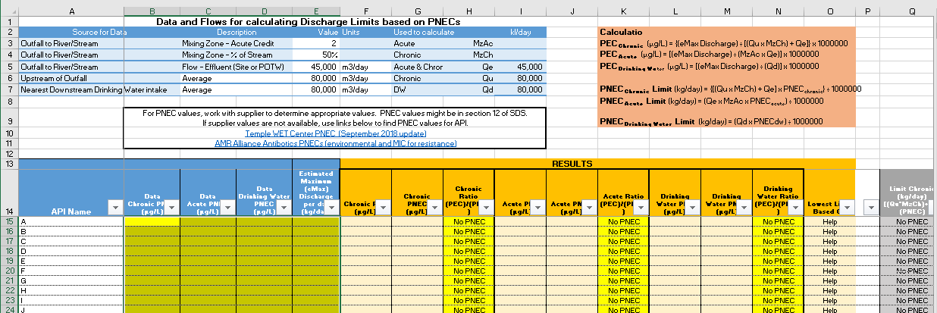
The PEC:PNEC Calculator Tool in the PSCI Resources Library

Slide 17
AGENDA
Where to get the PEC:PNEC Calculator Tool for use with All APIs provided in the PSCI Resources
How to use the PEC:PNEC Calculator Tool
Questions

Slide 18
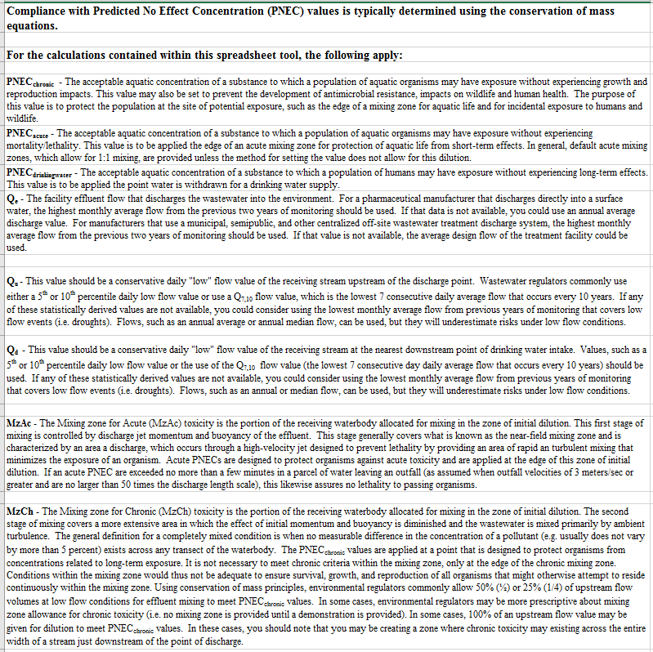
Step 1 – Read the “Terminology Used in this Tool” Worksheet
Familiarize yourself with the following terms before you use each “Tool”:
PNEC_{chronic}
PNEC_{acute}
PNEC_{drinkingwater}
Q_{e}
Q_{u}
Q_{d}
MzAc
MzCh

Slide 19
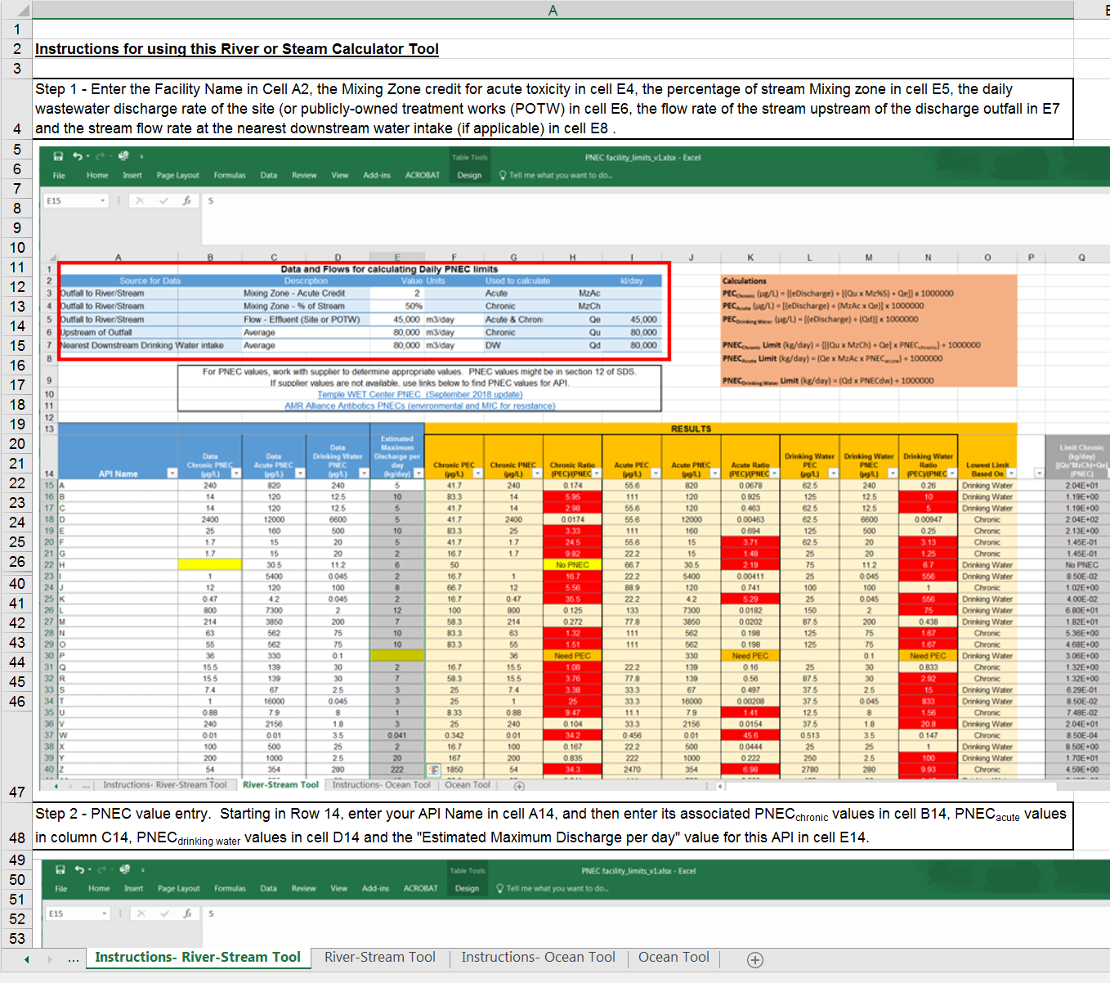
“Step-by-Step” instructions are provided for both the River-Stream and Ocean Tools

Slide 20
Step 1- Populating River/Steam and Effluent Discharge Information into the PEC:PNEC Calculator Tool
Hydraulics Data Entry Section – Rivers and Streams

Slide 21
Step 2 - Populating PNEC values in the PEC:PNEC Calculator Tool for your site APIs
PNEC Value Entry

Slide 22
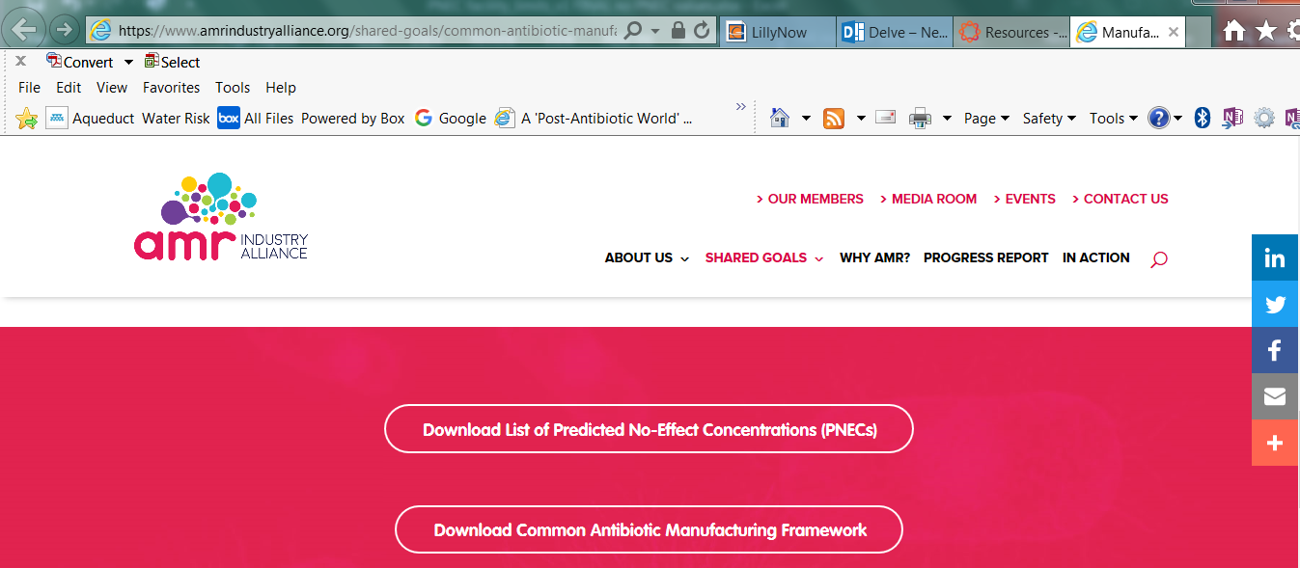
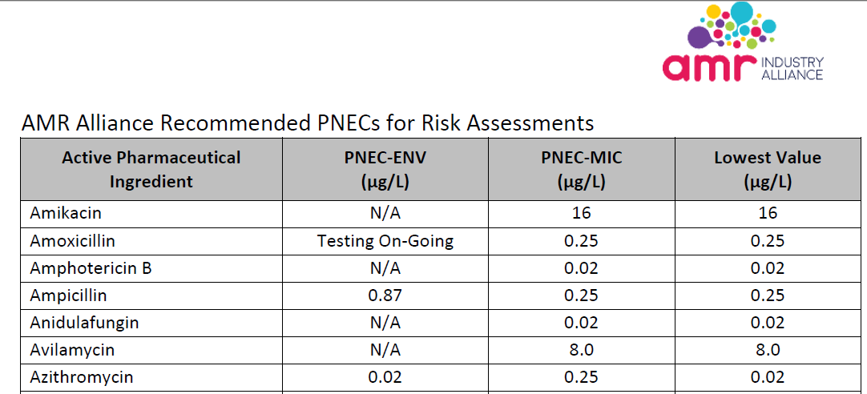
Example Use of a Selecting a PNEC Value for an Antibiotic

Slide 23
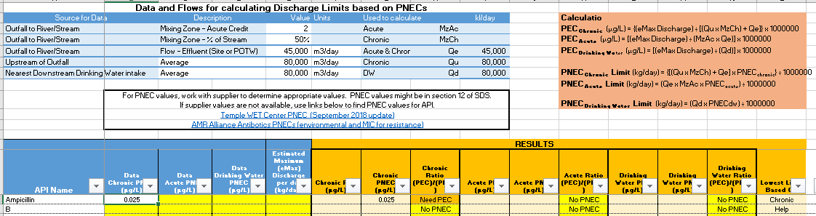
Example - Entering an AMR Industry Alliance Recommended PNEC Value into the Tool
AMR PNEC Value for Ampicillin is a Chronic type of value

Slide 24
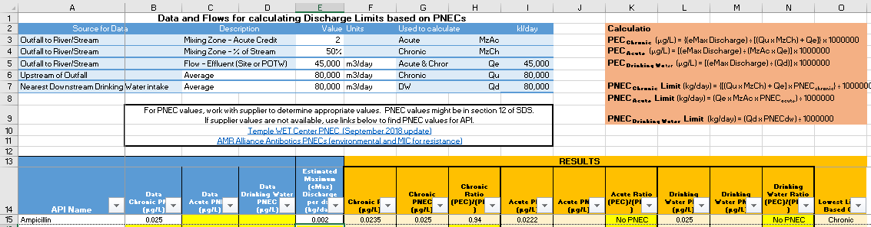
Step 3 – Entering an Estimated Maximum Daily Loss of API discharged in wastewater
Maximum Daily Mass of
API Discharged in Kg/ day

Slide 25
Step 4 – Evaluating PEC and PEC:PNEC Results from Maximum Daily Loss of API discharged in wastewater
Estimated Concentration
At the edge of the
Chronic Mixing Zone (ug/L)
PEC:PNEC ratio
Results (no potential
adverse impact if <1.0)

Slide 26

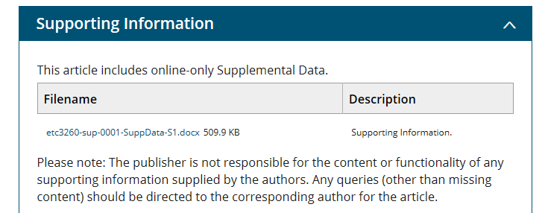
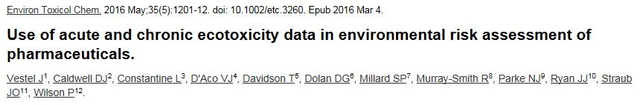
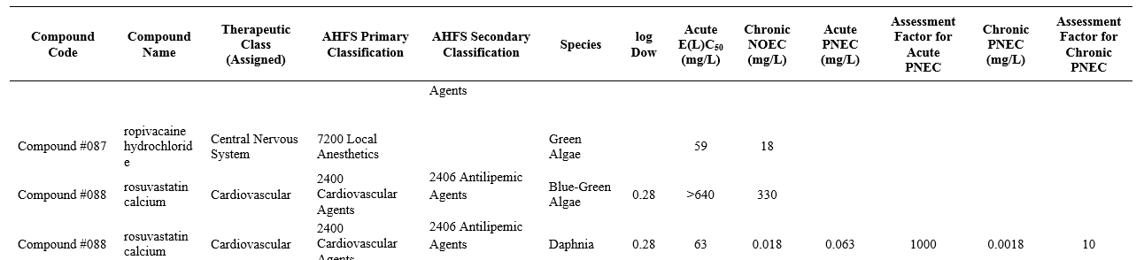
Example Use of a Selecting PNEC Values for a non-Antibiotic API from Peer-Reviewed Literature

Slide 27
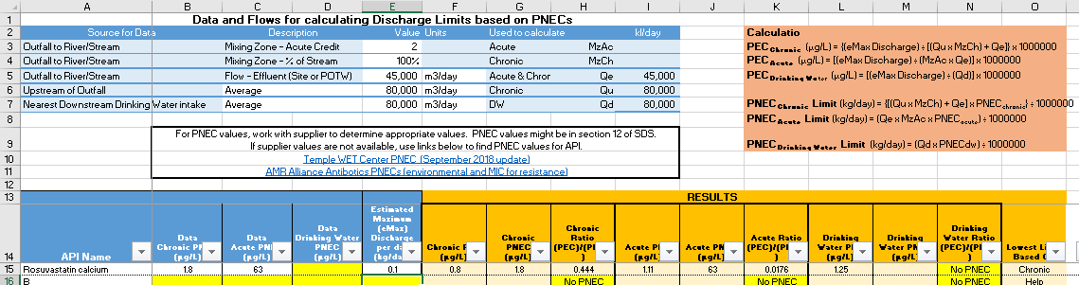
Results from using Rosuvastatin calcium
Peer-Reviewed Literature PNEC Values - Example
Vestel, et al
PNEC Values
Estimated
Chronic PEC
Estimated
Acute PEC
Maximum Daily Mass of
API Discharged in Kg/ day

Slide 28
Results of Rovusastatin calcium Peer-Reviewed PNEC Literature Value - Example
PEC:PNEC ratio
Results (no potential
adverse impact if <1.0)

Slide 29
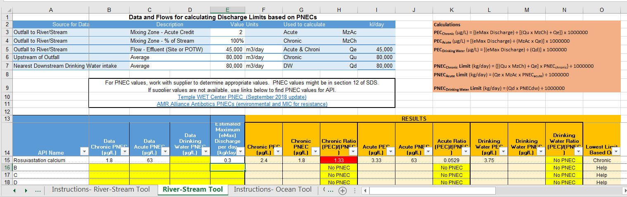
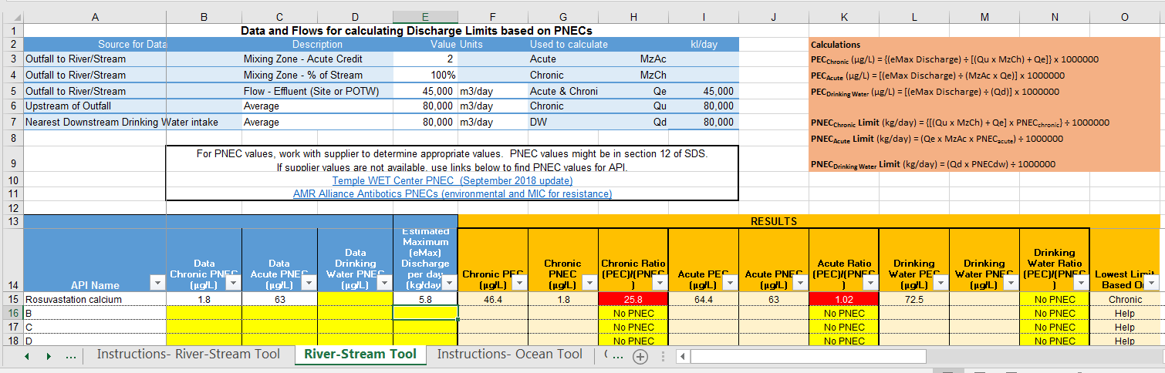
Using the Tool to recognize when your discharge may have potential chronic or acute impacts
The tool will automatically highlight PEC:PNEC values greater than 1.0
>300 gram discharge load would make Chronic PEC:PNEC >1.0
>5,800 gram discharge load would make both Chronic and Acute PEC:PNEC values >1.0

Slide 30
Tips for Using the PSCI PEC:PNEC Calculator Tool
Work with the molecule innovator to get PNEC Values
Use Peer-Reviewed PNEC Values
Understand the dilution factors to be used along with selected PNEC values
Be sure your site API losses of API in wastewater are maximum daily values (not an annualized average values)
If you have effluent analytical test results and know the flow when samples, calculate the actual mass in the effluent and use it instead of an estimated process balance value
Check for acute, chronic and drinking water PNEC values – Remember – the tool calculates mass discharge values to meet all three, and the lowest of the three calculated loading values drives controls

Slide 31
AGENDA
Where to get the PEC:PNEC Calculator Tool for use with All APIs provided in the PSCI Resources
How to use the PEC:PNEC Calculator Tool
Questions

