Slide 1
Emergency Preparedness and Response

Slide 2

SPEAKER
Aaron Duff, CFPS
Johnson & Johnson
Global Director of EHS Process Excellence and Standardization
Notes:
[Introduction from Annabel here
Welcome
Introduce speakers
Q&A at end
Lines are muted, use Q&A function
Being recorded
We’ll share the slides afterwards
Over to…

Slide 3
AGENDA
THIS WEBINAR WILL PROVIDE:
Overview of questions related to emergency preparedness & response in the PSCI audit checklist.
Prepare an emergency response plan, assessing and Planning
Preventing and Responding to emergencies
Basic elements to be considered when performing an impact assessment from neighboring industries.

Slide 4
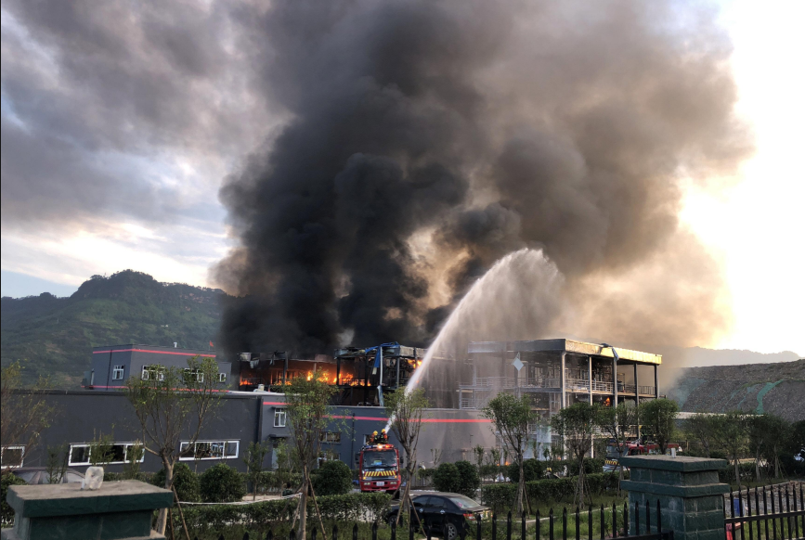
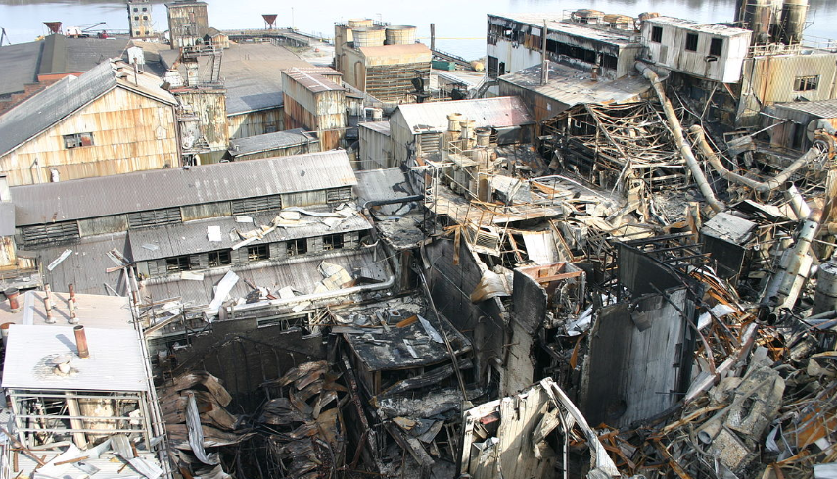
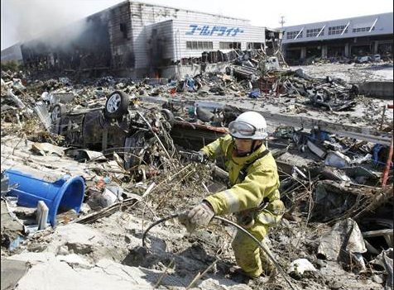

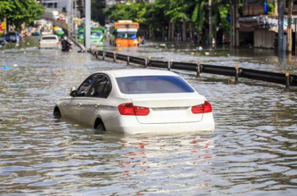
Explosion in China Factory killed 19
Sugar Explosion in Georgia Factory killed 14
NFPA reports 37,000 industrial fire 2009-2013 (USA)
58 Hurricanes between 2010-2017
Increased severe weather winters, water shortages, floods
Japan earthquake (Fukushima)
50% increase in flood events
Sydney announces water restrictions for business
Notes:
Severe Industrial fire– statistical 1/3 business do not reopen, (Building with fire protection 98 % of fires controlled with 1-3 sprinkler heads)

Slide 5
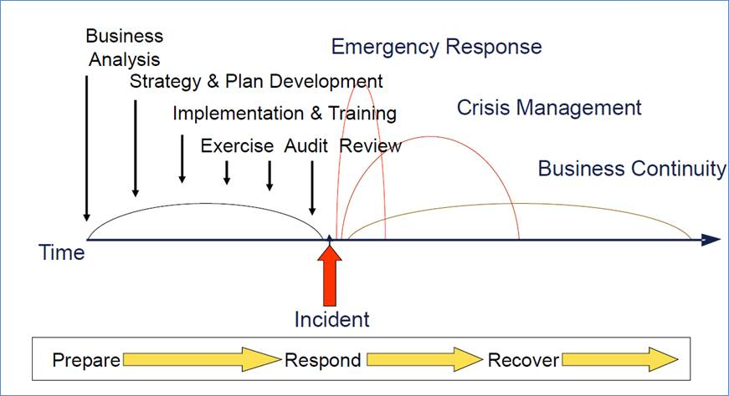
The Agenda and how it all ties together

Slide 6
Questions from Self-Assessment Questionnaire
Why are these questions important?
Q.No | Question | Guidance
85 | Is the facility emergency response equipment (fire extinguisher, fire pumps, sprinkler systems) visually inspected monthly, comprehensively inspected annually, and documentation maintained for all inspections? | Describe if the relevant emergency scenarios been addressed in the emergency response plan Natural: Earthquake, flood, tornado, hurricane, drought, etc. Chemical: Spill, fire, wastewater treatment plant upset, Human: Evacuation, first aid, medical emergency, civil unrest, active shooter/security threat, Does the facility have a communication system to alert the local community of impacts in the event of major emergency?
86 | Is the fire alarm system monitored 24 hours a day (including weekends and holidays) with prompt notification to emergency services (within 5 minutes)?
87 | Does the facility ensure that an adequate amount of fire water is maintained for fire protection?
88 | Are emergency exits and evacuation routes clearly marked, kept free of obstructions (unlocked)? Are emergency exit signs illuminated with emergency backup power?
89 | Are regular emergency evacuation drills conducted, and what is the frequency?
90 | Are emergency response plans in place? Please explain the key points of the emergency response plan: Indicate when the plan was last revised:
91 | Does the site have an on-site emergency response team that is trained for fire or other emergencies?
78 | Has the facility evaluated the impact of its operation on the community? Has the facility evaluated the impact from the activities of neighboring businesses?
Notes:
An emergency response expert can ask 100s of detailed questions however these give view of some important basic elements that show commitment to understanding emergency response elements:
Have we thought about and planned for emergencies
Facility emergency systems maintained
Are employees able to get to safe place
Are there SOPs and are they followed
Missing Two means of egress to safely exit - Emergency exit doors in locked condition? no evacuation routes– what are ideal requirements, maintenance & best practices
Automatic smoke detection & Fire Alarm System – importance why it required & maintenance (sometimes facilities by-pass system due to some x reasons like false alarms?) & best practices
Evacuation drills – some best examples to tally people onsite

Slide 7
PREPARING AN EMERGENCY RESPONSE PLAN
ASSESSING AND PLANNING
Notes:
Preparing an emergency response plan is about knowing your risk.

Slide 8
Assessing and Planning for Emergency Response
What are your Government regulation? Seveso, Community Right to know, SPCC, PSM, Safety Reg.
Assessing your risk starts with Inventorying potential risks and severity at your locations.
    Natural Hazards; Storms, Flood, Earthquake, Drought
    Chemical; Fire, Spills, Airborne Release
    Human; First-Aid, Confined Space, Work Place Violence
What response capability do you have in your city and what are the response times
    Transportation- will road be cleared, alternate routes people/goods
    Emergency response for Fire, Chemical, Medical, unique risks
    Communications- how is emergency information communicated to businesses/ residence
What are the reliability of your utilities services
    Water
    Electricity
    Waste Water (Fire Water Waste?)
What are your Managements expectations?
What are your customers expectations?
Notes:
Electricity--- Argentina recent event that impacted significant part of the country, is that something to prepare for? Puerto Rico power reliability as an example of low reliability and what business sometime do.

Slide 9
Assessing: What are your potential emergencies
Fire/Explosion
Chemical Delivery / Transportation
Civil Chemical Spills/Releases
Disturbances/Site Strikes/Protestors
Utility Loss (Power Loss)
Bomb Threats
Medical Emergencies
Sabotage
Elevator Entrapment
Workplace Violence
Chemical Release
Parcel / Letter
Severe Weather - Winter
Severe Weather – Severe Thunderstorm / Tornado
Hurricane
Biohazardous Materials
Media Relations
Unexploded Munitions/Ordnance (UXO)
Confined Space
Compressed Gasses
Earthquake
Nuclear Event

Slide 10
Assessing Emergency Risk
Potential Emergency | Risk Rating | Gover. Response | Gover. Resources | Management/ Customer Expectation | Site Engineering Controls | Site Administrative Controls | Gaps/ actions plan
Fire (example A) | High | 20 min. from notification | 1 truck 4 Fire Fighters, mutual aid 20 additional mins | Fire immediately controlled, no more than 48 hours delay in production | Offices have sprinklers Manuf. has no sprinklers Site has fire detection | Trained employee for fire handheld fire extinguishers | Create site fire brigade Training and equipment needed Create Crisis Mgmt Team
Fire (example B) | High | 4 min from notification | 3 truck, 12 Fire fighters, Pre-planned response, annual facility walk through, 3 mutual aid cities 7 min response | Fire immediately controlled, no more than 48 hours delay in production | Site is fully Sprinklered Site has full fire detection | Site CMT Inspect, Maint., Testing SOP Drills- with Gov. responders | None
Confined Space | Med | No trained responders | NA | No fatalities | Hazards identified with Sign | Work Permits Employees trained Rescue equipment and training | None

Slide 11
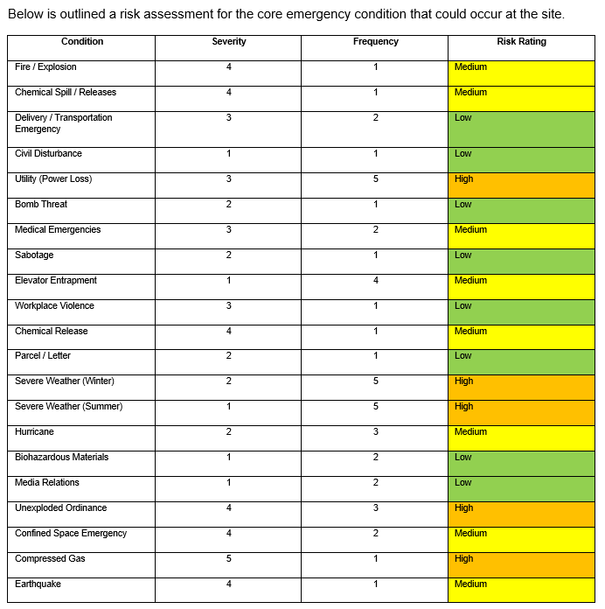
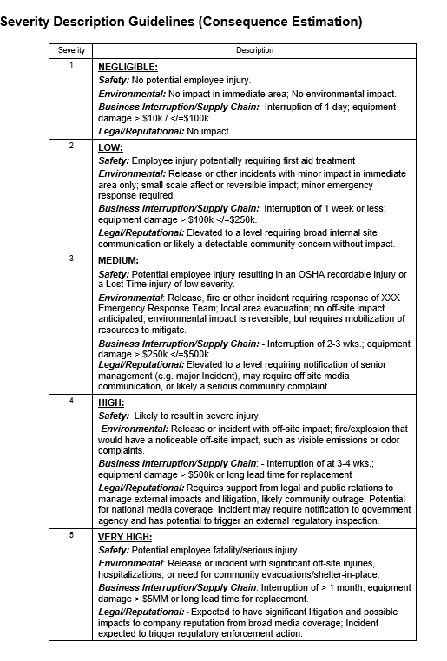
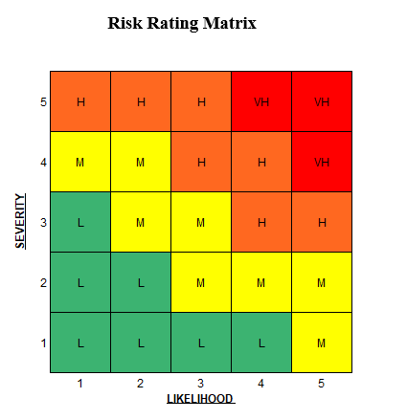
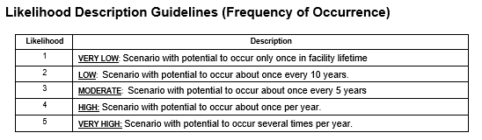
Risk-Tools
EXAMPLE ONLY

Slide 12
Planning
Objective of Emergency Plan
What are we protecting: describe facilities, operations, maps, neighbors, utilities
Applicable regulations
Defining Emergency: Many sites have 3 levels
  Can be handled by department
  Can be handled by site Emergency Response Team
  Government support needed
Crisis Management Team: Formal SOP describing roles and responsibilities (who does what)
Emergency Equipment: What, How much, Where is it (Inspect, Test, Maintain)
Specific written action plans for high impact risk events: immediate action to be taken to reduce impact of risk
Training/ Drills: ERT and site management (consideration include government responders)
Recovery Plans: specific plans on business resumption

Slide 13
PREVENTING AND RESPONDING TO EMERGENCIES
PREVENTION AND RESPONSE
Notes:
Preparing an emergency response plan is about knowing your risk.

Slide 14
Prevention
Physically Engineered Facility:
  Fire Suppression 97% of fires controlled with 1-3 sprinklers
  Fire Detection early detection/ early response
  Spill containment protect environment/ controlled clean-up
  Spill Detection early response / minimizes risk
  Fail Safe Designs WHAT IF
  Fire Rated Walls Contains /minimizes site wide impact
  Fire Doors Stop fire spread
  Guards Stop injuries from occurring
  Flood Barriers Stop flood damage
Management Procedures:
    Work Permits
    Inspections, Testing, Maintenance
    Routine/Non-routine work SOPs
    Pre-startup safety reviews (PSSR)
    Emergency Shut down
    Hazard awareness (identified and integrated into operating SOPs)
The BEST most effective emergency response plan is one never needed

Slide 15
Emergency Response
We know emergencies will happen, most emergencies will not happen exactly as planned for.
The best emergency response plans allow for flexibility
When an emergency occurs
  Responders show up to designed area, and one person is designed in charge (Incident Command) and a team of support
  Determine type of emergency and have the response plan available (grow or reduce size of team based on emergency)
  Establish goals and limits of response
  Who is impacted by emergency, do you need to communicate and to who. (employees, management, neighbors, government)
  Establish accountability; who do you need leading elements of response plan, and who will support leads, leads need to know who, and where their people are, and what they are doing.
  Incident Commander; needs to know when you need help, who to call for help, and ensure the risk to responders is acceptable.
  Frequency of communication updates should be established
  If Government responds (fire department) during an emergency is not the time to be introduced. Most external response organizations will take control of your facility, may not want to talk company employees, and may not allow your people to help.
  If emergencies go on for time, you need to have plans for feeding and resting your teams

Slide 16
PREVENTING AND RESPONDING TO EMERGENCIES
EVALUATING IMPACT OF NEIGHBORS
Notes:
Preparing an emergency response plan is about knowing your risk.

Slide 17
Impact of Neighbors
When assessing your neighbors risks and impacts what should we consider?
Do they have bulk chemicals, fire explosion risks, fumes?
What kind of work do they do, does it pose a risk? Fireworks warehouse?
Do they have good house keeping?
Are they upwind of your facility?
Do you share utilities (can you)?
Is their building protected by Fire Suppression?
Do they have security?
What direction does their stormwater run? Floods/ spills/ Fire Water
Do you pose a risk to them / or them to you?
Know your neighbors. Understanding their hazards allows you to make your emergency plans
Can your neighbor help you during an emergency? Equipment, Resources, Communications
(industrial mutual aid agreements)

Slide 18
EXAMPLES
Crisis Mgmt Plan Example
Emergency Plan Example
Notes:
Please ask questions by typing them into the Q&A function on your screen

Slide 19
Q&A

Slide 21
BACK-UP Slides

Slide 22
WHO RESPONDS VS. HOW TO THEY RESPOND?
FACILITY SCENE
FACILITY SCENE
Senior Leaders
Senior Leaders
Managers
Managers
Employees
Fire
Employees
Fire
Potential
Chaos
Potential
Chaos
Police
Police
Medical
Medical
What happened?
What caused it?
Was anybody hurt?
How bad is it?
Who should be notified?
Do we need to enact contingency plans?
What happened?
What caused it?
Was anybody hurt?
How bad is it?
Who should be notified?
Do we need to enact contingency plans?
Security
Security
EHS
EHS
What’s the emergency?
Who’s in charge?
What do we need to do?
Did everybody evacuate?
Media
Media

Slide 23
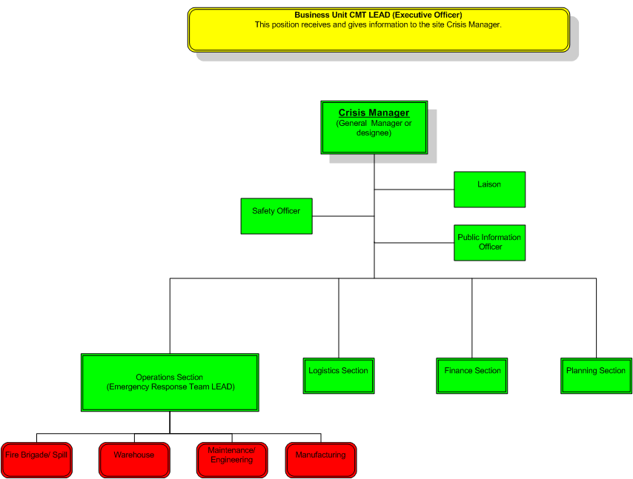
Span of Control:
Any one person in charge can handle between 2-7 direct reports.
Incident Command needs to be comfortable with delegation
Incident Command Structure for Emergencies
Notes:
ICS Structure
This is what a full ICS structure might look like for a major event. The organizational model expands to match the needs of the crisis event. Ideally, leaders with key assignments limit their span of control to 2 to 7 persons to maintain a high degree of functionality.

Slide 24
Example: ICS Major Crisis
Emergency Response Team
Site Crisis Management Team
(site Emergency Operations Center)
Corp Crisis Management Team
Communication
Communication
On-scene coordination led by a scene leader – established by “Incident Commander”
Deals with evacuations, fire fighting, responders, safety zones, activates site Crisis Management Team
A pre-determined “CMT Leader”
becomes the manager of the overall event as it escalates
Considers broad site impacts, off-site impacts, sustained supplies, manages media, considers agency notifications, deals with logistics, must notify BU Crisis Management Leader
Corp Crisis Leader – Maintains
primary contact with the facility CMT leader
Assesses broad company impacts,
significant media communication,
Companywide communications,
implements contingencies, maintains contact with Incident Commander
Primary focus on safety
and incident containment
Primary focus on impact of
event that could last
several days
Primary focus on
stakeholders, broad impacts,
and business continuity
Notes:
Example: ICS - Major Fire Crisis
Consider the impacts of a major fire that caused significant damage and potential for serious business interruption. If the fire event were to last for more than one day, consider the importance of establishing a communication structure that assured that the Incident Scene Manager connected with the Site Crisis Management Team, and they in turn with the BU Crisis Management Team. The on-going information flow would have to channel through pre-determined leaders in each group, in essence, managing the event like a “project” through an organizational chart.

Slide 25
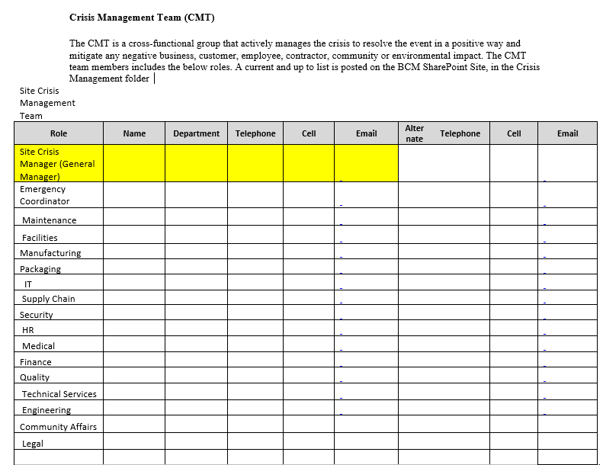
Example Crisis Management Team:
Each member of Team should have specific roles and responsibilities defined, including any tools or templates to support their responsibilities

