Slide 1
PSCI SAQ & AUDIT REPORT TEMPLATE UPDATE
KELLY KAPPLER & LYDIA ELLIOTT
20 FEBRUARY 2019
Questions will be taken at the end of the webinar.
Please utilize the chat feature to ask questions

Slide 2
MOTIVATIONS SAQ/AUDIT TOOL REFRESH
2018 – 2020 PSCI Strategy
New key issues to incorporate
Continuous improvement
Ability to track/trend findings
(input to enhance capability priorities, respond to inquiries, etc)
Balance thoroughness of audit with time required to complete so many questions
Provide auditor guidance for questions

Slide 3
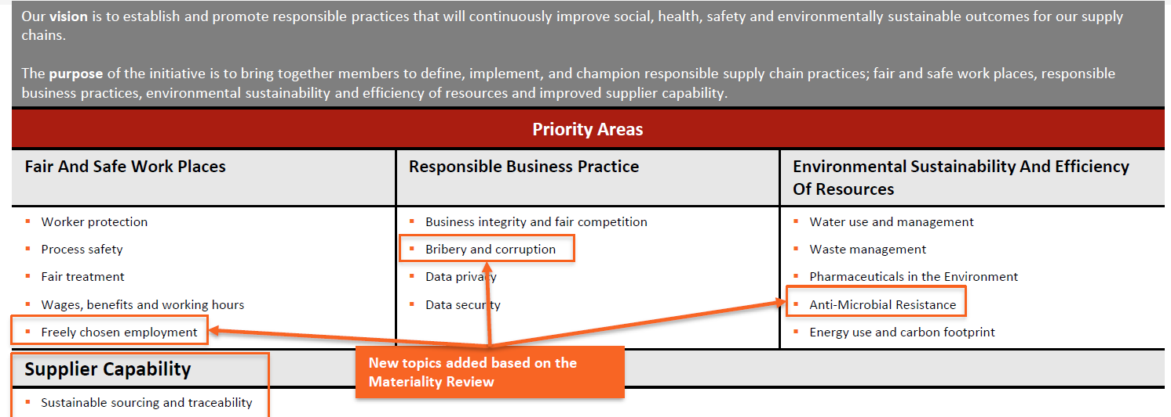
NEW TOPICS TO INCORPORATE IN SAQ

Slide 4





THE PSCI PRINCIPLES
ETHICS
LABOR
HEALTH & SAFETY
ENVIRONMENT
MANAGEMENT SYSTEMS
Business integrity & fair competition
Identification of concerns
Animal welfare
Privacy
Freely chosen employment
No child labor
Legal treatment of young workers
Non-discrimination
Fair treatment
Legal wages, benefits & working hours
Freedom of association
Worker protection
Safe work conditions
Process safety
Proper control of hazardous substances
Emergency preparedness & response
Communication of hazard information
Legal environmental authorizations
Management of waste & emissions
Spills & releases prevention
Water conservation
Manage pharmaceutical waste-water discharge
Commitment & accountability
Legal & customer requirements
Risk management
Documentation
Training & competency
Continual improvement
Bribery & corruption
Freely chosen employment
Anti-Microbial Resistance
Notes:
Some questions were consolidated, language refreshed, some content moved to be more streamlined, non value added questions deleted

Slide 5
FINDING CRITICALITIES
Critical Findings: Are very high risk findings that require immediate action to protect human life, the health of employees or the environment; May result in loss of license to operate or serious damage to reputation; Require immediate corrective action by the supplier; Need to be communicated to the audit sponsor prior to audit report finalization.
Other Findings: Are all other major or minor audit findings, which need to be corrected by the supplier in an appropriate period of time.
Major Findings: Findings that may pose major impacts to workers, the community, or the environment. Findings that may pose major regulatory non-compliances or illustrate systemic program gaps.
Minor Findings: Findings that may pose minor impacts to workers, the community, the environment. Findings that may pose minor regulatory non-compliances.
Non-Finding remarks: Are where the auditor wishes to raise an important comment, but this comment would not constitute any type of finding.

Slide 6
HIGHLIGHTS & ROLL OUT
Highlights:
Additional focus
  PIE/AMR
  Human rights
Auditor guidance
Risk focused
Introducing the updated SAQ/Audit tools
    Multi forum roll out including:
Announce at Fall 2018 AGM
Host webinar announcing to member companies & PSCI approved audit firms
  Auditor guidance notes
Include in annual report
Update tools:
Full version
Abbreviated version
Word
Excel

Slide 7
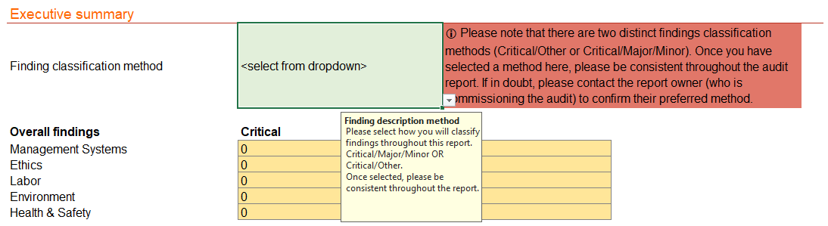
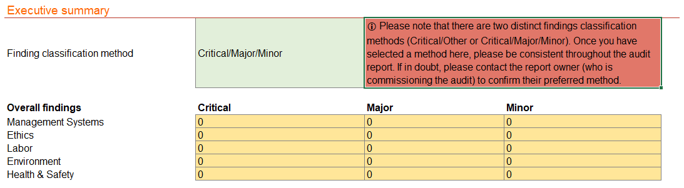
FINDING CRITICALITIES - EXCEL

Slide 8
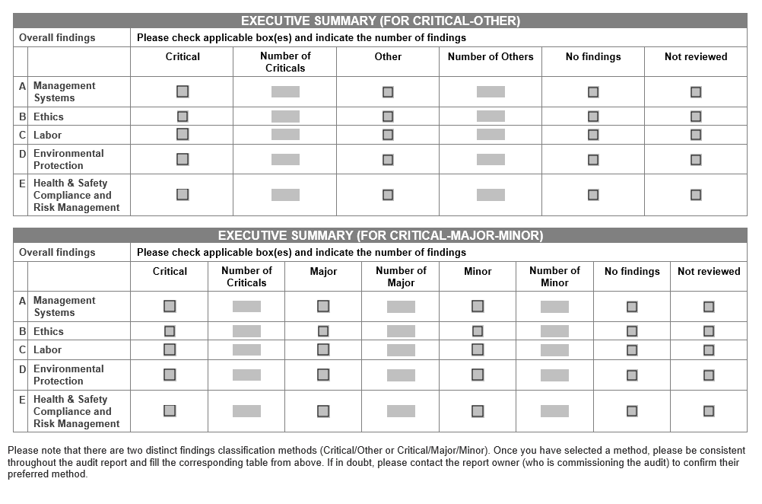
FINDING CRITICALITIES – WORD

Slide 9
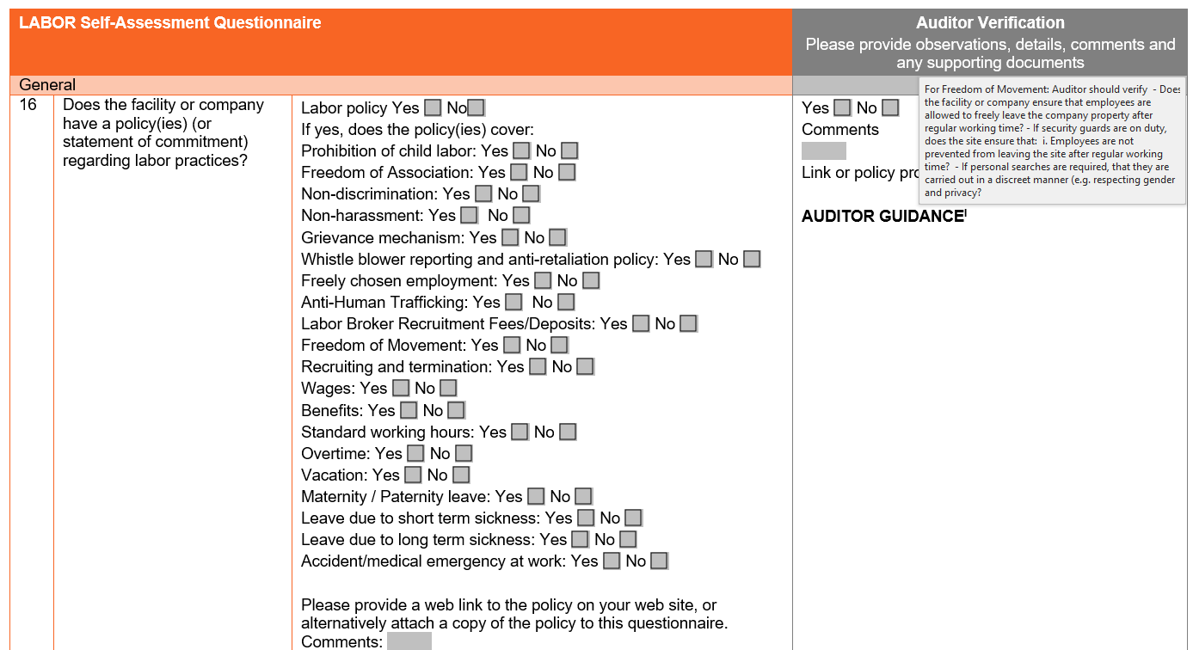
EXAMPLE 1
Refreshed list to logical order, expanded
Auditor guidance

Slide 10
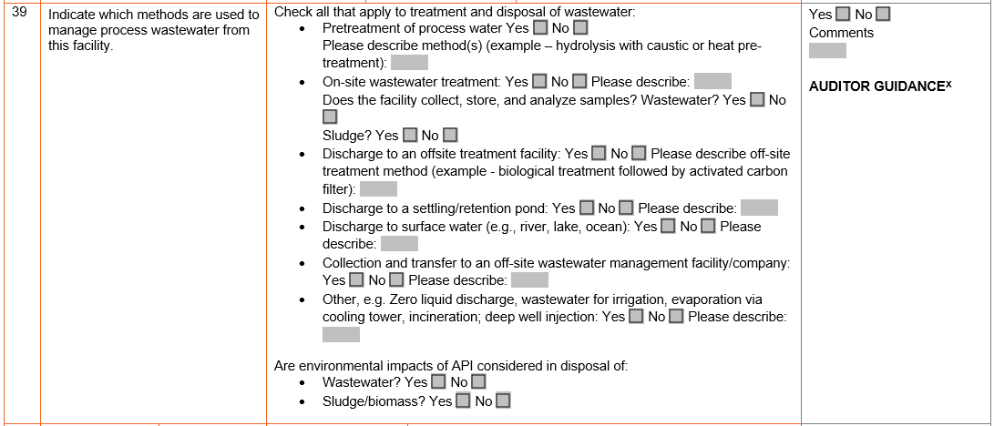
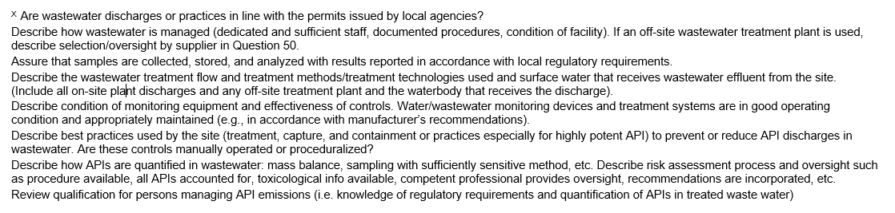
EXAMPLE 2
Extensive auditor guidance
Separated waste and wastewater questions

Slide 11
THE UPDATED TOOLS
The new tools have been updated from a few perspectives:
New content
  Revised questions
  Auditor guidance
New functionality
  Driven by revisions
  Driven by feedback from member companies and approved auditors
I’m now going to take you through the key updates to the tools

Slide 12
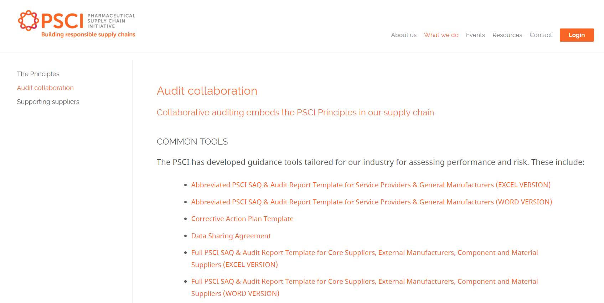
WHERE TO FIND THE NEW TOOLS
Audit tools are on the PSCI website in the way we work section, under audit collaboration:
https://pscinitiative.org/auditCollaboration
Tools that have been updated:
1) Full PSCI SAQ & Audit Report Template for Core Suppliers, External Manufacturers, Component and Material Suppliers
  Word version
  Excel version
2) Abbreviated PSCI SAQ & Audit Report Template for Service Providers & General Manufacturers
  Word version
  Excel version

Slide 13
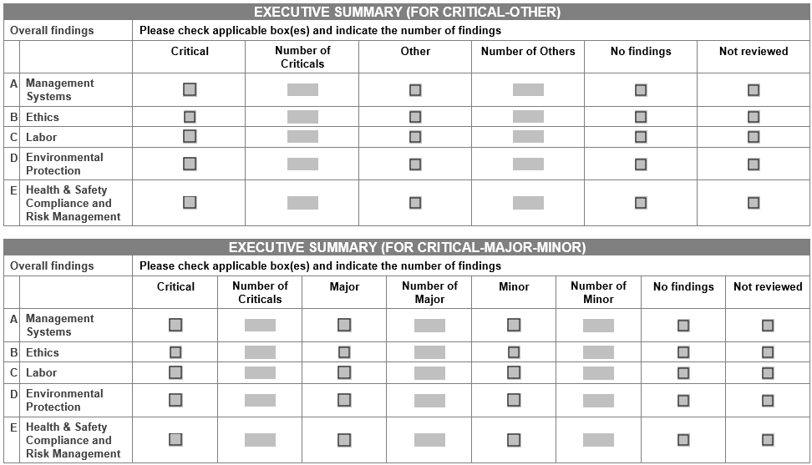
WORD VERSIONS – Findings classifications
Findings classifications, only the relevant executive summary should be filled in, depending on the findings classification required
  Critical / Major / Minor
  Critical / Other

Slide 14
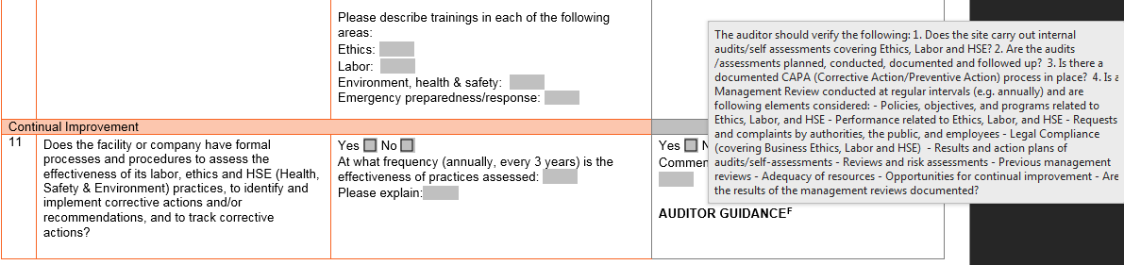

WORD VERSIONS – Auditor guidance
Auditor guidance, the updated auditor guidance has been added to the tool using endnotes.
1) To view the guidance pop-up
To view the guidance for a question hover over the ‘AUDITOR GUIDANCE’ note against that question

Slide 15
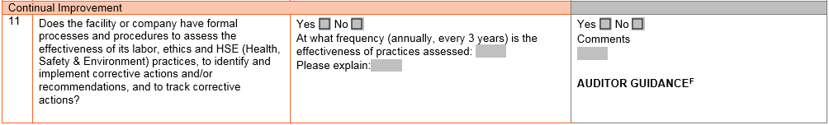
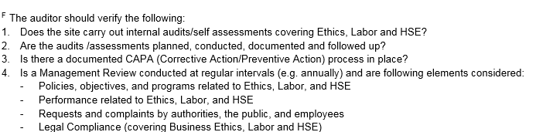
WORD VERSIONS – Auditor guidance
2) To view the full guidance text
To access the full auditor guidance, double click the letter next to ‘AUDITOR GUIDANCE’. This will take you directly to the end note in the auditor guidance section at the end of the document.

Slide 16
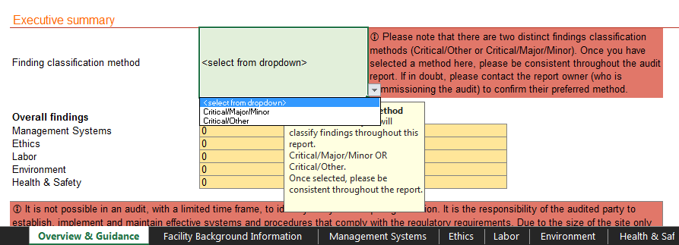
EXCEL VERSIONS – Findings classifications
Findings classifications, in the excel version the classification method needs to be selected before starting the evaluation and must not be changed in the process. Select the findings classification required from the summary table on the ‘Overview & Guidance’ tab it will update automatically to:
  Critical / Major / Minor
  Critical / Other

Slide 17
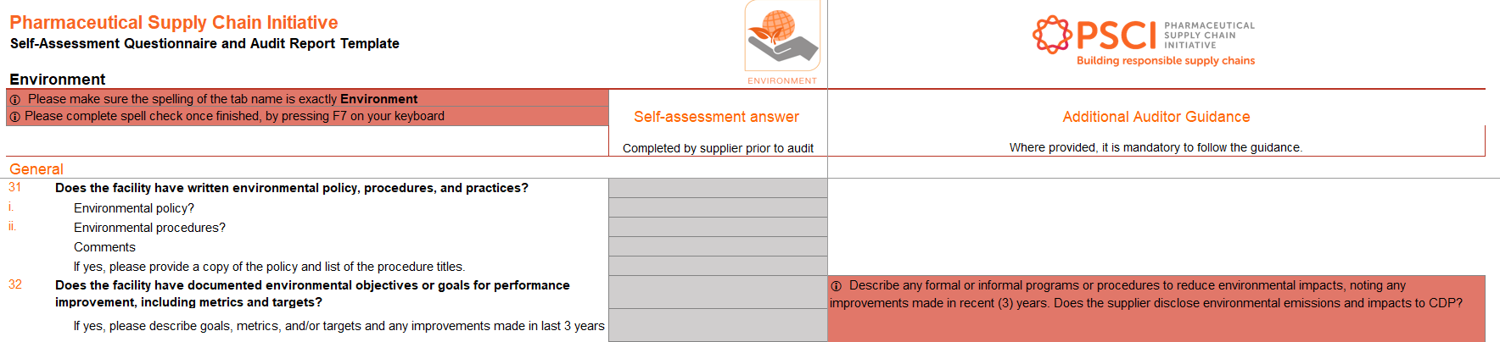
EXCEL VERSIONS – Auditor guidance
Auditor guidance, the additional auditor guidance that has been added is included in an ‘Additional Auditor Guidance’ column (K) in the excel tool.

Slide 18
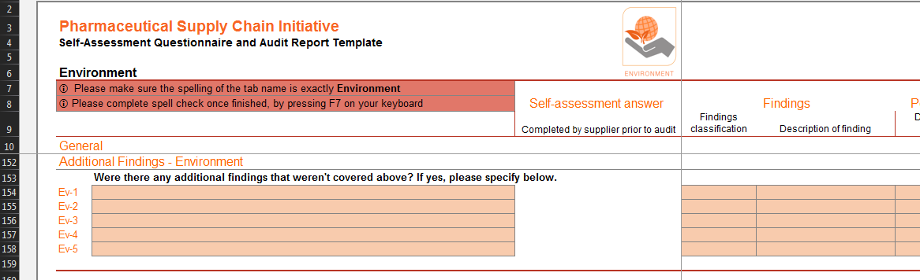
EXCEL VERSIONS – Additional findings
Space for additional findings, this is provided at the end of every section. This is aimed at including space for auditors to provide additional findings against a topic, like Environment that do not fit against a specific question.

Slide 19
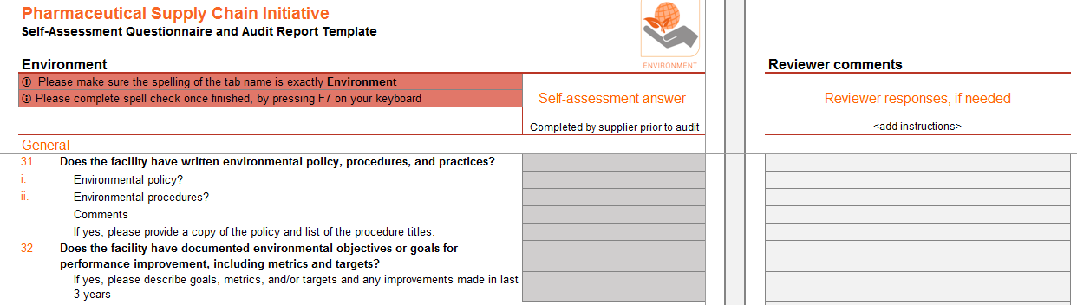
EXCEL VERSIONS – Reviewer comments
Reviewer comments, we’ve included an additional column (O) at the very right of each form for reviewer responses. This is intended to be a column where a reviewer can comment against questions if they have comments.

Slide 20
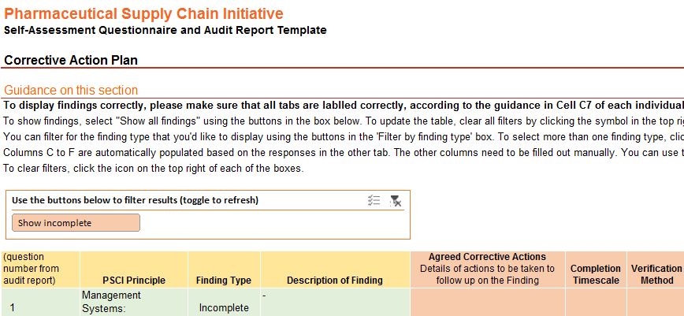
EXCEL VERSIONS – CAP sheet updated
CAP sheet updated, we’ve removed the Macro from the CAP sheet. The CAP sheet functionality is similar, but there are a few minor changes to how it works. Now findings can be filtered using the option menu at the top of the table.
In order to go back to reset the view, select this button

Slide 21
EXCEL VERSIONS – Other updates
Excel unlocked, some of the restrictions caused issues when using it, so we’ve unlocked the excel sheets in order to make using them simpler.
Please take care not to:
  Change any questions, similarly to the word version
  If combining sheets keep to the original sheet names, or the CAP sheet won’t work correctly
Spell check updated, we’ve removed the spell check Macro, as it was causing compatibility issues. Users now need to need to spell check using F7. This is clearly indicated at the top of each sheet where the spell check macro button used to be.

Slide 22

Questions

