Slide 1
The Pharmaceutical Supply Chain Initiative
An introduction

Slide 2


Contents
Slide 3
Slides 23-33
How to use this deck
Collaborative Impact Projects
The Global Supplier Conference
Supplier Partnership Program
Slides 4-8
Our anti-trust statement
The PSCI vision and principles
Slide 34
Slides 9-12
Overview of Topic & Regional Teams
Our membership
Led by our Members
Slides 36-49
Engaging with us: members
Engaging with us: suppliers
Engaging with us: auditors
Slides 13-15
PSCI Value Proposition
Materiality Assessment
Slide 40-41
Slides 16-22
Appendices: Strategy 24-26
The PSCI Strategic Pillars overview

Slide 3



Explainer slide
How to use this deck
This deck is intended to explain what the PSCI does, how it does it, and why.
You can:
Use individual slides in your own presentations
Circulate this deck to your suppliers to help them understand the PSCI or our Supplier Partnership program
Take wording from this deck as inspiration to help you explain PSCI to others, e.g. at conferences
Use the contents page to help you skip to relevant sections, e.g. an outline of the Supplier Partnership program.

Slide 4
An Overview of PSCI

Slide 5

Competition & Anti-Trust Statement
All PSCI activities take place under our anti-trust policy, designed to preserve trust in PSCI and to keep our work on the right side of competition laws.
As such, PSCI discussions will never:
Reveal commercial relationships between buyers and suppliers, whether current, past or potential.
Share experiences working with a supplier, except audits shared on the PSCI platform (which are data-secured and controlled for privacy).
Discuss pricing or quality received from suppliers – including indirect suppliers (e.g. service providers).
Share market insights or proprietary information on products e.g. product development.
All members and suppliers sign up to this, and it is distributed to event attendees.
We ask for everyone's cooperation to uphold the anti-trust rules.

Slide 6
An Introduction to the PSCI
The PSCI is the leading association for pharmaceutical and healthcare companies.
Our Vision
One Voice
Excellence in safety, environmental, and social outcomes, across the global pharmaceutical and healthcare value chain.
Our members come together as one voice to drive continual improvement in responsible outcomes across the pharmaceutical and healthcare industry.
Our Principles are the foundation for the industry’s expectations on responsible supply chain management.
Our Purpose
Our purpose is sector collaboration, using one voice to define, instil and drive responsible value chain practices.

Slide 7

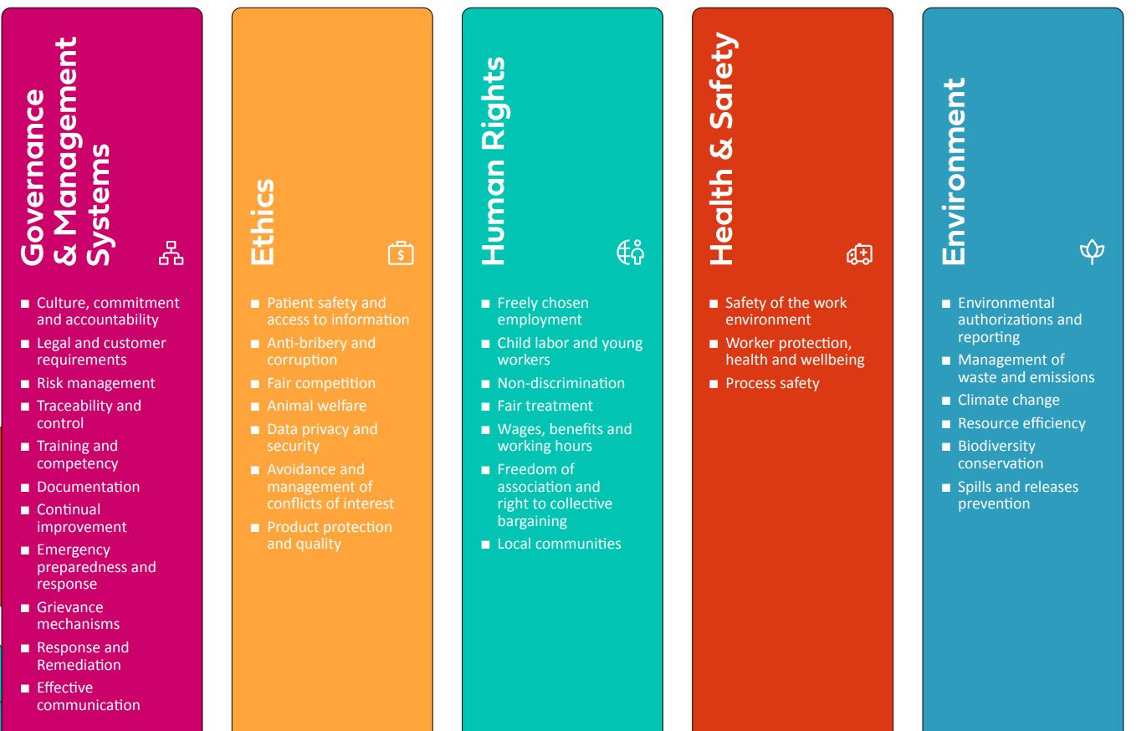
The PSCI Principles
First agreed in 2006, the PSCI Principles for Responsible Supply Chain Management are our blueprint for responsible practice, setting out our expectations for five relevant topic areas.
They form the foundation of the PSCI's tools, including our Audit Guidance and Templates, and our Maturity Model for supplier learning and development. All PSCI members integrate these Principles into their own supplier codes and uphold them in their operations, aiming for continual improvement by advancing supplier performance over time.
Notes:
https://pscinitiative.org/principles

Slide 8

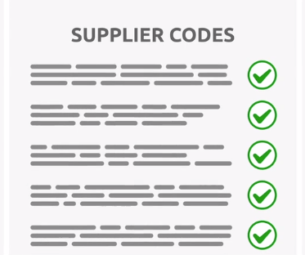
Committing to the Principles
All PSCI members commit to the Principles by integrating them into their own supplier codes and upholding them in their own operations
The PSCI supports our members to embed these Principles into their business practices

Slide 9
Our Members & Leadership

Slide 10


PSCI Members
36 Full Members
47 Associate Members
83 Members Worldwide in 2024
Full members contribute to the development of the PSCI and achievement of our vision through leadership positions and audit sharing.
PSCI members represent over 70% of the industry with over $1.2bn in combined revenues

Slide 11


PSCI Members
Associate Membership is intended as a pathway to Full Membership, enabling companies to develop their audit programs and learn from peers.
36 Full Members
47 Associate Members
PSCI has tremendous scale. This uniquely places us to identify opportunities where a collaborative solution works best and to execute this.
— 2024 PSCI Chair,
Deirdre O'Reilly

Slide 12
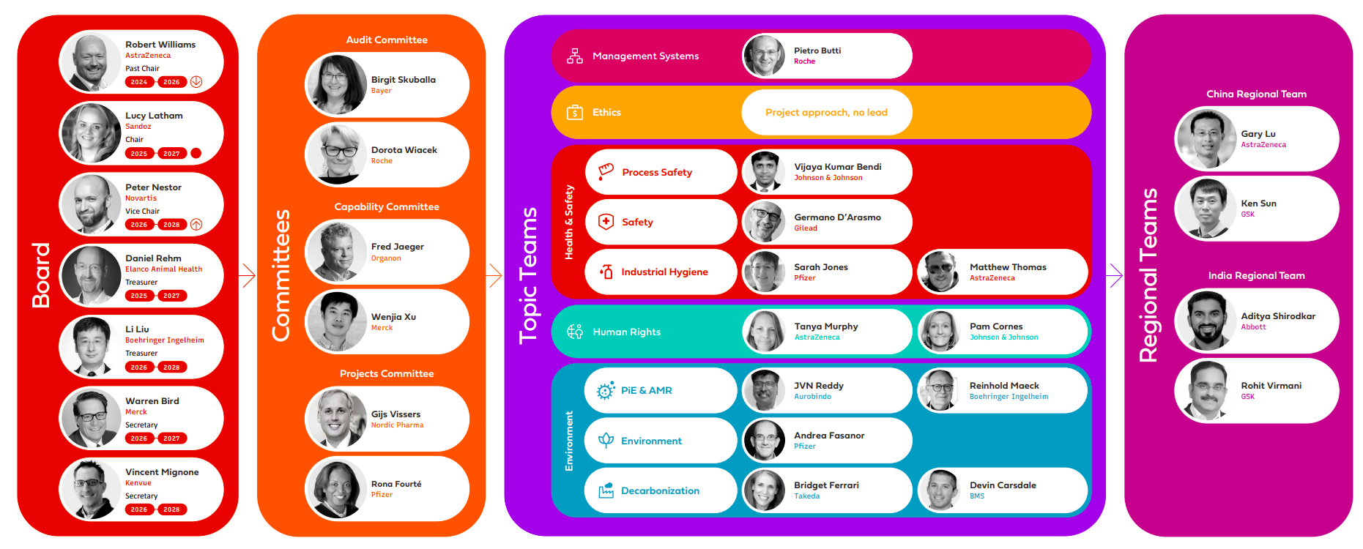
The PSCI is driven by three main Committees that reflect our impact areas: Audit, Capability, and Projects. These are led and composed of members who work together to implement our strategies and achieve our goals.
Topic Teams bring subject matter expertise to the PSCI’s programs, contributing to the ongoing development of our learning resources, tools and impact projects. They play a key role in keeping the Audit Protocol up-to-date with latest best practices.
Regional Teams target the specific needs of members and suppliers in China and India.
Led by our Members
The PSCI is guided by an elected Board of Directors, composed of representatives from the member companies. This Board is responsible for steering the PSCI's strategic direction, overseeing key initiatives, and representing the organization publicly.

Slide 13
Value Proposition & Materiality

Slide 14
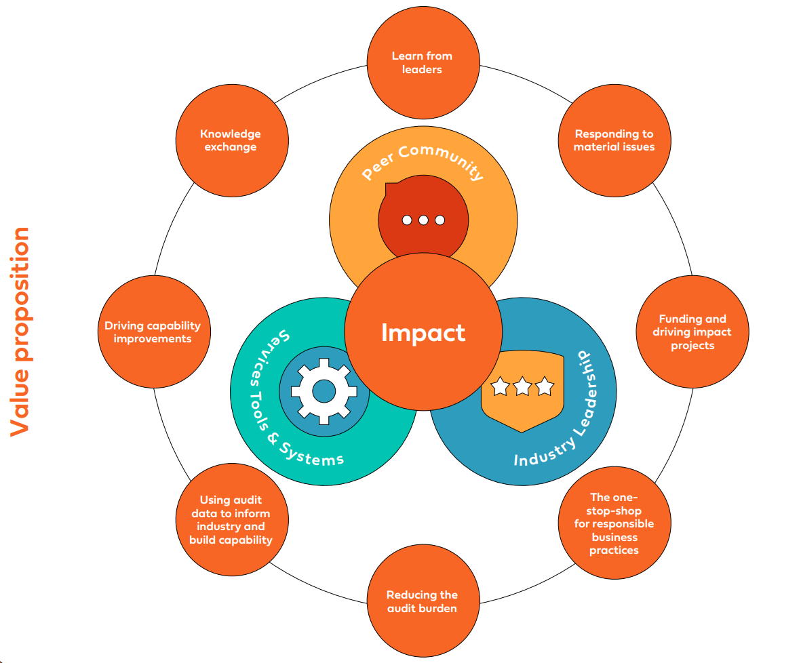
PSCI Value Proposition
PSCI delivers value to our members, to their suppliers, and the industry as a whole.
For members and suppliers, PSCI enables engaging in peer community, gaining access to useful services, tools, and systems, and contributing to industry leadership that drives meaningful and lasting impact.

Slide 15
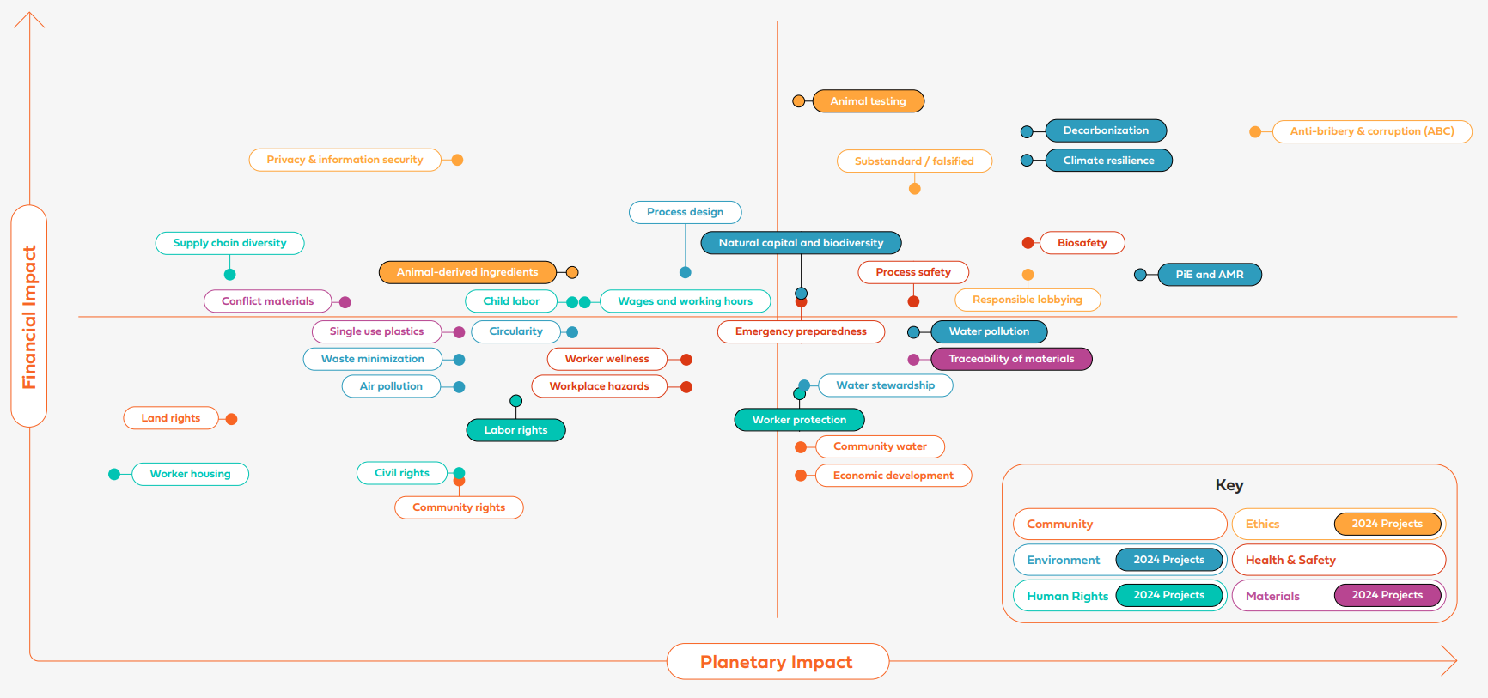
PSCI 2024 Materiality Assessment
In 2024, the PSCI conducted a double materiality assessment (DMA) for the sector, focusing on supply chains for the Pharmaceutical & Healthcare industries. The DMA considered the views and positions of PSCI members along with a range of outside sources across different topic areas.
Notes:
More information on the process and scoring: https://pscinitiative.org/viewResource?resource=2229

Slide 16
Our Strategic Pillars

Slide 17
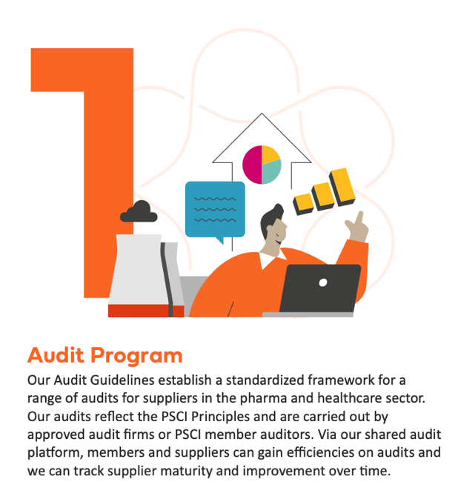
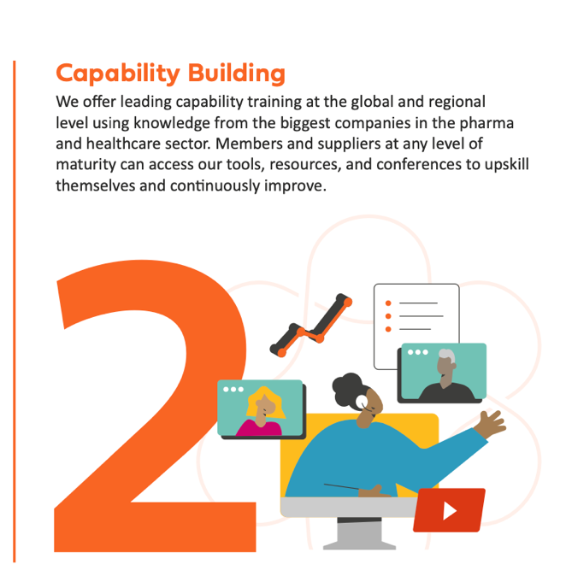

Our Strategic Pillars
The PSCI seeks to build responsible supply chains for the whole of the pharmaceutical and healthcare sector. We do this through three strategic pillars: Audit, Capability, and Projects.

Slide 18

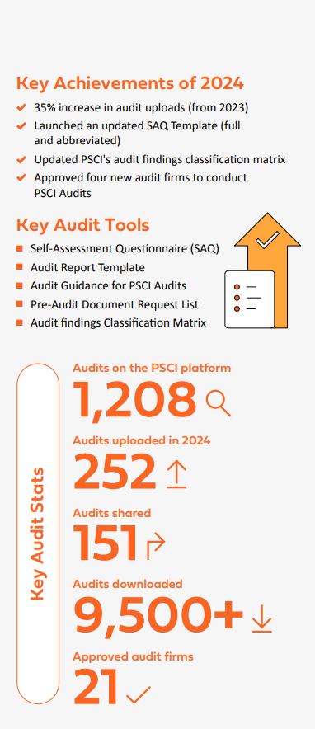
Audit
The PSCI Audit Framework is at the heart of realizing the PSCI’s vision for excellence.
The PSCI audit model, self-assessment questionnaire and supporting tools are an industry recognized framework for social and EHS supplier assessment in the pharma and healthcare sector. Our audits embed the PSCI Principles into the supply chain and are carried out by approved audit firms or qualified PSCI Member internal auditors.
Our digital audit platform enables members and suppliers to gain efficiencies on audits and focus attention on continuous improvement. Our annual audit findings analysis allows us to track supplier practices and maturity over time and create complementary activities within the Capability and Projects pillars.
The Audit Committee oversees this workstream, with expert insight from our Topic Teams.
Why engage with the PSCI Audit Framework?
Best practice: up to date protocol and tools, auditors updated and trained
Efficiency: members access >1k+ existing audit reports, support time-saving amongst members and suppliers
Transparency: support data sharing across industry

Slide 19
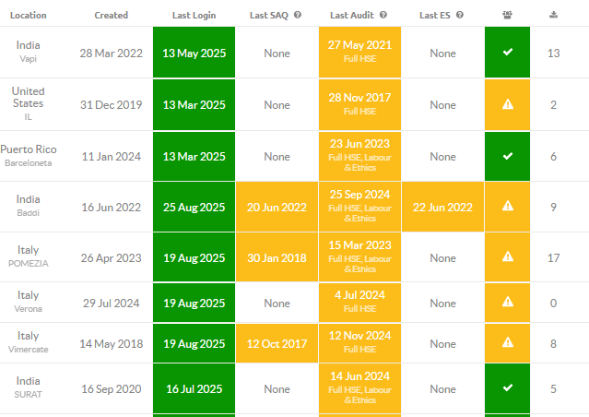

2025 Highlights
Audit
Modular SAQ: Customize SAQ for suppliers based on size, location, and segmentation.
AI integration: Utilize AI for audit tools and audit findings analysis. ​
Audit uploading and sharing: Further promote audit uploading and sharing.
Planned audits: Explore new approaches to collaborate on potentially overlapping audits, focusing on engagement with Supplier Partners.​
Make auditor training available on Learnster.​
Explore auditor qualifications.​
Enhance collaboration with Audit firms: Assess and work more closely with approved audit firms, including gathering feedback, and conducting quarterly meetings to exchange concerns and share knowledge.​
Example of supplier sites and audit reports on the PSCI platform:
Notes:
Launch of the online SAQ, enabling suppliers to site to complete their self-assessment virtually, direct into the psci platform. Complete.
Working with audit firms to ensure good quality audits:
-Auditor training resource update, with great input from across the PSCI Topic Teams. Complete.
-Revision of audit firm agreements, another step to ensure good quality, comprehensive audits. This process is nearly complete, with discussions ongoing with a few audit firms re details of the agreement
-Review of PSCI’s approved audit firms - gathering feedback and ensuring quality. Completion in Spring 2024
SAQ update against revised Principles – embedding the updated Principles across PSCI audit documents, reflecting up to date best practices and expectations. Completion in Spring 2024

Slide 20
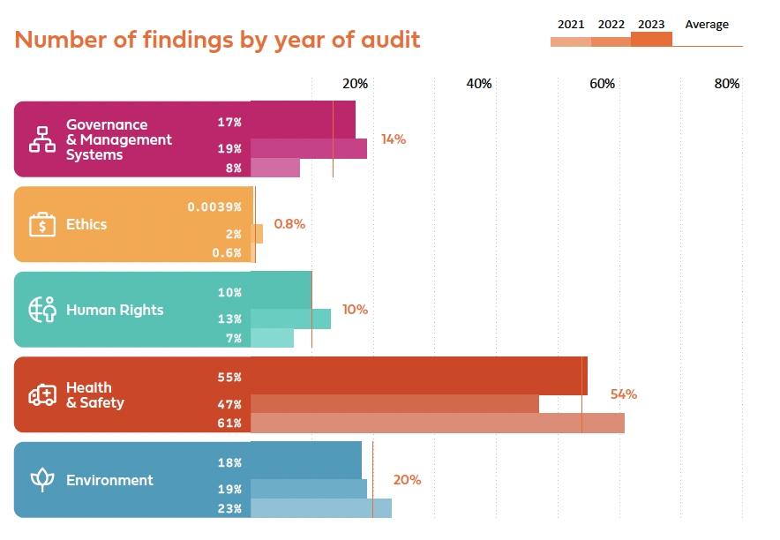
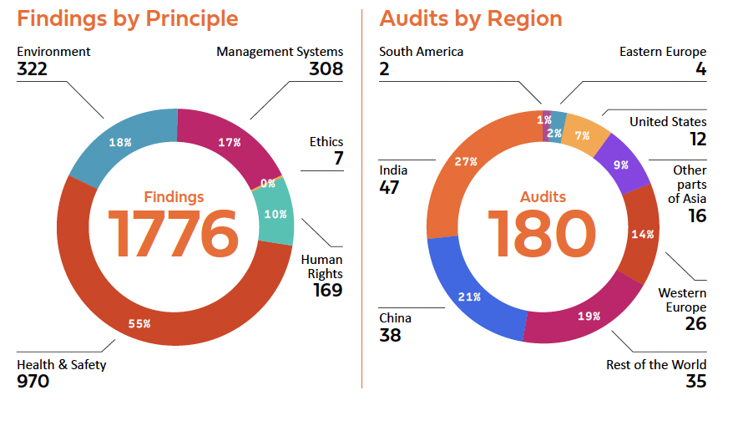
Audit Findings Analysis
Each year we analyze the findings from audits on the PSCI platform under the relevant topic areas of the PSCI Principles. This gives us visibility over how audit findings are changing over time and our impact on the industry.

Slide 21

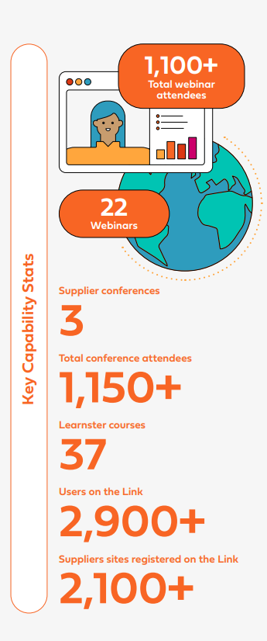
2024 stats
Capability
Supporting suppliers to improve their practices is at the core of PSCI’s purpose.
The PSCI seeks to be a driving force for supplier learning and development. Our Maturity Model and digital learning plans provide suppliers with a structured curriculum to improve their practices in line with the PSCI Principles. This is accompanied by a wider portfolio of educational content including expert-led conferences, topic-specific webinars, and specialist tools.
These courses and tools reflect the good practices that are expected by the industry and assessed via the PSCI Audit Framework.
This work is led by the Capability Committee with expert insight from our Topic and Regional Teams.
Why engage with the PSCI Capability Framework?
Access and (for members) input to industry standards – Principles, Maturity models, Learning Plans
Tailored supportive resources for suppliers – Conferences, webinars, and Learnster
For members, dialogue with peer SMEs – via Topic Teams

Slide 22
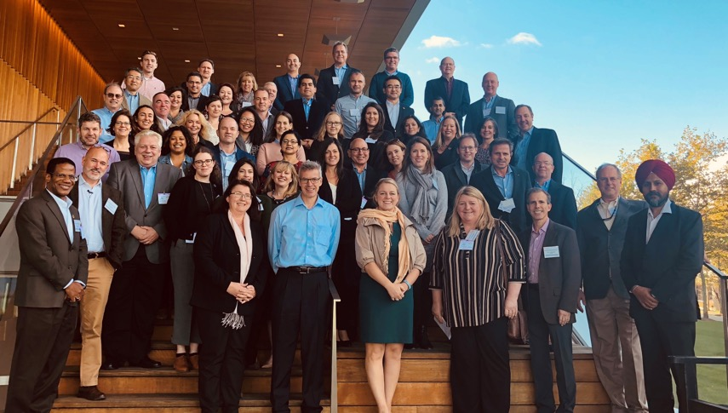
2025 Highlights
Capability
Maturity Models: Comprehensive models covering all aspects of responsible supply chain topics, each with a clear pathway for improvement through connected learning plans and resources.
Webinars: Hosting over 20 webinars annually, reaching thousands of suppliers and expanding our library of freely available, topic-specific webinars.
Learnster: Launched in 2023, Learnster transforms detailed, technical learning resources created by our members into engaging, interactive courses.
Indian Suppliers: Expanding our reach among Indian suppliers with a larger-than-ever conference and a series of in-country events and workshops.
Chinese Supplier Conferences: Celebrating ten years of supplier conferences in China, delivered in Mandarin and reaching [~2,500] suppliers in total.
Global Supplier Conference: Initiated in 2021 and delivered virtually, with content tailored for EUR and NAM suppliers.
Free Access: All resources and events are offered to suppliers free of charge.
PSCI Capability Tools
Supplier Conferences
Environment Survey
Learning Plans
Maturity Models
Webinars
Legislation Tracker
PNEC Calculator Tool
Notes:
Launch of the online SAQ, enabling suppliers to site to complete their self-assessment virtually, direct into the psci platform. Complete.
Working with audit firms to ensure good quality audits:
-Auditor training resource update, with great input from across the PSCI Topic Teams. Complete.
-Revision of audit firm agreements, another step to ensure good quality, comprehensive audits. This process is nearly complete, with discussions ongoing with a few audit firms re details of the agreement
-Review of PSCI’s approved audit firms - gathering feedback and ensuring quality. Completion in Spring 2024
SAQ update against revised Principles – embedding the updated Principles across PSCI audit documents, reflecting up to date best practices and expectations. Completion in Spring 2024

Slide 23
Collaborative Impact Projects

Slide 24

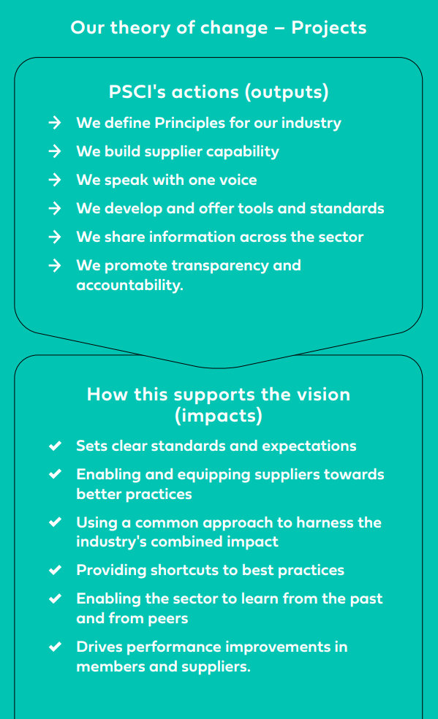
Projects
PSCI launched our Projects workstream in 2024 and it has quickly become a become a key impact driver in the PSCI’s new strategy.
Our scope, influence, and robust governance structure enables members to collaborate effectively on industry-wide topics, speaking with one voice to the industry on key topics.
Working on projects together as members, suppliers, and partners allows us to deliver greater impact. Current projects range from developing position papers, to improving supplier wastewater practices, to partnering to increase renewable energy usage across the industry.
The PSCI Projects Committee oversees this workstream, and projects are individually implemented through our Committees and Teams.
Why engage with the PSCI Projects Framework?
Solve specific challenges, collectively
Members can propose projects and gather support and funding
Have greater impact through a collaborative approach

Slide 25




2025 Highlights
Energize
Horseshoe Crabs
Partnering with the Energize program to support industry-wide decarbonization efforts.
This project focuses on reducing the use of Horseshoe Crab blood, addressing conservation concerns, and
promoting sustainable and ethical sourcing practices within the industry.
In its second phase for 2025, it emphasizes assessing member progress, engaging with stakeholders on the US(LAL) conservation position, and enhancing practices through capability-building resources.
India Connect
Raising the PSCI's profile in India through exhibitions, face-to-face
workshops in pharma hub locations, and participating in industry events such as CPHI India.
Notes:
Launch of the online SAQ, enabling suppliers to site to complete their self-assessment virtually, direct into the psci platform. Complete.
Working with audit firms to ensure good quality audits:
-Auditor training resource update, with great input from across the PSCI Topic Teams. Complete.
-Revision of audit firm agreements, another step to ensure good quality, comprehensive audits. This process is nearly complete, with discussions ongoing with a few audit firms re details of the agreement
-Review of PSCI’s approved audit firms - gathering feedback and ensuring quality. Completion in Spring 2024
SAQ update against revised Principles – embedding the updated Principles across PSCI audit documents, reflecting up to date best practices and expectations. Completion in Spring 2024

Slide 26



2025 Highlights
India Wastewater Labs
CSRD & Impact Assessments
Assessing, validating, and endorsing select labs in India for
analyzing APIs in a wastewater matrix at low detection limits.
Identifying the main similarities and differences between human rights & environmental impact assessments against the new Double Materiality requirement from CSRD.
Responsible Sourcing
Human Rights & Fair Recruitment
Developing a common approach to sourcing palm oil and lactose.
Developing an open access map on high-risk labor migration corridors.
Notes:
Launch of the online SAQ, enabling suppliers to site to complete their self-assessment virtually, direct into the psci platform. Complete.
Working with audit firms to ensure good quality audits:
-Auditor training resource update, with great input from across the PSCI Topic Teams. Complete.
-Revision of audit firm agreements, another step to ensure good quality, comprehensive audits. This process is nearly complete, with discussions ongoing with a few audit firms re details of the agreement
-Review of PSCI’s approved audit firms - gathering feedback and ensuring quality. Completion in Spring 2024
SAQ update against revised Principles – embedding the updated Principles across PSCI audit documents, reflecting up to date best practices and expectations. Completion in Spring 2024

Slide 27
The Global Supplier Conference

Slide 28

Global Supplier Conference
Building on the success of the Regional PSCI conferences held annually for suppliers based in India and China, we launched our Global Conference in 2023, open to suppliers around the world.
The conference is an opportunity to come together to understand stakeholder expectations, learn about key industry topics, and collaborate as part of the PSCI network.
Attendees:
rated the conference 4.5 stars
reported their knowledge increased by 20%
Quotes:
Since the first conference we have welcomed over 1000 unique attendees from over 62 countries.
"The sessions provided clarity and confirmation of knowledge, and the conference delivered useful information on the roadmap to implement sustainability."
We will be bringing the conference back again in 2026, aiming to build towards a future where sustainability is embedded in every link in the pharmaceutical supply chain.
The virtual event will be free to attend and open to companies in the pharmaceutical and health value chain.
2026
"Great insights and learnings on the latest 'hot topics' in the pharma industry."
Notes:
The legal agreement: Supplier Partnership will be governed by legal agreement between the PSCI and the Supplier Partner. This will include the following provisions:
The supplier’s rights to use the PSCI name and PSCI Supplier Partnership logo [/badge] under set conditions
The supplier’s agreement to support the cause of the PSCI and not to harm its reputation
Other obligations on the supplier, including to co-operate with the PSCI processes, agree to re validation every three years and to pay the agreed Supplier Partnership Contribution annually
Provisions to terminate under conditions of damaging the PSCI’s reputation, non-payment of contribution etc.

Slide 29
Our Supplier Partners

Slide 30

Supplier Partnership
What is it?
Formal recognition for supplier companies in the pharma and healthcare industry that are
  Engaging with PSCI programs and projects
  Committing to the PSCI’s mission
  Providing advice and input in a structured way
  Demonstrating best practice
How will Supplier Partners be formally recognised?
Formal Partnership by contract
Listed on the PSCI website
Right to use the PSCI Supplier Partner logo and publicly talk about their partnership
Shared audits on the Link platform to allow buyers to review their performance
Active connection into the PSCI’s networks to form supplier consultation groups
Preferred partner for conference presentations and other best practice case studies and projects
Why supplier partnership?
Strengthen our collaboration with the supply chain​
Provide recognition for the suppliers who engage with the PSCI​
Support and reinforce our supplier tools​
Bring in the supplier voice​ to PSCI
Offer an alternative to membership for suppliers who wish​ to meaningfully connect with the PSCI
What it isn’t…
The PSCI Supplier Partnership is not an accreditation and is not a guarantee of business with a PSCI Member.
Notes:
The legal agreement: Supplier Partnership will be governed by legal agreement between the PSCI and the Supplier Partner. This will include the following provisions:
The supplier’s rights to use the PSCI name and PSCI Supplier Partnership logo [/badge] under set conditions
The supplier’s agreement to support the cause of the PSCI and not to harm its reputation
Other obligations on the supplier, including to co-operate with the PSCI processes, agree to re validation every three years and to pay the agreed Supplier Partnership Contribution annually
Provisions to terminate under conditions of damaging the PSCI’s reputation, non-payment of contribution etc.

Slide 31
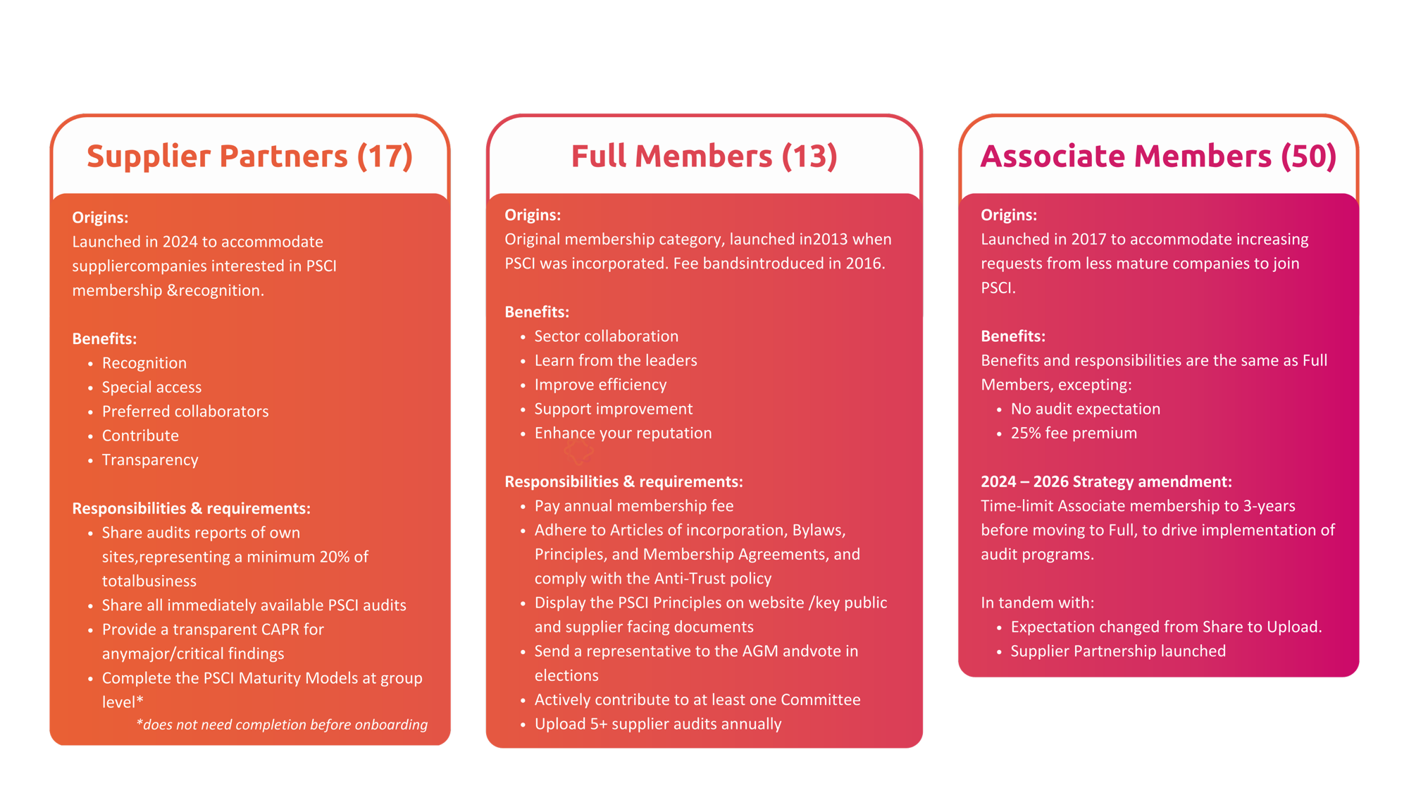
Overview: Members and Supplier Partners
Notes:
Detail on member benefits:
Sector collaboration: Come together as one voice to move the industry, joining a collaborative network of professionals working to drive responsible supply chain practices.
Learn from the leaders: Develop your knowledge, learning from the experts that are advanced in responsible practices in sector.
Improve efficiency: Access and contribute to the shared audit program, reducing audit duplication.
Support improvement: Use PSCI supplier resources to train your suppliers in accordance with the PSCI Principles for Responsible Supply Chain Management.
Enhance your reputation: Be a recognized advocate of a responsible pharmaceutical and healthcare value chain.
Detail on Supplier Partner benefits:
Transparency: Demonstrate your commitment to the PSCI Principles by sharing audits and completing the Maturity Models.
Contribute: Register interest in Teams and Committees to receive regular updates and be invited to consult on an ad-hoc basis.
Preferred collaborators: Option to collaborate with members on projects when invited, and opportunities to present at the PSCI supplier conferences.
Special access: In addition to standard supplier access, Supplier Partners have special access to customised content and can request visibility of audits posted by other companies, subject to approval of the audited company and sponsor.
Recognition: your logo on the PSCI website and the right to use the Supplier Partnership badge and pre-agreed text in marketing.

Slide 32

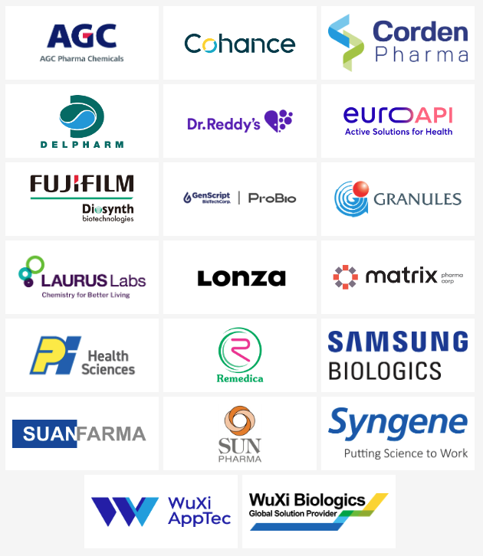
Our Supplier Partners

Slide 33
Supplier Partner Benefits
Supplier Partners gain access to these key benefits:
Greater transparency
One voice
Recognition
Join a global community committed to responsible business practices
Collaborate with customers & potential buyers via our Teams and Projects, inputting to best practices
Forum to share your expertise, with opportunities to present at conferences & webinars
Use of the PSCI Supplier Partnership logo on company website and promotional material.
Boost your reputation by becoming acknowledged externally for your dedication to responsible supply chain
Recognition & acknowledgment on PSCI website
Access to the PSCI shared audit platform, with over 2,000 supplier sites registered
Access to PSCI audit & environment survey reports of supplier sites (once permission granted)*
Invite your suppliers to share audits and environmental data
*Audit permissions: Before any audit is shared, both Supplier & Member must agree via our Data Sharing Agreement. They may agree to share with specific companies, all Members, or all Partners.

Slide 34
Topic & Regional Teams

Slide 35


Management Systems
Topic & Regional Teams
Ethics
Our three strategic pillars are supported in the creation of frameworks and tools, curriculum development, event delivery and impactful projects by the subject matter experts in our Topic Teams and local knowledge in our Regional Teams.
Topic Teams
Human Rights
Industrial Hygiene
Process Safety
Safety
Our Topic Teams
We have nine Topic Teams that each work in a specific area of the PSCI Principles. Subject matter experts in our member companies contribute their time and knowledge to support our key programs in Audit and Capability and deliver impactful Projects.
Decarbonisation
Environment
PiE & AMR
Our Regional Teams
Regional Teams
There are two PSCI Regional Teams in China and India. These teams use their local knowledge to develop important projects, and they drive the PSCI Supplier Conferences in these regions.

Slide 36
Engaging with us

Slide 37

Members
Getting the most out of your membership with PSCI
We encourage all our members to participate wherever they can, sharing their insights and expertise - collaboration enhances our collective success.
You can:
Attend PSCI events such as our member meetings, annual conferences, and webinars for knowledge sharing and networking opportunities
Keep up to date by regularly checking our website, following our social media, and reading our member newsletters
Join a topic or regional team to be directly involved in innovation
Communicate with your suppliers about the PSCI, sharing our work and ways they can participate, e.g. our Supplier Partnership Program

Slide 38
Suppliers
Getting the most out of your membership with PSCI
Maximize your PSCI engagement: share audits, access free expert events, assess your sustainability maturity, and meet customer ESG expectations.
You can:
Share PSCI audits and self-assessments of your facilities with multiple customers at once, reducing the burden of multiple audits
Access free, expert-led conferences, resources, and webinars on topics like decarbonization, anti-bribery and corruption, and sustainable packaging
Understand the maturity of your practices against the industry-agreed PSCI Maturity Model and track your improvements over time
Align with the expectations of your customers around sustainability and ESG topics

Slide 39
Audit firms
Getting the most out of your engagement with PSCI
We encourage auditors to use our resources, to share their experiences and to work alongside us. We are better together!
You can:
Become an approved audit firm. Find out more via the PSCI website. Once this is done, you can…
Access resources and online training to maintain knowledge and stay abreast of developments on important topics.
Access our free protocol for audits and SAQs, offering confidence that the audit reflects up-to-date and industry-agreed best practices.
Support efficiency and multiply the impact of audits you conduct, by a) using the PSCI audit protocol and b) encouraging its upload to the PSCI audit platform*.
*Audited suppliers and audit sponsors can upload audits to the PSCI platform. Both parties have data privacy rights to determine who can view the SAQ or audit report.
Notes:
Value case for auditors:
Access a free-to-use protocol for audits and SAQs.
Have confidence that your audit protocol reflects up-to-date and industry-agreed best practices.
Access support and training to maintain knowledge and stay abreast of developments on important topics.
Support efficiency and amplify the usefulness of audits you conduct, by using the PSCI audit protocol and audit sharing platform.
Be recognised for your organizational commitment to high quality auditing.

Slide 40
Appendices

Slide 41
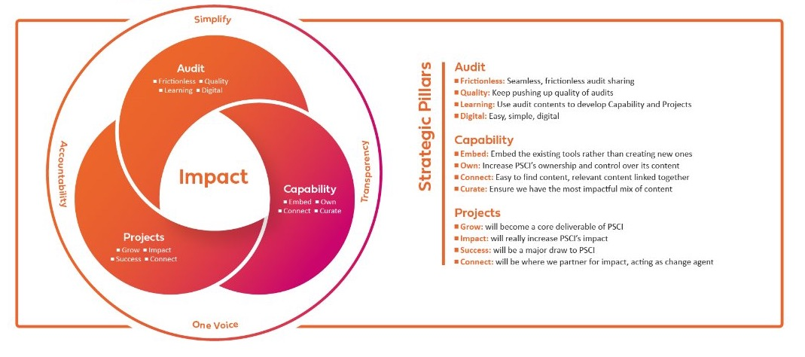
Our 2024-26 Strategy
In 2024, PSCI launched a new three-year strategy focused on deepening impact through its three core workstreams: Audit, Capability Building, and Projects.

Slide 42




Contact us
Get in touch to learn more about what we do:
www.pscinitiative.org
info@psciniative.org
+44 (0) 7587 076 059

