Slide 1
Introduction to PSCI Audits
Prepared by the PSCI Audit Committee

Slide 2
Agenda
PSCI Introduction
PSCI Shared Audit Program
The membership
The PSCI Principles
2021-2023 Strategy
Audit platform stats
Common audit findings
Remote audits – best practice sharing
Supplier Self-Initiated Audits
Audit sharing impact

Slide 3

THE PSCI VISION
Our VISION is for excellence in safety, environmental, and social outcomes across the whole of the global pharmaceutical and healthcare supply chain.
Notes:
This is our vision…
And our mission is to provide members with a forum to establish industry principles that guide ethics, labor & human rights, health & safety, environmental sustainability, and management systems practices to support continuous improvement of suppliers’ capabilities.

Slide 4

PSCI – INTRODUCTION VIDEO

Slide 5



















































THE MEMBERSHIP
51** companies already share the PSCI VISION and are committed to
continuous improvement in the supply chain
**Members as of August 2021
*Associate members have the following symbol: The rest are full members.
PSCI membership growth over the past years is shown in the appendix.
Notes:
We have 51 member companies and are governed by an elected Board of Directors which is our primary decision-making body.
The basic principle is inclusivity. PSCI welcomes all companies that are serious about embracing our vision in the pharma and healthcare supply chain.
Comment 2 levels of membership (Full and associate): more details in the appendix.

Slide 6
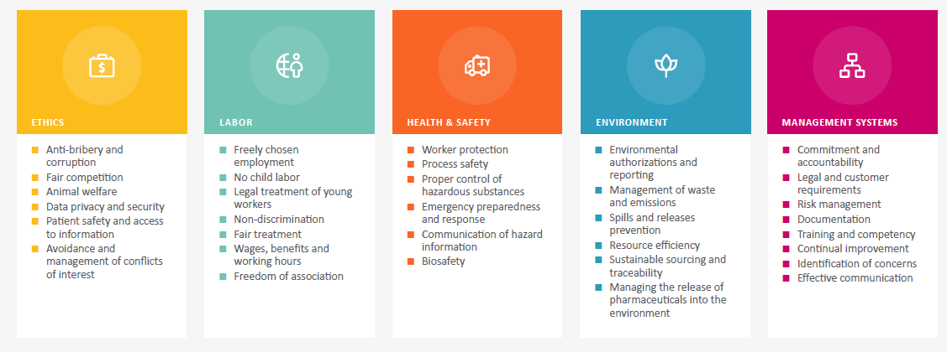
THE PSCI PRINCIPLES
FOUNDATIONAL COMMITMENTS: HUMAN RIGHTS, ENVIRONMENTAL SUSTAINABILITY, RESPONSIBLE BUSINESS

Slide 7
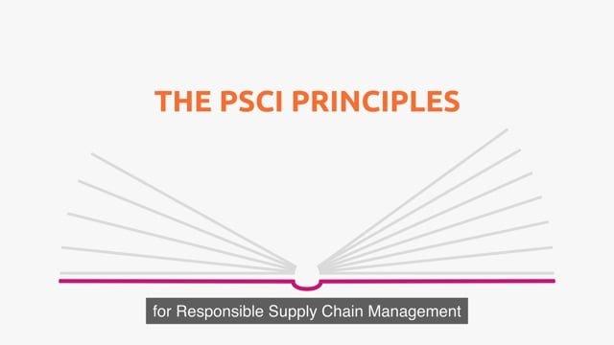
THE PSCI PRINCIPLES

Slide 8
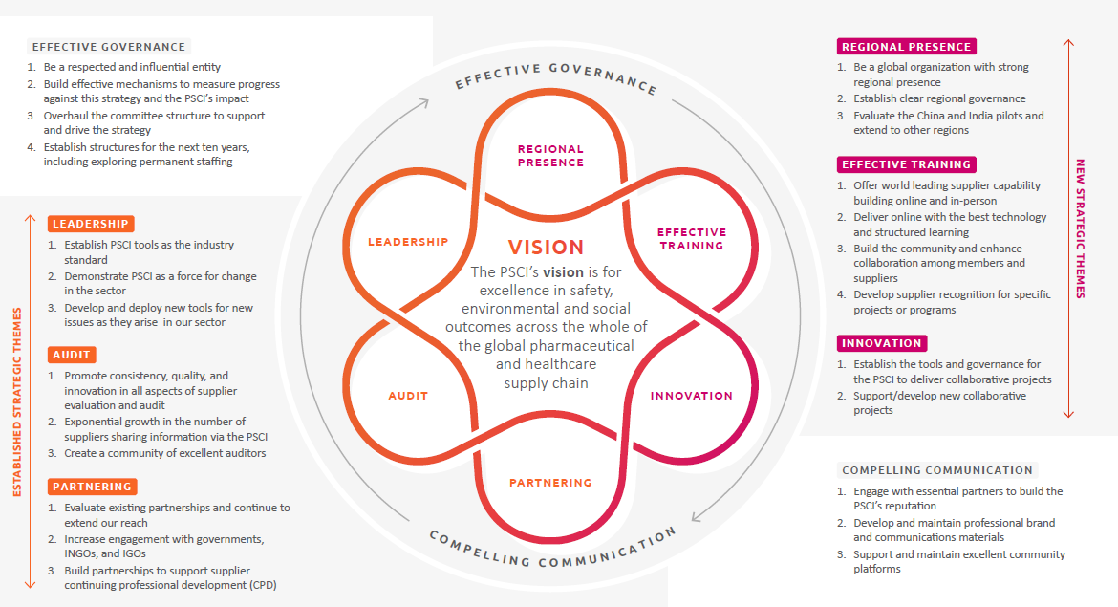
THE PSCI STRATEGY 2021-2023

Slide 9
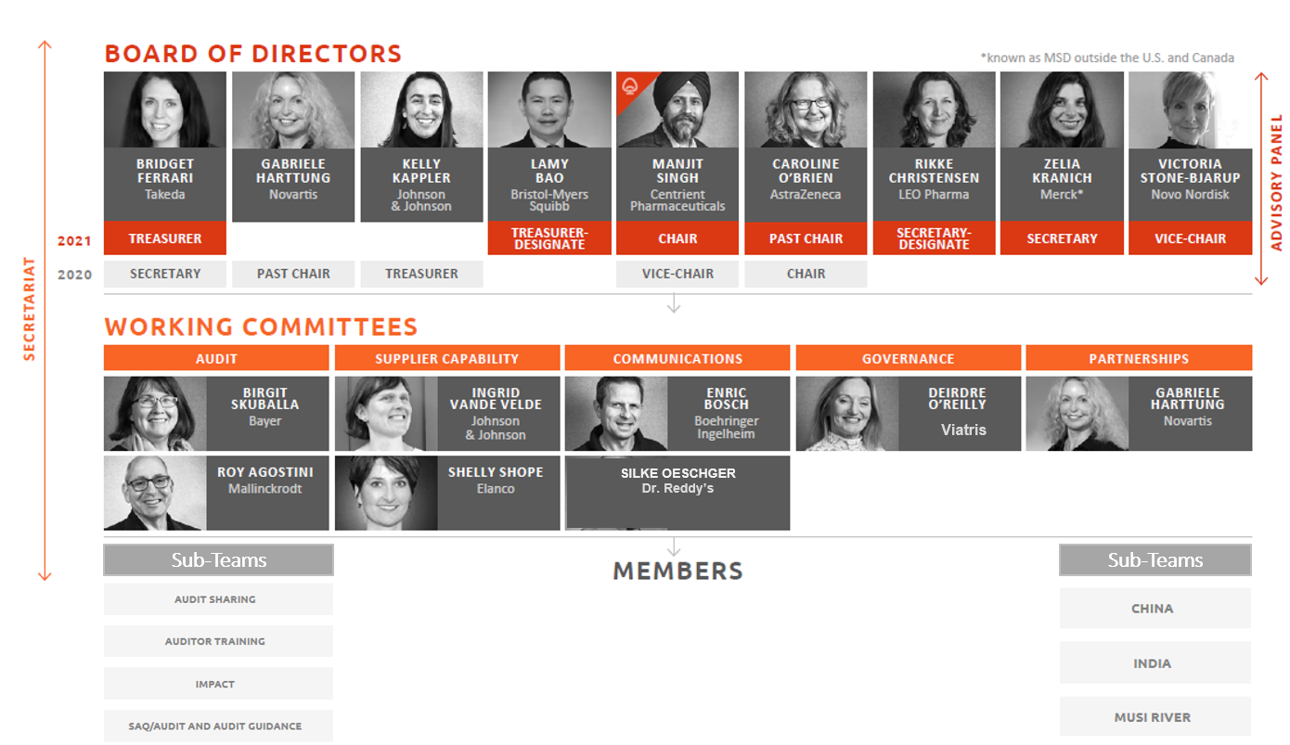
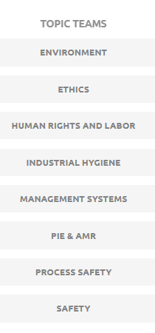
HOW WE WORK
Topic Teams
Notes:
PSCI has a Board of 5 Directors, elected by members, and is the primary decision making body.
They have set up 5 working committees to tackle key workstreams, adding the Partnerships Committee as a new working group in 2019.
Special project groups are set up when the need arises, e.g. last year the Sustainability Data project group which is now integrated into the Capabilities committee.
The Secretariat plays a supporting role. The Advisory Panel challenges the Board, more on the Advisory Panel on slide 19.

Slide 10
Agenda
PSCI Introduction
PSCI Shared Audit Program
The membership
The PSCI Principles
2021-2023 Strategy
Audit platform stats
Common audit findings
Remote Audits – best practice sharing
Supplier Self-Initiated Audits
Audit sharing impact

Slide 11
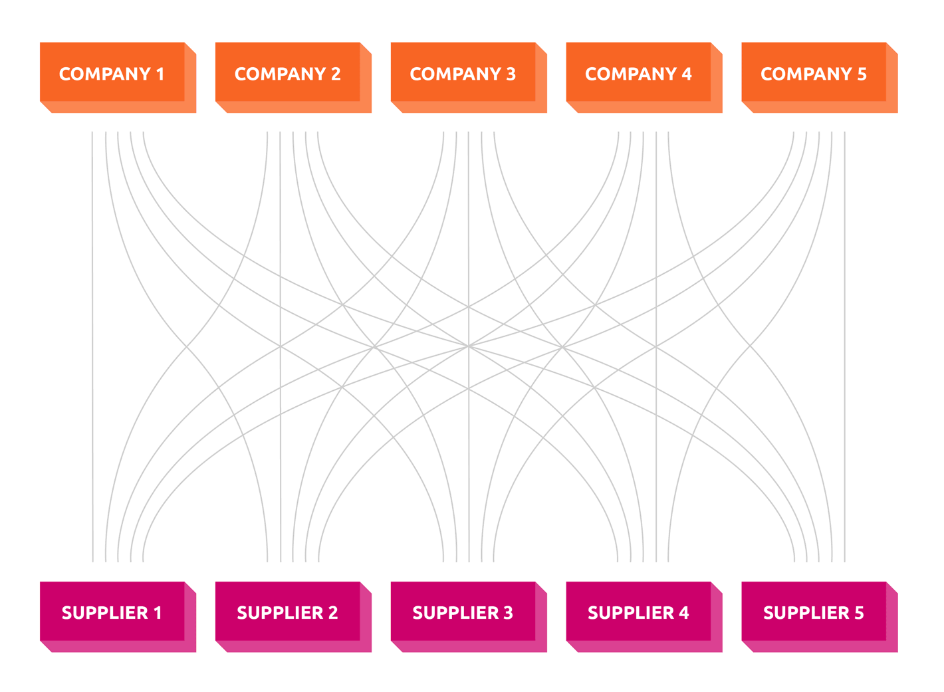
The PSCI Audit Program
Why collaborate on audits?
  Reduced duplication
  Cost and resource savings
  Greater visibility
  Better identification
  Continuous improvement
  One industry voice

Slide 12
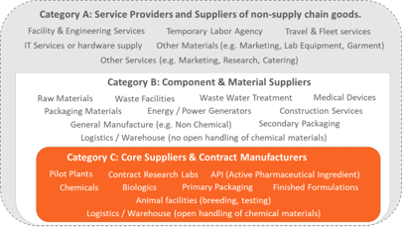
PSCI Audit Program (cont.)
Five-step audit process
1. Preparing for the PSCI Audit
4. Sharing the PSCI Audit
5. CAP follow-up
2. Carrying out the Audit
3. Audit report and corrective action plan (CAP)
Supplier categories
PSCI Audit Tools
Audit Guidance for PSCI Audits
Full SAQ & Audit Report template (Excel)
Abbreviated SAQ & Audit Report template (Excel)
Data Sharing Agreement
Pre-audit document request list
Full SAQ & Audit Report template (Word)
Abbreviated SAQ & Audit Report template (Word)
PSCI Supplier Self-Initiated Audit Brochure

Slide 13
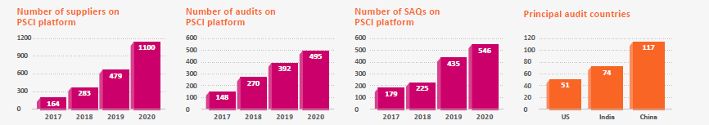
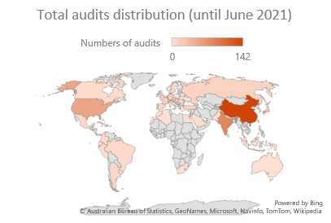
Audit platform statistics
As of Q2 2021, there were 548 audits on the Link.
  60 new audits have been added this year
  33% of them (179) are audited within 2 years, since 2019 July
  53% (292) are audited within 3 years.
Majority of the audits are from core suppliers (API, Finished Formulations, Chemicals)
Total downloads equalled over 3100. The top 4 downloaded audits are from suppliers in China (634), India (627), US (305) and Italy (276).

Slide 14
Audit Findings Analysis (2020)
92 of all the audits (103) uploaded in 2020 had findings. Among these 92 audits, 37 (40%) were conducted in 2020, 48 (52%) were audited in 2019 and 7 (7%) were audited in 2018.
Around 1200 findings were recorded for the audits, averaging 13 findings for each audit.
Over 80% of the findings are from API, Chemical and Finished Formulations suppliers, more than half of them are from China and India.
Around 1% of total findings are critical findings, consistent with what we found in 2019 analysis. The critical findings lie in H&S, Environment and Labor, but not in Ethics and Management System.
Notes:
This slide focuses on audits uploaded in 2020, which include those audited in 2018 and 2019. A detailed analysis on year on year comparison by audited year (instead of uploaded year) will be available on the Link prior to the Spring Meeting.

Slide 15
Audit Findings Analysis (2020)
  H&S has always been the area with most findings, accounting for around 50% of all the findings each year, followed by Management and Environment.
  Topics/subclauses with most findings:
    H&S: safety work permits, pallet racking related, electrical safety, PPE/RPE, risk assessment and monitoring, emergency evacuation
    Environment: Hazardous substance handling and storage, Environmental policies and goals
    Management System: supplier evaluation, risk management (business continuity planning, risk assessment scope, management of change), regulatory compliance
    Labor: overtime & overtime pay, labor policy scope
    Ethics: Policies & protocols not established, policy scope (e.g. not covering fair competition)
Notes:
This slide focuses on audits uploaded in 2020, which include those audited in 2018 and 2019. A detailed analysis on year on year comparison by audited year (instead of uploaded year) will be available on the Link prior to the Spring Meeting.

Slide 16
Remote, partly remote and onsite audits
Besides the established onsite site audits, PSCI Audits can also be conducted fully remote or party remote:
Fully Remote audit: the entire audit, including the verification of responses to questions within the SAQ, was conducted without onsite presence of the audit team via remote methods, such as livestreaming video, telephone/video call, etc.
Partly Remote audit: part of the audit was conducted remotely and part of the audit was conducted onsite.
Onsite audit: the audit and verification of responses to questions on the SAQ were carried out via onsite visit(s).
Further information can be found in the PSCI Audit Guidance.

Slide 17
Planning of Remote Audits (1)
Feasibility
Decide whether a full/partly remote audit is possible (PSCI member / 3rd party audit team, supplier)
Preferred technical tool(s)
for communication, virtual site tour and data exchange
Both the audit team and the supplier should be familiar with the selected tools (e.g. MS Teams, Skype, Zoom)
Data privacy
Selected tools should be checked and test beforehand
All information shared during any full or partly remote audit is to be treated confidentially and under consideration of data privacy regulations
In some cases, a confidentiality agreement may be required
Information/documents/ agreements needed prior to the audit
As a minimum, suppliers complete and provide the PSCI SAQ to the audit team
Further documents/information might be requested
Agreement on means of data sharing (e.g. cloud drive, vimeo, email, etc.)
Put together by PSCI member company Bayer

Slide 18
Planning of Remote Audits (2)
Evidence gathered and verification
Audit team checks the completed PSCI SAQ and focusses on questions/topics for which a certain level of evidence can be gathered
Time resources
Audit teams: Be ready to spend more time for any partly or fully remote audit. It is likely that similar or even more time will be required to conduct the overall audit.
Audit days / duration
Recommendation to split agreed number of audit days (e.g. 2 days) into several online meetings, e.g. 4 hours per day on overall 4 days (virtual meetings for ~ 8 hours can be very challenging for all parties)
Virtual site tour
In case a virtual site tour is possible, align on technology (e.g. live streaming via mobile devices and MS Teams, Google Glasses, Realware…)
Note that the social part of the PSCI audit is difficult to verify and only limited information can be gathered
Instead of a full site tour, emphasis should be put on selected areas or critical processes
Put together by PSCI member company Bayer

Slide 19


Conducting Remote Audits
  Be aware that a remote audit is a different type of audit, with different situations, different levels of input, no comprehensive site tour, etc.
  Each meeting/interview session needs to be well prepared (both from auditors as well as from suppliers). Good time management is required.
  Remain flexible as unforeseen situations will arise. Try to find the simplest and most efficient solution to resolve any issue.
  If possible and connectivity allows, all parties should keep the camera switched on. Even in virtual meetings, it is possible to recognize facial expressions/body language to some extent, and realize e.g. whether all participants feel comfortable.
  Maintain good auditor interpersonal skills - communication is key. Auditors should be senior and experienced in auditing.
Put together by PSCI member company Bayer

Slide 20
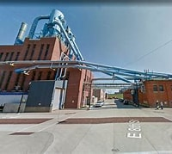
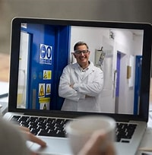
Virtual Site Tour
  Conducting a virtual site tour is only possible if the supplier allows this.
  Site tours can be realized by using audio-visual tools, e.g. cameras on mobile devices.
  Some challenges of a virtual site tour compared to an on-site audit:
    Supplier staff needs to be familiar with the applied technology, e.g. mobile device connected to MS Teams
    Supplier staff needs have time enough to change to different locations, e.g. from production to technical areas
    Special requirements of ex-areas (e.g. use of intrinsically safe devices) need to be considered
    Disturbances can be caused by poor/no WIFI connectivity but also by noise from machinery, HVAC systems etc. Low battery charge due to longer tours may become an issue as well.
  Auditors and suppliers need to align and confirm focus topics/areas, e.g. production activities the audit team would like to see and when they take place.
  Recording of virtual site tours is generally not permitted.
Put together by PSCI member company Bayer

Slide 21
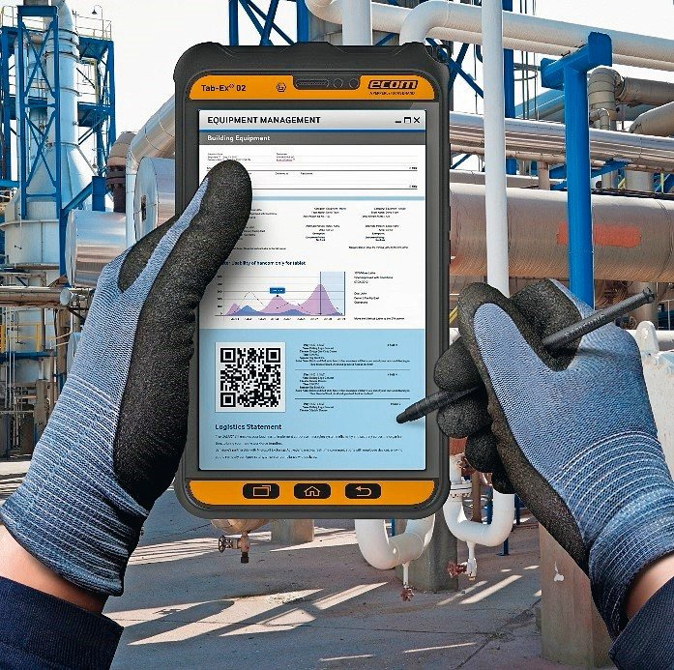
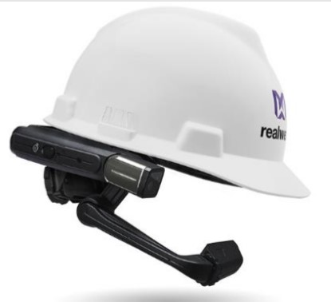


Remote Audits – best practice example
Technology – best practice Adapted from the communication between a supplier and a client’s tech team. The client was happy with this remote test experience and they can trust what they see.
Hardware: an intrinsically safe tablet with camera Communication tool: Zoom Network: intranet + internet. The pad connects to the intranet (WIFI) and then can connect internet and uses approved Applications. The client’s tech team can request what they want to see in the Zoom meeting and our operator can show it via the tablet. The client can check the parameter and operation conditions via the tablet with camera.

Slide 22
Supplier Self-Initiated Audits
What is a supplier self-initiated audit?
A supplier self-initiated audit is completed by an approved third-party audit firm and shared with other PSCI members on the PSCI platform
A proactive approach (pending a request from a PSCI member or their supplier)
Any PSCI Member or supplier to PSCI Member may take advantage of a supplier self-initiated audit (onsite or remotely are current acceptable methods)
You, as a supplier, may request a supplier self-initiated audit to a PSCI Member company or the PSCI Secretariat. PSCI funding is available for a limited number of audits in 2021.

Slide 23
How to conduct Supplier Self-Initiated Audits
Supplier screens and selects a suitable PSCI approved audit firm
  A supplier self-initiated audit can be conducted in locations where audit firms have expressed competency
  Audit firms provide qualified auditors for conducting the audit
  Supplier owns the audit and bears the audit cost
The audit should use the PSCI published tools and guidance
  PSCI Audit SAQ and Audit Report Templates: EXCEL, WORD | PSCI Audit Guidance
  Both onsite and remote methods are acceptable
Supplier loads and shares his report on the PSCI platform with PSCI members. A user guide for uploading and sharing audits is available.

Slide 24
Benefits of Supplier Self-Initiated Audits
The SSIA Program:
  Results in high quality audits because it uses the PSCI audit process including approved audit firms, audit protocols, redacting and sharing
  Has the potential to reduce the audit burden on the supplier such as the number and scale of future audits
  Offers flexibility to suppliers because they will be more in control of timing, logistics, and scope
  Will tip the scales toward more suppliers being audited than would otherwise occur
  Provides the PSCI membership with more supplier options
  Allows the supplier to be proactive by identifying risks and opportunities

