Slide 1



Road Safety in India
Rajani Chavan
Mahesh Chandak
Bayer
06 Nov 2025

Slide 2




Speakers
Mahesh Chandak
Head of SSHE - South Asia & Global Road Safety Lead, Bayer
30+ years of SSHE experience including industry and consulting
Global Road Safety Lead at Bayer
Member - CropLife International Road Safety Team
Member – Federation of Indian Chambers of Commerce & Industry (FICCI) Road Safety Team
Rajani Chavan
South Asia SSHE Enablement Lead, Bayer
25+ years of SSHE experience including industry and consulting
Leading India Road Safety Program at Bayer
Proven excellence in driving Health & Wellness, Safety, Human Rights programs across Asia – Pacific
Global Change Champion at Bayer in New Ways of Working
SSHE - Sustainability, Safety, Health, Environment
Notes:
SSHE - Sustainability, Safety, Health, Environment

Slide 3


ANTI-TRUST
Key points to avoid in our discussions:
Reveal commercial relationships between buyers and suppliers, whether current, past or potential.
Share experiences working with a supplier, except audits shared on the platform (which are data-secured and controlled for privacy).
Discuss pricing or quality received from suppliers – including indirect suppliers (e.g. service providers)
Share market insights or proprietary information on products e.g. product development.

Slide 4

Agenda
Why talk about Road Safety?
Program Elements
Key Takeaways
Q&A
ROAD SAFETY

Slide 5

Why talk about Road Safety?

Slide 6
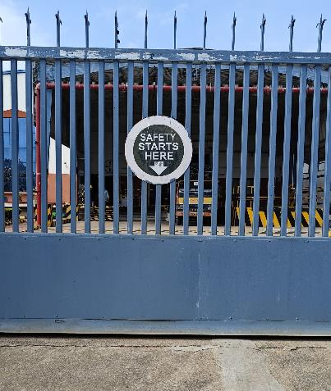
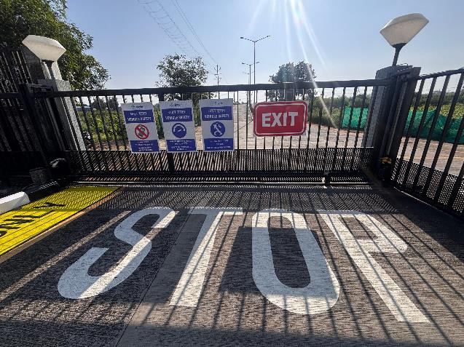




What is our messaging on Corporate’s Safety Responsibility?
Site Entrance
Site Exit
Notes:
Road Accidents in India – MORTH

Slide 7


It is a global challenge yet to be solved
Globally there are over 1300K deaths from road accidents including 170K in India.
> 50% road fatalities are vulnerable traffic participants: pedestrians, motorcyclists, or cyclists
UN Decade for Road Safety: In 2021, UN pledged a decade of action for road safety to reduce road deaths and injuries by 50% by 2030 but progress is lacking.
Road accidents are the leading cause of fatal injuries for employees in most industries (both on or off the job)
Most collisions are linked to our behavior on the road and are preventable!
Notes:
road accidents are the leading cause of fatal injuries for employees in most industries
Most of the high severity injuries reported at Bayer are related with Road Safety, which is by far our #1 risk for severe Injuries and fatalities
So far in 2023, we have reported over 400 collisions with 19 of them resulting in injuries; 5 were high severity injuries and 2 of those were fatalities! This is more than half of the total reported high severity injuries (status 2023-05-22). Although a team of experts has been working to gather road safety data, significant data gaps still exist. These are staggering numbers to include in your conversations on importance of this topic.
Bayer’s commitment to sustainability includes our promise to look after the health, safety, and well-being of everybody working with us. The right to health and safety are core human rights.
We want to avoid every accident – but especially the severe ones. We want everyone to go back home healthy and safe - every day.

Slide 8

The Worrisome Reality of Indian Roads
40,000
1,72,890
Road Accident Fatalities in India
84,000
Source: Road Accidents in India 2023 by MORTH
Notes:
Road Accidents in India – MORTH

Slide 9
Road Risk Exposure for Pharma Sector
Urban & Rural
Sales Reps
2 & 4-Wheeler
2 & 4-Wheeler (Own)
Personnel on the Road
Work Commute
Buses, Tempos & Cabs
Bulk Chemicals
Logistics
Finished Goods

Slide 10

Road Safety Program Elements

Slide 11
Building a Robust Road safety Program
Policy & Planning Ahead
  Develop & enforce robust road safety policy
  Journey planning & developing boundary conditions for 4W/ 2W use
  Exchange best practices with value chain & leverage CSR programs
Positive Culture
  Visible leadership commitment in team meetings and campaigns
  Robust incident reporting for targeted actions & proper root cause analysis
  Performance monitoring & trend analysis for key metrics
  Strong Management Review by road safety Steering team
Safe driving skills & behaviour
  Differentiated training programs (induction & refresher)
  Telematics to observe driver behaviour and make meaningful intervention
  Peer drives for feedback
  Communication campaigns to reinforce key messages
Safe Vehicles
  Minimum safety standards for vehicles used for company business based on job risk
  Proactive maintenance protocols
  Need to consider mandatory helmets and protective gear for motorcycle users
Notes:
Preparing for a safe drive: Conduct self and vehicle checks before every ride to ensure fitness and roadworthiness.
Traffic rules and compliance requirements: Understand traffic signs, signals, and the “language of the road” for safer navigation.
Safe Riding Practices: Follow speed limits, wear protective gear, and stay alert to surroundings.
Emergency response: Stay calm, use hazard signals, and seek immediate help when needed.
Stay Protected: Prevent heat stress and always adhere to rules for personal and road safety.

Slide 12
Road Safety Program Elements
- Safe vehicles
- Safe Driving Skills & Behaviours
- Promoting Safety Culture
- Policy and Planning Ahead
  Minimum vehicle safety standards based on job risk
  Proactive maintenance protocols
  Mandatory helmets and protective gear for motorcycle users

Slide 13
Essential safety features for company vehicles
Mandatory / Essential Features in Cars
  Dual Front Airbags: Mandatory for all new cars in India since July 2019.
  Anti-lock Braking System (ABS) with Electronic Brakeforce Distribution (EBD)
  Electronic Stability Control (ESC) / Electronic Stability Program (ESP)
  Seatbelt Reminders
  Speed Alert Systems
  Rear Parking Sensors and Rear-view Camera
  High-Strength Body Structure / Reinforced Cabin
  Fire Extinguisher and First-Aid Kit
  Warning Triangles/ Reflective Light
  In-Case of Emergency (ICE) Card in glovebox
NCAP (New Car Assessment Program) evaluates vehicles in three main areas:
  Adult Occupant Protection (AOP): Measures protection for adult passengers in frontal and side impact crashes.
  Child Occupant Protection (COP): Assesses protection to child dummies in the rear seats using appropriate child restraint systems.
  Safety Assist Technologies (SAT): Awards points for the fitment of active safety features like Electronic Stability Control (ESC), seatbelt reminders, and pedestrian protection systems.
  NCAP Ratings: Range from 1 to 5 stars, with 5 being the highest level of safety performance based on crash tests.
Ensure all safety features are functional and consistently used. Conduct regular checks and maintenance of the vehicles
Notes:
Electronic Stability Control (ESC) helps control during skidding or loss of traction by automatically applying individual wheel brakes and, if necessary, reducing engine power
A pedestrian protection system (PPS) technology protect pedestrians in the event of a collision. These systems use sensors to detect a pedestrian and then activate active features, like lifting the engine hood, to create a more forgiving impact zone, or passive features, such as external airbags and redesigned vehicle structures. The ultimate goal is to either prevent a collision or, if unavoidable, reduce the severity of the impact on the pedestrian.

Slide 14
Road Safety Program Elements
- Safe vehicles
- Safe Driving Skills & Behaviours
- Promoting Safety Culture
- Policy and Planning Ahead
  Differentiated training programs (induction & refresher)
  Telematics to observe driver behaviour and make meaningful intervention
  Peer drives for feedback
  Communication campaigns to reinforce key messages

Slide 15
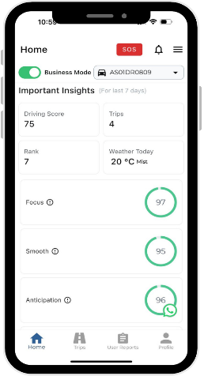
Telematics to drive engagement and promote safe behaviours
AI-powered mobile app to monitor and analyze driving behavior
At-risk driving parameters:
  Harsh acceleration
  Harsh braking
  Phone handling
  Over-speeding
  Harsh cornering
Provide actionable insights
Security & Privacy considerations
  Personal & Business Mode
  Role-based access control
  GDPR Compliance
Courtesy: SafetyConnect mobile app

Slide 16








Conduct Interactive Workshops to shape Mindset & Behaviours
Take CARE on the Road Workshops
Distractions
  Visual – Auditory - Physical- Cognitive
Concentrate on the road
Avoid all distractions and keep your mind clear
Non-Compliance
Always follow Rules
Wear a seatbelt / helmet and comply with local road safety laws
  Not aware or not complying with
  rules
Aggression
  Honking – Irritation – Rash driving
Relax & enjoy your ride
Keep emotions in check and limit your speed
Fatigue
Energize for a safe drive
Prepare for your ride and keep your energy levels up
Sleepy-Tired-Less Alert-Low Energy

Slide 17
Road Safety Program Elements
- Safe vehicles
- Safe Driving Skills & Behaviours
- Promoting Safety Culture
- Policy and Planning Ahead
  Visible leadership commitment
  Robust incident reporting & proper root cause analysis
  Performance monitoring & trend analysis
  Strong Management Review by road safety Steering team

Slide 18
Improve Risk Perception and Reporting
Focus on leading indicators and identify potential for severe injury or fatality
0
Road incidents pose potential for Severe Injury/Fatality (SIF)
Need to improve risk perception on road to identify and report
Engage business leaders for safety performance management review and take timely actions
Severity of incident
Fatality
Do not be Reactive - & wait for injuries to happen
Recordable
Injury
1
Collision with Injuries'
First Aids
5
Collision without injuries
(Near Misses)
30
Encourage Proactive reporting &
take actions
Unsafe behaviours from telematics/
peer drive feedback (Safety Observations)
150
Notes:
Collision with Injuries

Slide 19
Ensure Proper Investigation & Share Lessons Learnt
Incident reporting
Leading and Lagging indicators
Investigation
Inherent challenge to follow hierarchy of controls
Share learnings
Periodic messaging required to build awareness
CAPA
Need to enhance culture for continual improvement
  To identify root cause and define appropriate CAPA
  Professional third parties now available in India

Slide 20
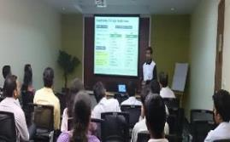
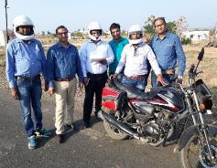

Sustainable/ Continual Improvement by enhancing Safety Culture
Awareness
Accountability
Ownership
We know the programs, rules and requirements
We hold each other accountable to practice safe behaviours
I practice and model safe behaviours

Slide 21


Fostering Ownership amongst
Two-wheeler Riders
Conduct more periodic sensitization campaigns
Involve families in select campaigns
Make helmet use mandatory and include it as cardinal rule in policy
Promote other protective gear like shoes, elbow and knee guard, laptop bag with reflective tape, etc.
Laptop bag with high visibility band provided to two-wheeler riders
Keychain with helmet and family message
providedtwo-wheelereler riders
Notes:
Sharing example of keychain with helmet message

Slide 22
Road Safety Program Elements
- Safe vehicles
- Safe Driving Skills & Behaviours
- Promoting Safety Culture
- Policy and Planning Ahead
  Develop & enforce robust road safety policy
  Journey planning & developing boundary conditions for 4W/ 2W use
  Exchange best practices with value chain & leverage CSR programs

Slide 23
Road Safety Policy Elements
- to Foster Employee Ownership
1. Define Cardinal Rules Non-negotiables, e.g. statutory documentation, mobile use, helmet/seat belt, DUI etc. | 2. Include Critical Awareness Elements 3-second rule, vehicle check and maintenance, load management, emergency response
3. Integrate road safety into business
4-wheelers 15-minute stretch break every 2 hours of driving No driving on highways between 9 p.m. - 5 a.m. <300 km / day of driving | 2-wheelers 10-minute stretch break every 1 hour of riding No driving on highways between 7 p.m. - 6 a.m. <100 km / day of driving
4. Make road safety an organizational topic Define roles and responsibilities e.g. People Managers - Accountable for team’s compliance, providing resources and fostering culture HSE – Awareness training, incident investigation and sharing learnings Vehicle Fleet Management – providing safe vehicle and facilitating proper maintenance Human Resources – Consequence Management – Rewards/ Penalties

Slide 24

Key Takeaways

Slide 25
Road safety program – The Road Ahead
  Aspire for Zero fatalities on the road and continuous reduction in high-severity injuries
  Form Road Safety Steering Team and Champions Team
    Steering Team – Leaders from all business and functional stakeholders (Business, Fleet Team, HR, Legal, etc.)
    Champions Team – Enthusiastic volunteers from various teams to drive the program implementation
  Improve reporting rigor and facilitate exchange of incident learnings and best practices
  Design and Implement fit-for-purpose programs
    Improve program maturity in 4 program elements based on PDCA cycle
    Improve organizational awareness and team accountability for employee ownership and safe driver behaviours
  Periodic campaigns e.g. during India Road Safety Month (Jan) and UN Road Safety Week (May)
  Engage with your value chain and leverage CSR initiatives for road safety
Notes:
Support community road safety education programs in collaboration with civil society in LMIC
Support campaigns targeting vulnerable groups like children, cyclists, and motorbike users
Sponsor micro-infrastructure projects such as safe crossings, reflective signage, and speed calming measures in high-risk zones near our sites
Engage employee volunteers for community initiatives & school outreach programs near our sites

Slide 26
Q&A

Slide 27

Register now for last webinar of 2025 on Human Rights
Webinar scheduled for December 11, 2025
Scan the QR code or click the link in the chat to register for the Human rights webinar and
Please forward registration details to relevant colleagues in your organizations and supplier
Over 600 participants have joined PSCI India webinars in 2025 YTD
We look forward to your continued participation!

