Slide 1
PSCI Webinar
Managing active pharmaceutical ingredients (API) in manufacturing effluent
January 2016

Slide 2
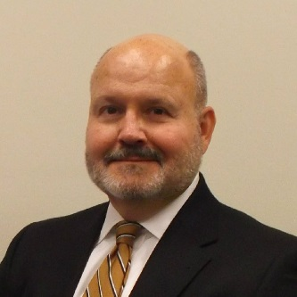
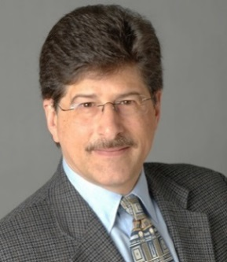

Our speakers
Dan Caldwell, J&J
Dan Caldwell is a Toxicology Fellow in Environment, Health, Safety & Sustainability at Johnson & Johnson. His focus is science advocacy for regulatory assessment of environmental exposure to chemical ingredients. He chairs the Inter Association Initiative PiE Task Force Environmental Control Work Group.
Frank Mastrocco, Pfizer
Frank Mastrocco is Pfizer’s Director of Environmental Toxicology for the Global Environment, Health, and Safety – Product Stewardship Group. His responsibilities include environmental risk assessment support to manufacturing and established product operations and lead representative in the area of Pharmaceuticals in the Environment (PiE).
Visit: www.pscinitiative.org Email: info@pscinitiative.org @pscinitiative

Slide 3
Managing active pharmaceutical ingredients (API) in manufacturing effluent
Dan Caldwell, J&J and Frank Mastrocco, Pfizer
January 27, 2016

Slide 4
Agenda
1 | Why is managing active pharmaceutical ingredients (API) in manufacturing effluent important and what is the industry doing to improve public perceptions?
2 | Understanding where you stand at the moment and how to advance your program to the next level through the maturity ladder concept.
3 | Calculating API discharge concentration called the Predicted Environmental Concentration (PEC) and comparing it to the Predicted-No-Effect-Concentration (PNEC).
4 | Simple steps to reducing API process losses to waste water and what to do when the PNEC is exceeded.

Slide 5
Agenda
1 | Why is managing active pharmaceutical ingredients (API) in manufacturing effluent important and what is the industry doing to improve public perceptions?
2 | Understanding where you stand at the moment and how to advance your program to the next level through the maturity ladder concept.
3 | Calculating API discharge concentration called the Predicted Environmental Concentration (PEC) and comparing it to the Predicted-No-Effect-Concentration (PNEC).
4 | Simple steps to reducing API process losses to waste water and what to do when the PNEC is exceeded.

Slide 6
Why is managing active pharmaceutical ingredients (API) in manufacturing effluent important?
First, and foremost, we all need to do what we can protect the environment.
  The ecosystem serves your community, protecting it improves quality of life
It’s good ‘business-sense’
  Stakeholder concerns are prompting regulators to take actions that will impact our business model
  Sustainable Investors and product procurement programs are extending their research across the supply chain and considering the addition of ‘environmental considerations’ to their decision-making process

Slide 7





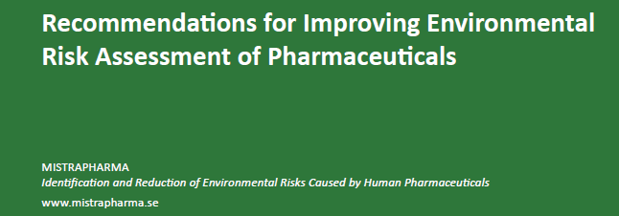
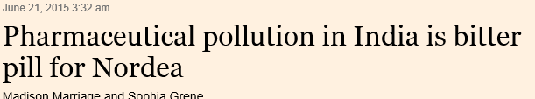
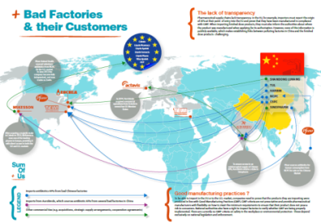
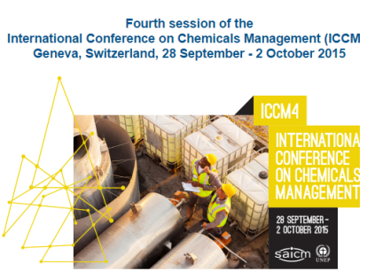
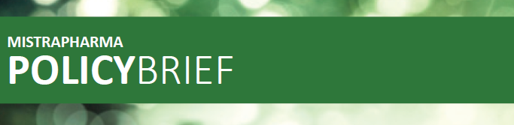
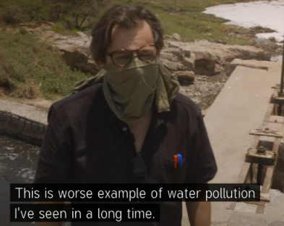
Stakeholders voicing their concerns
Focus on the Pharmaceutical Supply Chain
Mistra Pharma - Swedish research center briefs EU Parliament, recommends including manufacturing losses in drug approval decision (June 2, 2015)
Sum of Us – Activist group proposes link between antibiotic contamination from Chinese suppliers and antimicrobial resistance. The report, ‘Bad Medicines’ names several major companies (June 11, 2015)
Nordea - The largest Nordic financial services firm expresses concerns with water pollution in India from pharmaceutical suppliers (June 21, 2015)
SAICM – UNEP declares pharmaceuticals as a new emerging policy issue with focus on developing countries (October, 2015)
1
2
3
4

Slide 8
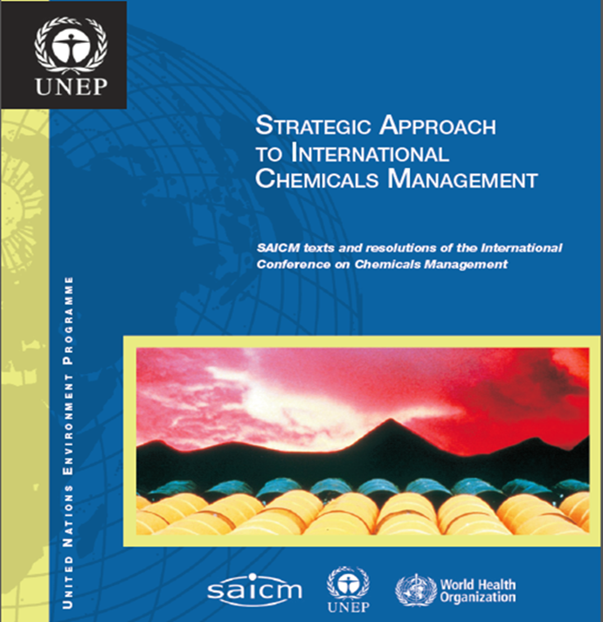
Stakeholders voicing their concerns
At its first session, held in Dubai, United Arab Emirates, from 4 to 6 February 2006, the International Conference on Chemicals Management adopted the Dubai Declaration on International Chemicals Management and the Overarching
Policy Strategy. The Conference also recommended the use and further development of the Global Plan of Action as a working tool and guidance document. Together these three documents constitute the Strategic Approach to
International Chemicals Management.
Emerging Policy Issues:
Lead in Paint
Chemicals in Products
Endocrine Disrupting Chemicals
Hazardous substances in electrical and electronic products
Nanotechnology and manufactured nanomaterials
Environmentally Persistent Pharmaceutical Products*
*Added October, 2015

Slide 9
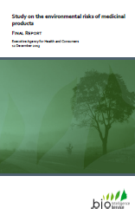
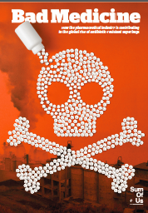





Stakeholders voicing their concerns
THREAT
Environment parameter added to GMP, Approval or Procurement | [Manufacturing included in ERA]
It is clear that there is a Global Focus on Manufacturing Efficiency

Slide 10
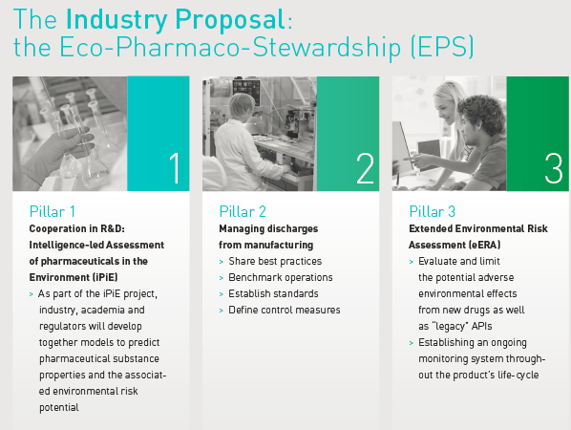
What is the industry doing to improve public perceptions?
The Eco-Pharmaco-Stewardship ‘Pillars’

Slide 11
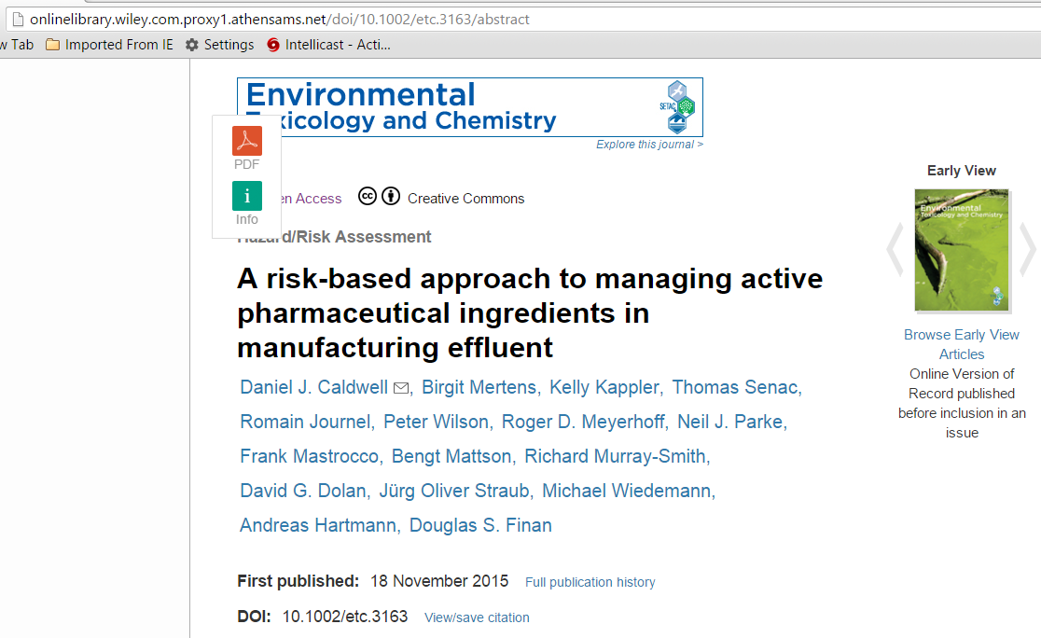
Industry Guidance: The focus of this webinar
PSCI Webinar: Managing manufacturing effluent | January 2016

Slide 12
Agenda
1 | Why is managing active pharmaceutical ingredients (API) in manufacturing effluent important and what is the industry doing to improve public perceptions?
2 | Understanding where you stand at the moment and how to advance your program to the next level through the maturity ladder concept.
3 | Calculating API discharge concentration called the Predicted Environmental Concentration (PEC) and comparing it to the Predicted-No-Effect-Concentration (PNEC).
4 | Simple steps to reducing API process losses to waste water and what to do when the PNEC is exceeded.

Slide 13
Wastewater Maturity Ladder
High-Level
Step 6
Integrate & maintain continuous improvement
*Process technology reviewed and evaluated for BAT
*If direct discharge , is TIE (Toxicity Identification Evaluation) done?
-Whole effluent testing (acute/chronic)
*If direct discharge , is TRE (Toxicity Reduction Evaluation) done?
-Techniques to reduce toxicity tested implemented?
*Rational water management
-Awareness campaign
-Effluent reuse
-Rainwater capture/use
*Advanced training including microscopic sludge analysis
-Microorganism activity level
-Floc forming bacteria identification (staining)
-Filament identification
Advanced
Step 5
Audit/Benchmark
Share/implement best practices
*Opportunities for improvement identified and evaluated
-Audit of production and WW treatment as they relate to each other
-Evaluation of water and product use in production to investigate technology efficiency and effectiveness
*Have operational efficiencies been benchmarked and improvements evaluated?
-Comparison of performance of similar plants in order to optimize
-Comparison of operational costs of similar plants in order to optimize
Step 4
Control Risks
*Wastewater acceptance policy
-Dedicated acceptance person
-Awareness of the impact of new waste streams
-Procedures available/in place
*Awareness/evaluation of value of microscopic sludge analysis?
*Water consumption optimization awareness
*Preventative maintenance program
*Trending of important parameters and process deviations
*Operational WWTP emergency procedure
-Back-up power available
-Failure alarm system for critical equipment
-Personnel available 24/7
Minimum
Step 3
Assess Risks
*Removal efficiency of organics and nutrients evaluated and in line with design
-COD, BOD, N, P removal
*Rest capacity understood
*Spill/Calamity control in place
-Awareness
-Procedures available/in practice
*Advanced training
-WWT organizations
-Follow-up training
-Advanced data interpretation and evaluation
*Integration of production planning and WWT capacity/capability
*Evaluation of water and pollution balance
-Water consumption in production? Rainwater
-Sound water and mass balance
Step 2
Easy fixes, quick wins, must do’s toward prevention and compliance
*Communication link WWTP w/Production
Communication and Planning
*Basic spill /calamity procedure
-Calamity tank available
-External processing
*Regular follow-up of WWTP
-Influent characterization
-Sludge characterization
*Redundant critical equipment
-pumps, blowers available
*WWTP laboratory safe and controlled
-General lab safety rules
-Regular instrument calibration
Step 1
Commit & Plan
Basic awareness & knowledge
*Legal compliance and knowledge about fate and nature of effluent
-Fate of effluent known and fully permitted
-yearly discharge volume accounted for
*Monitoring effluent characteristics and standards
*Dedication of assigned persons for WWT
*Basic training of WWT responsible persons
*Understanding design capacity and performance

Slide 14
A word about permits
Most discharge permits will address established parameters, e.g., control of pH, biological oxygen demand, chemical oxygen demand, etc.
Some discharge permits include periodic general toxicity testing, i.e., whole effluent toxicity
Most discharge permits will NOT directly address active pharmaceutical ingredients (APIs) but DO include a ‘general duty’ clause, i.e., “No toxics in toxic amounts”.
Zero discharge doesn’t always equal ‘zero risk’
  Ground dispersion may result in:
    Dermal/inhalation exposure to applicator and/or recreational users
    Edible vegetation and/or groundwater users
    Terrestrial organisms
    Mist inhalation from opened cooling uses.

Slide 15
Agenda
1 | Why is managing active pharmaceutical ingredients (API) in manufacturing effluent important and what is the industry doing to improve public perceptions?
2 | Understanding where you stand at the moment and how to advance your program to the next level through the maturity ladder concept.
3 | Calculating API discharge concentration called the Predicted Environmental Concentration (PEC) and comparing it to the Predicted-No-Effect-Concentration (PNEC).
4 | Simple steps to reducing API process losses to waste water and what to do when the PNEC is exceeded.

Slide 16
What Is an Environmental Risk Assessment?
Good management practices may not eliminate all API released to water
Your responsibility is to know whether the amount released could have a potential impact on the environment and to take appropriate action
Environmental Risk Assessment requires data and professional judgment
Predicted Environmental Concentration (PEC)
Predicted No Effect Concentration (PNEC)
Risk Quotient (RQ)
PEC /PNEC <1, Low risk
PEC /PNEC >1, Potential risk:
Reassess/take appropriate action
PSCI Webinar: Managing manufacturing effluent | January 2016

Slide 17
Mass Balance: Approach
Waste, Air (mass or %)
Product (mass)
Waste, recovered
(mass or %)
Input (mass)
Site WW Flow rate, m³/d
Waste, Effluent
(mass or %)
PSCI Webinar: Managing manufacturing effluent | January 2016

Slide 18
PEC Data Collection & Analysis
Review batch records to determine API losses
Estimate API losses (account for batch and cleaning cycles)
Estimate treatment plant removal efficiency using the API chemical and physical properties, literature, or assume 0%
Get wastewater and receiving water flows
Examples
On-Site
Off-Site
batch records
product yield
batch/year
cleaning cycles
wastewater POG¹
wastewater flows
WWTP unit ops
API analyses²
POTW flow
POTW unit ops
receiving water flow
  1 POG = Point of Generation
  2 API analysis of wastewater, solvent waste, solid waste, etc.

Slide 19
Deriving the PNEC
No Observed Effect Concentration (NOEC)
PNEC
=
Assessment Factor (AF)
  No Observed Effect Concentration (NOEC): The amount of a substance where no harm to an organism has been observed
  Lowest Acute Effect Concentration (LC): The smallest amount of a substance that will harm an organism. Expressed as LC₅₀ or EC_{50.} Acute studies used when no chronic data are available.
  Assessment Factor: Factor used to account for uncertainties; varies inversely with strength of data set

Slide 20
Sources of PNEC Information
Published data – Journals such as: Environmental Toxicology and Chemistry, Environmental Science and Technology, Aquatic Toxicology, others
Vestel, J. et al. Use of acute and chronic ecotoxicity data in environmental risk assessment of pharmaceuticals, Environmental Toxicology and Chemistry, Accepted Article DOI: 10.1002/etc.3260
PSCI Webinar: Managing manufacturing effluent | January 2016

Slide 21
Database of Pharmaceutical PNECs
Temple University Water & Environmental Technology Center
Database of curated aquatic toxicity data and PNECs for APIs
Contains information from Vestel paper plus additional compounds
Currently accessible by Center members (password protected); discussions in 2016 for open access
PSCI Webinar: Managing manufacturing effluent | January 2016

Slide 22
Example of database information
Compound Name | Therapeutic Class (Assigned) | AHFS Primary Classification | AHFS Secondary Classification | Species | log Dow | Acute E(L)C₅₀ (mg/L) | Chronic NOEC (mg/L) | Acute PNEC (mg/L) | Assessment Factor for Acute PNEC | Chronic PNEC (mg/L) | Assessment Factor for Chronic PNEC
diclofenac | Central Nervous System | 2800 Central Nervous System Agents | 2808 Analgesics and Antipyretics | Daphnia | 4.51 | 80.1 | 10
diclofenac | Central Nervous System | 2800 Central Nervous System Agents | 2808 Analgesics and Antipyretics | Fish | 4.51 | 166.6 | 0.32 |  |  | 0.032 | 10
diclofenac | Central Nervous System | 2800 Central Nervous System Agents | 2808 Analgesics and Antipyretics | Green Algae | 4.51 | 0 | 10
diclofenac | Central Nervous System | 2800 Central Nervous System Agents | 2808 Analgesics and Antipyretics | Green Algae | 4.51 | 71.9 | 49.2 | 0.0719 | 1000
PSCI Webinar: Managing manufacturing effluent | January 2016

Slide 23
Calculating the Risk Quotient
Risk Quotient
(RQ)
PEC
<1 or >1?
=
=
PNEC
Risk Quotient
Less than (<) 1 | Indicates that the expected concentration is lower than the concentration indicating low/no potential environmental risk
Greater than (>) 1 | Indicates that the expected concentration exceeds the no-effect concentration indicating the potential for risk

Slide 24
Agenda
1 | Why is managing active pharmaceutical ingredients (API) in manufacturing effluent important and what is the industry doing to improve public perceptions?
2 | Understanding where you stand at the moment and how to advance your program to the next level through the maturity ladder concept..
3 | Calculating API discharge concentration called the Predicted Environmental Concentration (PEC) and comparing it to the Predicted-No-Effect-Concentration (PNEC).
4 | Simple steps to reducing API process losses to waste water and what to do when the PNEC is exceeded.

Slide 25
Risk refinement flowchart
Yes
Recalculate
Refinement of data
Analytically determine
PEC/PNEC
possible ? (e.g. using
API concentration of
>1
yield data, waste layer
No
effluent, and
information)
recalculate
MEC/PNEC
Stop &
MEC/PNEC
reassess
> 1?
No
if needed
Yes
Identify sources
of API
At source
No
Treatment at
control feasible
other locations,
Implement
?
including
solution
end of pipe
Yes

Slide 26
Refining the Mass Balance Approach with POTW & dilution effects
Waste, Air (mass or %)
Receiving
Water
Waste
Input (mass)
POTW
Site WW Flow rate, m³/d
(POTW)
Dilution ratio receiving water
Product (mass)
Flow rate, m³/d
PSCI Webinar: Managing manufacturing effluent | January 2016

Slide 27
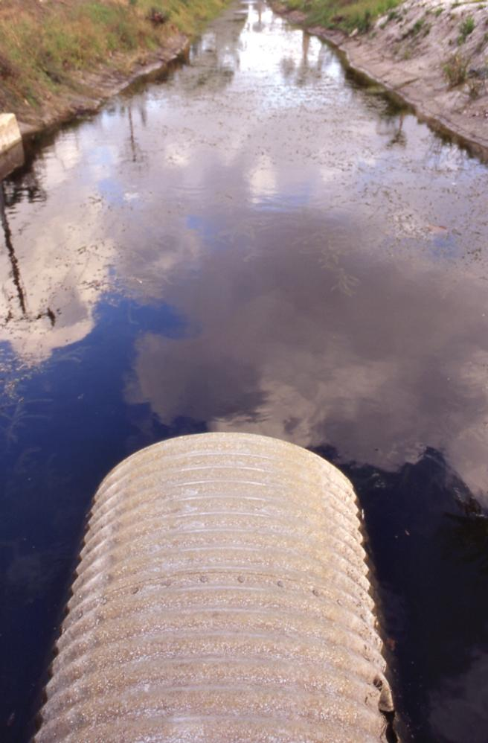
Risk refinement actions
Use Good Management Practices
Eliminate direct sewer discharges of rejected/spilled material
Use dry cleaning practices as much as practical with appropriate disposal
Minimize equipment rinse discharge
Implement these practices and then re-calculate RQ
If RQ still greater than 1, further action needed

Slide 28

We’ll be back …
Several more sessions are planned to answer your questions and work through a case study.
PSCI Webinar: Managing manufacturing effluent | January 2016

Slide 29

Questions

Slide 30

The Pharmaceutical Supply Chain Initiative
Need more information?
Visit: www.pscinitiative.org
Email: the PSCI Secretariat at info@pscinitiative.org

