Slide 1

EQMS Ingenuity
Your Global Partner in EHS
www.eqmisingenuity.com
+91 9810297613, 8826191654
akchaturvedi01@eqmsingenuity.com,
nashraf@eqmsingenuity.com

Slide 2
About US
EQMS INGENUITY is a premier provider of Environment, Health, and Safety services, headquartered in New Delhi, India. Our evolution from modest beginnings to a trusted industry leader is driven by our steadfast commitment to customer satisfaction and exemplary work ethics. We specialize in delivering high-quality safety solutions designed to meet the unique needs of your business.

Slide 3
A legacy of EHS excellence
25
30+
Years of Experience
NEBOSH programs every year
50+
8
BBS implementation
Intl Partners

Slide 4
01
02
Services
Accreditions
03
04
Software services
Clients
05
Auditors Profile

Slide 5
01
Our Services

Slide 6
OUR SERVICES
Behaviour Based Safety
EHS Software
NEBOSH/IRCA Trainings
Process Safety Management
Experience a transformative safety culture with our "6-Steps BBS Program", guiding you from design to performance enhancement.
Trust our comprehensive software suite to reduce hazards and enhance overall productivity, ensuring a secure environment for your workforce and assets.
Unlock your potential with a NEBOSH qualification, guided by our skilled and experienced tutors. Elevate your SHE career and the next step towards advancement.
Implement PSM to identify and mitigate the risks of catastrophic accidents involving hazardous processes and materials. Achieve a safe work environment, compliance with regulations, and improved operational outcomes.

Slide 7
OUR SERVICES
Auditing
EHS Newsletter
Compliance Management
Management Systems Consulting
Meet regulatory standards while fostering a culture of safety within your organization. Ensure a safe and compliant workplace with our comprehensive safety audit services.
Stay informed about key legislative updates and emerging trends, in the ever-evolving EHS landscape with our expert insights and timely information.
Create sustainable competitive advantage for your organization through our ISO and sectoral consulting services. Our professionals are trained to develop superior strategic management process and risk-based management systems.
Manage your individual projects while ensuring total regulatory compliance. Enhance workplace efficiency through high-quality legal training, expert audit advice, and the implementation of tailored programs that meet your business's unique needs.

Slide 8

Accreditions
02

Slide 9
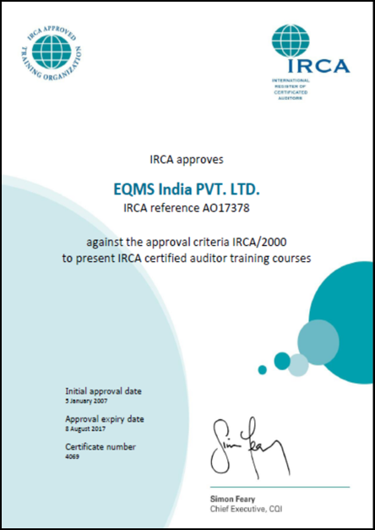



Accreditions

Slide 10
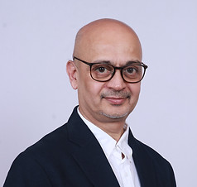
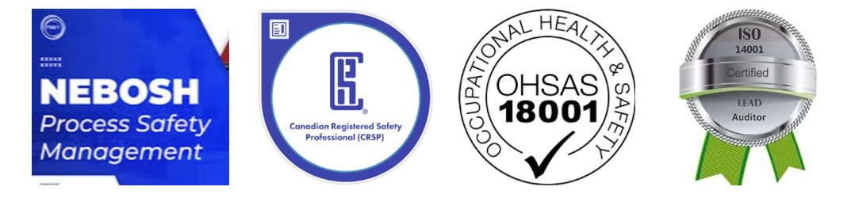
Our Visionary Leader
AKC has played a pivotal role in guiding EQMS Ingenuity from its inception through significant growth and evolution. His leadership fostered a strong organizational culture, positioning the company as a trusted name in the field of Environment, Health, and Safety (EHS). With 25 years of experience serving clients across Southeast Asia and the Middle East, AKC continues to drive excellence in the EHS industry.
Arun Kumar Chaturvedi, Director

Slide 11
Software Services
03

Slide 12
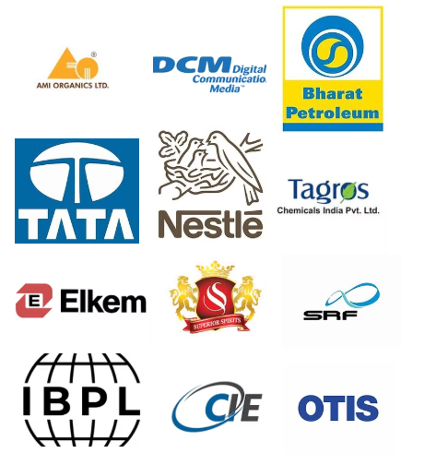
EQMS Ingenuity Software Services
Our innovative software is designed to effectively track and manage incidents, hazards, and risks while ensuring compliance with EHS regulations and standards. With real-time visibility into your EHS performance, you can easily identify trends and pinpoint areas for improvement.

Slide 13
EHS Software suite
Behavior Based safety
Legal/regulatory compliance
Unsafe act/condition reporting
Near miss reporting
Incident report and investigation
Audit/HSE inspection management
Conduct, Track and Analyse safe and At-Risk Behaviors
Track updates and maintain a Compliance Score of your EHS and Labour Compliances
Report incidents in real-time, track resolutions, and analyze data
Facilitate real-time reporting, and implement preventive measures to mitigate future risks.
Report , Investigate and Analyze Work place near misses & Incidents
Create HSE inspection Checklist, Inspect and Score Safe & unsafe Conditions

Slide 14
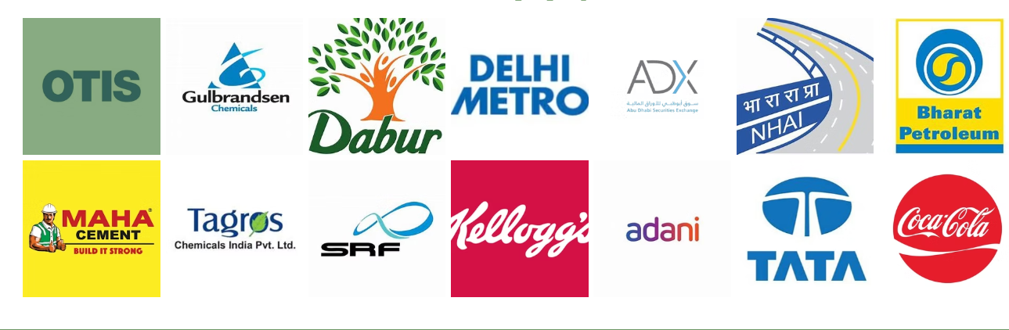
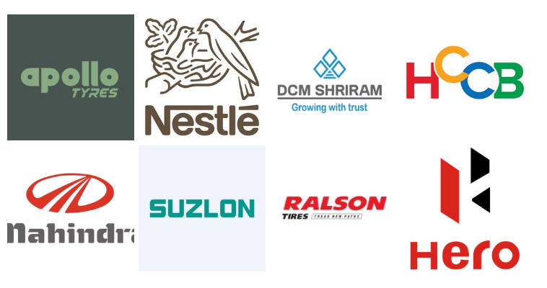
Our Clients
05

Slide 15

Auditors Profile
06

Slide 16
Brief Profile of Lead Auditor
Arun Kumar Chaturvedi – Director Technical – BE in civil Engineering and ME in Environmental Engineering. Lead auditor in ISO 14001/ISO 45001: 2018. He is the lead faculty for NEBOSH UK Process Safety Management and International General Certification Courses.
Professional Objective:
Dynamic and results-driven Safety and Environmental Professional with over 25 years of progressive leadership in Occupational Safety, Process Safety, and Environmental Consulting. Proven track record in developing and implementing comprehensive SHE (Safety, Health, and Environment) management systems, risk assessments, process safety frameworks, and behavior-based safety programs. Dedicated to enhancing safety culture, improving operational performance, and ensuring regulatory compliance on a global scale.
Professional Experience:
Director-Technical, EQMS Ingenuity Pvt. Ltd. 1998 - Present
Spearheaded consulting projects across diverse industries including Oil & Gas, Steel, Pharmaceuticals, Infrastructure, and Heavy Engineering.
Designed and implemented robust Process Safety Management Systems (PSM) aligned with OSHA 1910.119 and CCPS RBPSM models
Delivered over 20 NEBOSH-certified Process Safety Management courses, training more than 400 participants globally with a 95% pass rate.
Led comprehensive HAZID/HAZOP/LOPA studies for multinational corporations including BPCL, HPCL, Tata Steel, SABIC, and more, significantly mitigating process risks.
Developed and executed ISO 45001 and ISO 14001 SHE management systems,
Conducted over 50+ safety audits, behavior-based safety interventions, and technical training programs, driving continuous improvement in safety standards.

Slide 17
Brief Profile of Lead Auditor
Key Skills:
  Process Safety & Risk Management; Occupational Health & Safety Audits; Behavior-Based Safety (BBS) Implementation; SHE Management Systems ; HAZID, HAZOP, LOPA Studies
Certifications:
  Canadian Registered Safety Professional (CRSP), 2023 ( Number 23-8297)
  NEBOSH UK HSE Certification in Process Safety Management, 2021
  IRCA, UK Approved Lead Auditor in ISO 45001, 2022
  Certified PHA HAZOP Leader, Velosi Training Institute, 2022
  Affiliated Member, IOSH UK
Publications:
  "Environmental Business Opportunities in India" (ISBN No. 81-900672-0-6)
  "Indian Environmental Legislation - Guide for Industry and Business" (1995-97 Editions)
  Global Work Experience:
  India, Malaysia, Abu Dhabi, Thailand, Sri Lanka, Maldives, Philippines, Singapore, Belgium

Slide 18
Brief Profile of Auditors
In addition, EQMS Ingenuity pool of auditors are having minimum following qualifications:
Diploma Industrial Health and Safety
Diploma in Chemicals Safety
Industry experience with minimum Industry experience in Pharma of 20 – 25 years
Lead auditors in ISO 14001 and ISO 45001: 2018
Intensive EHS audit experience including in the filed of pharma
Knowledge of local regulations and GMP as followed in pharma industries
Worked as MR / Safety Head / EHS Managers in Industry Sectors
Our auditors are also having qualifications such as:
  Accredited Energy Auditor and Manager from BEE India
  Approved Training of ISO 45001: 2018 from CQI-IRCA UK
  Approved Training of International General Certification from NEBOSH UK
  Certified Lead validator / verifier of CDM and GHS Systems
  Lead trainers on Indian EHS Legislations
  EQMS Ingenuity auditors have intensive auditing experiences in the field of automobiles, refineries, petro chemicals, pharma, heavy engineering, Power, Infrastructure, renewable, solar, ports, steel etc.
  Detailed CVs of the auditors can be send on request. Pls contact Mr. Nadeem Ashraf (nashraf@eqmsingenuity.com)

Slide 19
Thank you!
www.eqmisingenuity.com
+91 9810297613, 8826191654
akchaturvedi01@eqmsingenuity.com,
nashraf@eqmsingenuity.com

