Slide 1
The revised PSCI Principles Key changes

Slide 2

At a glance
This is the second revision to the PSCI Principles (three-year cycle, the last being in 2020)
Based on consultation with internal and external stakeholders
Formally approved in May 2023
Five key changes:
‘Management Systems and Governance’ strengthened and moved to the front to reflect its foundational nature
More emphasis on Human Rights, now widened to include the rights of communities around sites
Including the wider concepts of ‘grievance’ and ‘remediation’ in line with Human Rights soft law
A new requirement for a ‘safety culture’ at supplier sites and worker wellbeing as well as worker safety
A stronger emphasis on climate change, and the explicit measurement and reduction of greenhouse gas emissions

Slide 3
PSCI Principles
The PSCI Principles:
are foundational
set members’ expectations of suppliers
form the base for all PSCI’s tools and materials
apply to all locations engaged in supply to PSCI members
Companies supporting the Principles:
  will integrate and apply these Principles in a manner consistent with their own supplier programs
  at a minimum, operate in full compliance with all applicable laws and regulations; but behaving responsibly often means going beyond these
  understand the Principles are best implemented through a continual improvement approach

Slide 4
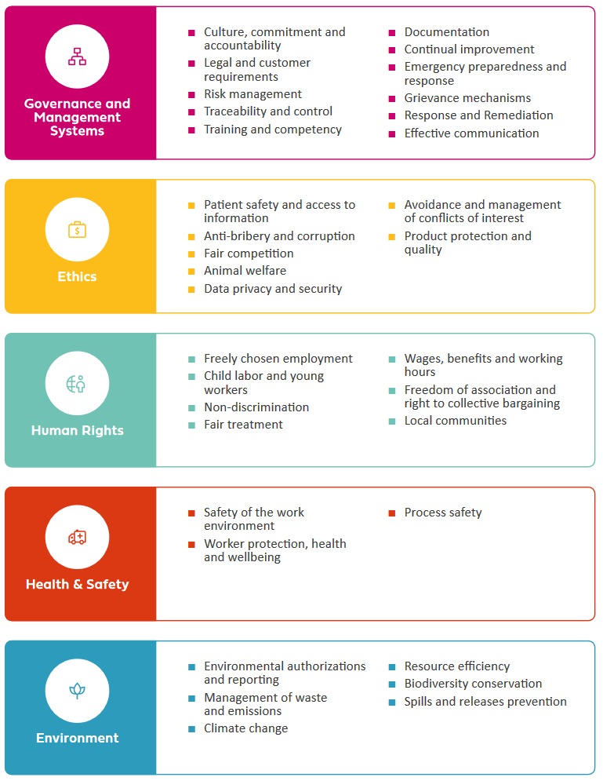
The revised Principles

Slide 5
PSCI Principles – Preamble
Clearer definition of scope
“The Principles are expected to apply to all locations engaged in supply to PSCI members, along with ancillary facilities such as worker accommodation when provided.”
Previously embedded in multiple sections, now drawn to the front.
Reference to the Maturity Models & Learning Plans
“PSCI’s topic-specific maturity models and learning plans are available to guide suppliers towards better practices.”
Addition of a Glossary
“Glossary: Any word identified in the text with an asterisk (*) is defined in the Glossary at the end of the Principles.”
Please note that the definitions in the Glossary below are provided for guidance only and are not part of the PSCI Principles.
New text: Orange

Slide 6
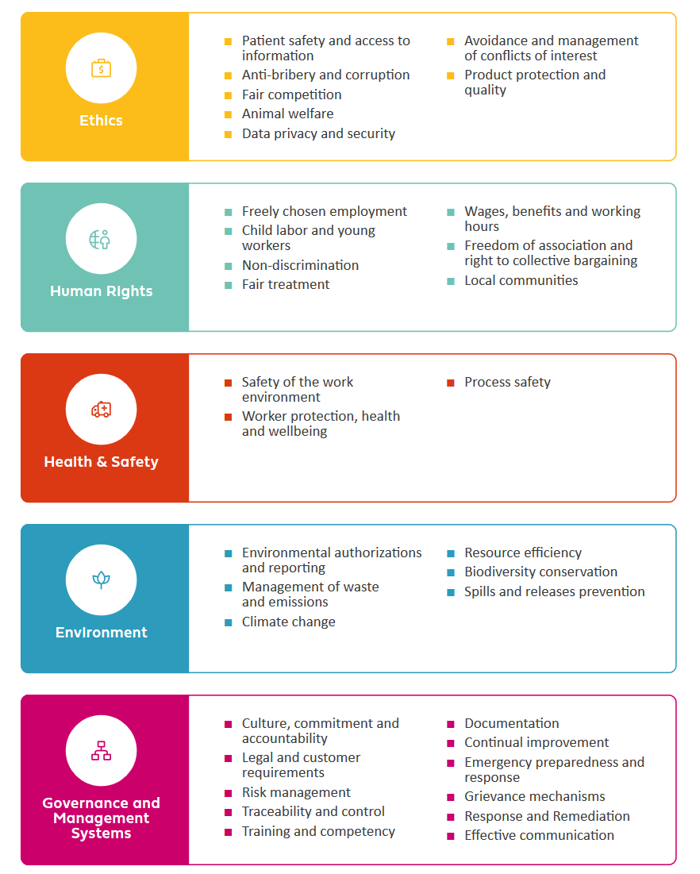
PSCI Principles – Governance and Management Systems (1)
‘Management Systems’ renamed ‘Governance and Management Systems’
Now the first Principle, reflecting its foundational nature
Section’s scope expanded
Preamble: “Good governance and management systems are the foundation for compliance with all the PSCI Principles. Suppliers shall use appropriate systems to conduct due diligence on risk and impact, monitor legislation, set priorities, assign responsibility, adopt risk-mitigation measures, and facilitate continual improvement and compliance.”
New: Culture of responsible practices
“Suppliers shall demonstrate commitment to the concepts described in this document by allocating appropriate resources and identifying senior responsible personnel, thereby creating a culture of responsible practices.”
Moved from Environment section: Traceability and Control
“Suppliers shall have systems in place to carry out due diligence on their own supply chain, including traceability for the sources of raw materials to support legal and sustainable sourcing.”
Moved from H&S section: Emergency Preparedness and Response
“Suppliers shall have effective emergency plans and response procedures.”
Text carried over: Black
New text: Purple

Slide 7
PSCI Principles – Governance and Management Systems (2)
‘Management Systems’ renamed ‘Governance and Management Systems’
Now the first Principle, reflecting its foundational nature
New: Establishment of grievance mechanisms
“Suppliers shall establish grievance mechanisms accessible to internal and external stakeholders who shall be encouraged to use them to report concerns, illegal activities or breaches of these Principles at work without threat of or actual reprisal, intimidation or harassment.”
New: Remediation for incidents
“Suppliers shall properly investigate incidents or concerns relating to these Principles, take necessary corrective actions, and provide remediation where required.”
Expanded scope: Effective communication
“Suppliers shall have effective systems to communicate these Principles to relevant stakeholders including their workers, contractors, suppliers and local communities.”
Text carried over: Black
New text: Purple

Slide 8
PSCI Principles – Ethics
New: ‘Product Protection and Quality’
“Suppliers shall ensure that management and security systems protect products, components and ingredients from the risks of adulteration, falsification, or theft for the purpose of illegal resale.”
Small changes to the ‘Anti-bribery and Corruption’ subprinciple
“All forms of corruption including, bribery, extortion and embezzlement are prohibited. Suppliers shall not pay or accept bribes, or participate in other corrupt inducements in business or government relationships, or through the use of intermediaries to secure an unfair advantage. Suppliers shall ensure they have adequate systems in place to prevent corruption and comply with applicable laws.”
Text carried over: Black
New text: Orange

Slide 9
PSCI Principles – Human Rights
‘Human Rights and Labor’ renamed ‘Human Rights’
Section’s scope expanded to cover more stakeholders
Preamble: “Suppliers shall be committed to respect the human rights of internal and external stakeholders ensuring to treat them with dignity and respect.”
New: Commitment to conduct human rights impact assessments
Preamble: “PSCI member companies commit to regularly assess all adverse human rights impacts they may cause or contribute to, through their own business practices, including purchasing and other supply chain practices.”
New: Right to collective bargaining
“Suppliers shall respect the rights of workers, as set forth in local laws, to associate freely, join or not join labor unions, seek representation and join workers’ councils, as well as to bargain collectively. Where the right to freedom of association and collective bargaining is restricted under law, the employer facilitates, and does not hinder, the development of parallel means for independent and free association and bargaining. Workers shall be able to communicate openly with management regarding working conditions without fear of retaliation.”
New: Voluntary overtime
“Overtime work shall be voluntary.”
New: Rights of local communities
“Suppliers shall respect the rights of the local communities around their sites including the right to a clean and healthy environment.”
Text carried over: Black
New text: Green

Slide 10
PSCI Principles – Environment
Section’s scope expanded to include tier-2 suppliers
Preamble: “Suppliers shall operate in an environmentally responsible and efficient manner to minimize adverse impacts on the environment, and to help their own suppliers do the same.”
Section’s scope expanded to cover broader environmental impacts
Preamble: “Suppliers are encouraged to conserve natural resources, reduce greenhouse gas (GHG) emissions, preserve biodiversity and clean water, and minimize and control the use of hazardous materials.”
New: Standalone ‘Climate Change’ subprinciple
“Suppliers shall monitor and reduce their GHG emissions and support their suppliers to do the same.”
Expanded scope: ‘Resource efficiency’
“Suppliers shall strive for circularity, designing out waste, taking measures to improve efficiency and reduce the consumption of resources, including water, favoring renewable and sustainable sources. They shall also take measures to reuse and recycle.”
New: Biodiversity conservation
“Suppliers shall understand their impacts on biodiversity, reducing and mitigating their footprint wherever possible.”
Text carried over: Black
New text: Blue

Slide 11
PSCI Principles – Health & Safety
Section’s scope expanded to include workers’ wellbeing
Preamble: “Suppliers shall provide a safe and healthy working environment and support the wellbeing of workers. Health and Safety measures shall extend to contractors and subcontractors on supplier sites.”
Expanded scope: ‘Worker Protection’
“Suppliers shall protect workers from over exposure to chemical, biological, physical hazards*. Appropriate equipment, facilities and services shall be provided to support worker safety, health, and wellbeing.”
New: Commitment to conduct general health & safety assessments of the work environment
“Adequate risk assessments and emergency plans shall be in place to ensure the safety of the work environment*. Safety information relating to hazardous materials – including pharmaceutical compounds and pharmaceutical intermediate materials – shall be available and used to educate, train, and protect workers from hazards. …
New: Culture of safety
… Suppliers shall demonstrate good housekeeping practice and a culture* of safety.”
Text carried over: Black
New text: Red

