Slide 1

General Introduction
What is Process Safety Management
Vijaya Kumar Bendi, Manager- External Supply EHS&S, Johnson & Johnson Pvt. Ltd.|Sub-Lead of PSCI Process Safety Topic Team
vbendi@its.jnj.com

Slide 2
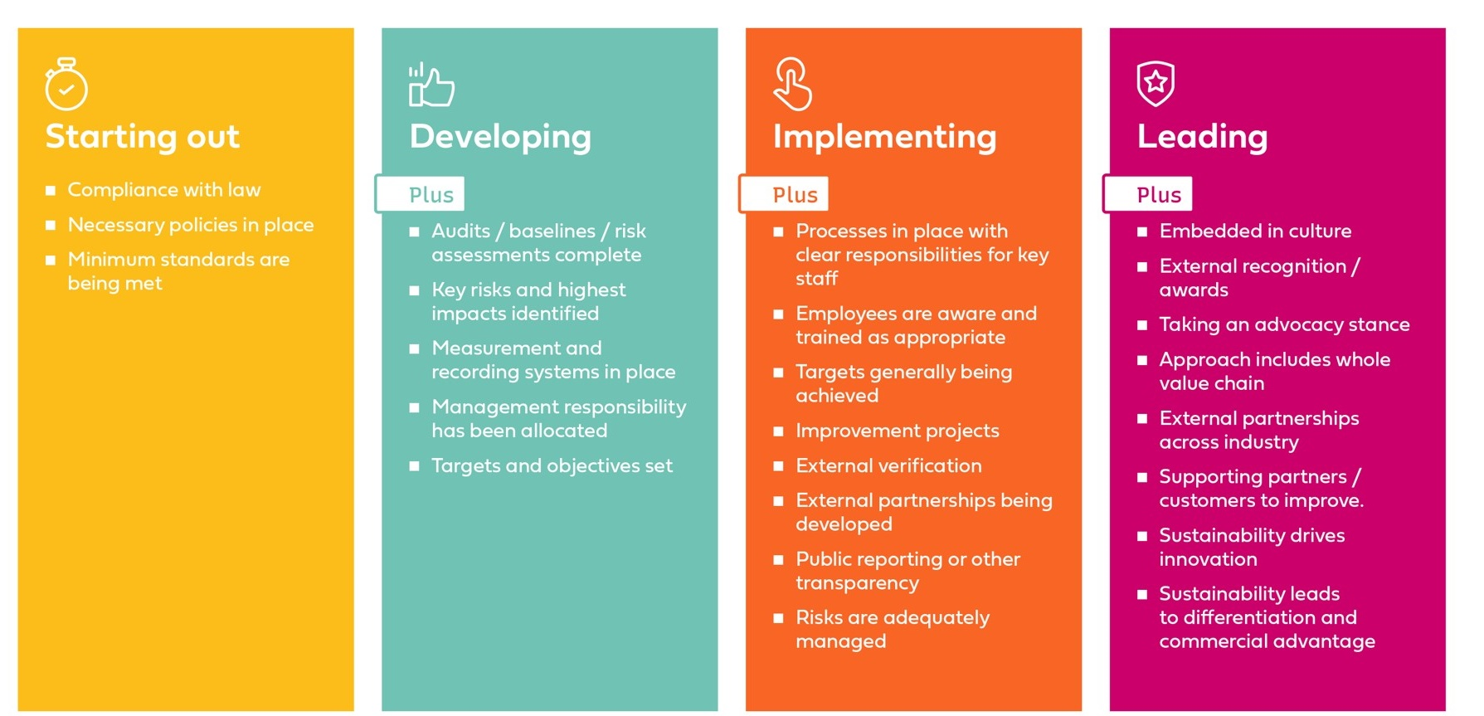
PSCI supplier maturity model
The PSCI maturity models are a roadmap helping suppliers evaluate how responsible their current practices are and what progress against the PSCI Principles looks like.

Slide 3
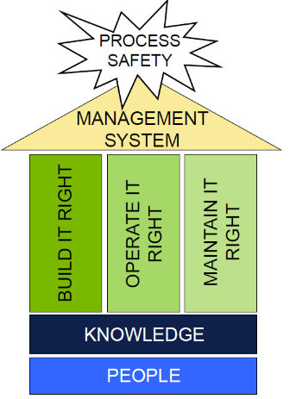
Process Safety Management (PSM)
PSM is a part of Safety management systems needed to prevent possible catastrophic incidents caused by the use, storage, transport and manufacture of hazardous materials, like Combustible powders, Chemicals, Solvents, Flammable / Toxic gases used in the manufacturing processes.
PSM identifies, evaluates, and controls Process Safety risk, thereby minimizing chance of Process Safety incident.

Slide 4
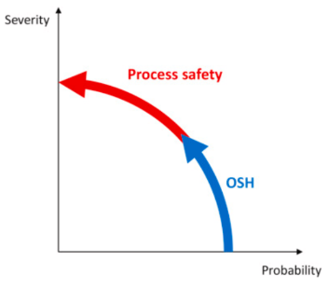
Process Safety vs Occupational Safety
Process Safety | Occupational Safety
Focus on preventing fires, explosions and toxic release incidents in process facilities, which can lead to multiple fatalities and heavy asset, production, environmental & reputation damage. Prevention of high consequence low frequency risks. Concerns people in the workplace and surrounding areas and impacts Organization’s business. | Focus on work injury prevention, occupational health and safety, etc. Prevention of low consequence and high frequency risks. Concerns people in the workplace and does not impact Organization’s business.

Slide 5
Evolution of Process Safety
Last 50 years, there have been numerous Process Safety incidents across the Globe in various industrial sectors, like Petroleum/Petrochemicals, Chemicals, Pharmaceuticals, Food, etc.
These incidents resulted in fatalities, injuries, property loss, and environmental damages.
Jan’20 - Explosion during testing of new reactor ,Tarapur, Boisar
May’20 – Styrene gas release in LG Polymer
June’20 – Boiler explosion in Dahej, Bharuch
Jan’22 – Reactor explosion in API Pharma plant in Nakkapally
Apr’22 - Reactor blast in Chemical company in Viziawada
June,22- Explosion in chemical facility in Vadodara
1988
Piper Alpha, Scotland
Explosion in off-shore terminal
2005
Texas City Refinery, US
Explosion of leaked ISOM during start up.
2020 - 2022
India
1984
Bhopal, India
MIC leakage
2007
T2 Lab, US
Reactor explosion due to runaway reaction caused by loss of cooling
1976, Seveso, Italy
Valve broke at a chemical plant in Meda, Italy, resulting in release of highly toxic dioxin TCDD
2010
Pike River, New Zealand
Explosion in coal mine
1974, Flixborough, UK
20” bypass system ruptured causing Cyclohexane vapor cloud explosion
2018
Chemical plant, Tarapur, India
Reactor explosion during Nitration reaction
These events led to the development of Process Safety Management

Slide 6
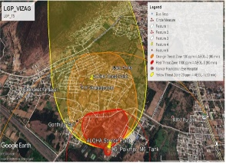
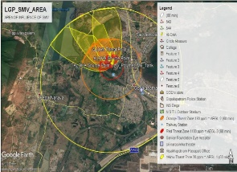
Recent Process Safety Incident
Date: Early hours of 7th May’20
Description:
    Uncontrolled release of Styrene vapor at LG Polymers, Vizag from one of the Styrene storage tanks.
    Styrene vapors / fumes spread over a radius of 3km beyond the factory premises, affecting the populace of 5 villages.
Consequences: 12 fatalities & 585 citizens being hospitalized.
Causes as mentioned in the Committee report : (runaway polymerization )
    Modification in tank design leading to significant thermal stratification going unnoticed
    Disregard to the increase in polymer content
    Non-adherence of SOP for TBC addition as polymerization inhibitor
    No consideration of diverse situations, like handling operations during COVID-19 (Thorough Pre-Startup Safety Review (PSSR) has not conducted prior to startup to ensure that installations meet the original design due to changes during the lockdown period).
(Ref: The Report Of The High-Power Committee formed by Government of Andhra Pradesh)

Slide 7

General thoughts about Applicability of Process Safety
Applicable in Chemical Processes & Reaction.
Applicable for Chemical , Petro-Chemical & Agro Chemical
Other operation like Utility , storage tank , warehouse doesn’t come under process Safety requirement
PSM Scope is handling of Flammable Solvent / Chemical
Applicable for API and not in Formulation / Injectable Units / R&D
Applicable for Hazardous & Critical Reaction like Hydrogenation , Exothermic , Gas liberation etc.
Several miss conceptions, perceptions & considerations are there.

Slide 8
Hazards in Pharma Industries
Critical Manufacturing operations & Processes
  Formulations : Drying, Unit operations using solvent / combustible powders.
  API : Hazardous reaction , Hydrogenation, Water sensitive, Shock Sensitive , Exothermic, Highly Reactive etc., flammable / toxic gas handling.
Storage & Handling of Bulk materials like solvent (polar / nonpolar, Acid / Alkali, combustible powder (API / Excipient).
Handling Combustible powders
R&D / Kilo / Scale up lab operations include handling of hazardous substance like API, flammable liquids / gases, toxic/reactive substances, or combustible powders, etc.
Engineering and utility operations, including steam boilers and other power generation equipment,, Pressure vessel (Air / Nitrogen), HVAC etc.
Storage and handling hazardous Waste.

Slide 9
Challenges in Pharma Industry
Process Safety is an evolving concept in Pharma industry.
Adoption of varied Engineering standards, site layout constraints.
Process Safety Data availability.
Resource constraints on PHA (Process Hazard Analysis).
Manual / Semi automatic / Batch operations.
Diversity of powders and chemicals used bring different set of challenges.

Slide 10

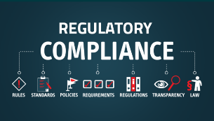
Benefits of Process Safety
Ensures business continuity and robustness of Supply Chain
Develop employee skills and foster the right workplace behaviors and culture
Regulatory compliance
Deliverance of Commitment on time
Brand Reputation
Employee / People Engagement

Slide 11
Advancements in Process Safety development
Reputed International agencies have developed their performance assessment tools and requirements for Process Safety Management.
        DNVs ISRS (International Sustainability Rating System)
        RC (Responsible Care)
        British Safety Council 5 Star / Sword of Honour for Process Safety accomplishments
  PSM has made in-roads in Academics.
        NEBOSH HSE Certificate in Process Safety Management
        CCPS Certified Process Safety Professional
    Process Safety is included in Curriculum at Premier Universities.
  PSM has emerged as necessity in Pharma industries and various audit requirements.
  Few Pharma companies are focusing on need of setting up of Process Safety lab.
  PSM focus audits

Slide 12

The First Steps
Develop progressive PSM program based on the maturity level of Organization’s Process Safety
Know the hazards of manufacturing processes, chemicals used, unit operations and waste generated
Integrate Process Safety Management program with Operations
Identify, Assess, Implement mitigative measures for Process Safety Risk.
Resources allocation – manpower / budgets.
Develop and Monitor Leading / lagging indicator.
Audit program to identify gaps and strengthen the systems.

Slide 13
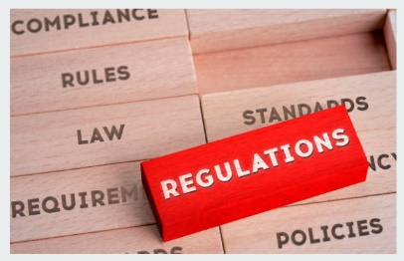
PSM Covers Regulatory Aspect of ..
US : OSHA CFR 1910.119 – Process Safety Management
European : Seveso III Directive / Process Safety Management
India : The Factories Act & Rule, MSIHC, EPA 1986 etc.
China : AQ/T 3034-2010 PSM Regulation

Slide 14
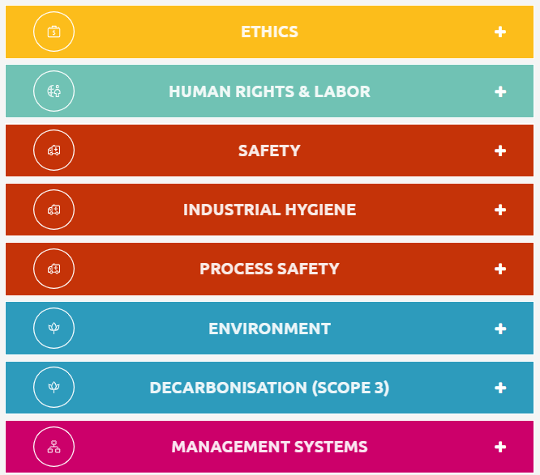
PSCI supplier maturity model
PROCESS SAFETY
EMERGENCY RESPONSE (ERP)
EXPLOSION PROTECTION / ATEX / NFPA
FIRE PROTECTION
MANAGEMENT
MOC
PSI
PSSR
RISK ASSESSMENT
STORAGE OF CHEMICALS
TRAINING

Slide 15
“A chain is only as strong as its weakest link”

