Slide 1

Particulate Containment Verification with Surrogate Monitoring
Maharshi Mehta CIH CSP FAIHA, President
Ankit Sharma, CIH, LFOH, Associate Director
International Safety Systems Inc., Houston TX.
USA, Ireland, UK, Germany, France, India, China
August 4, 2022

Slide 2

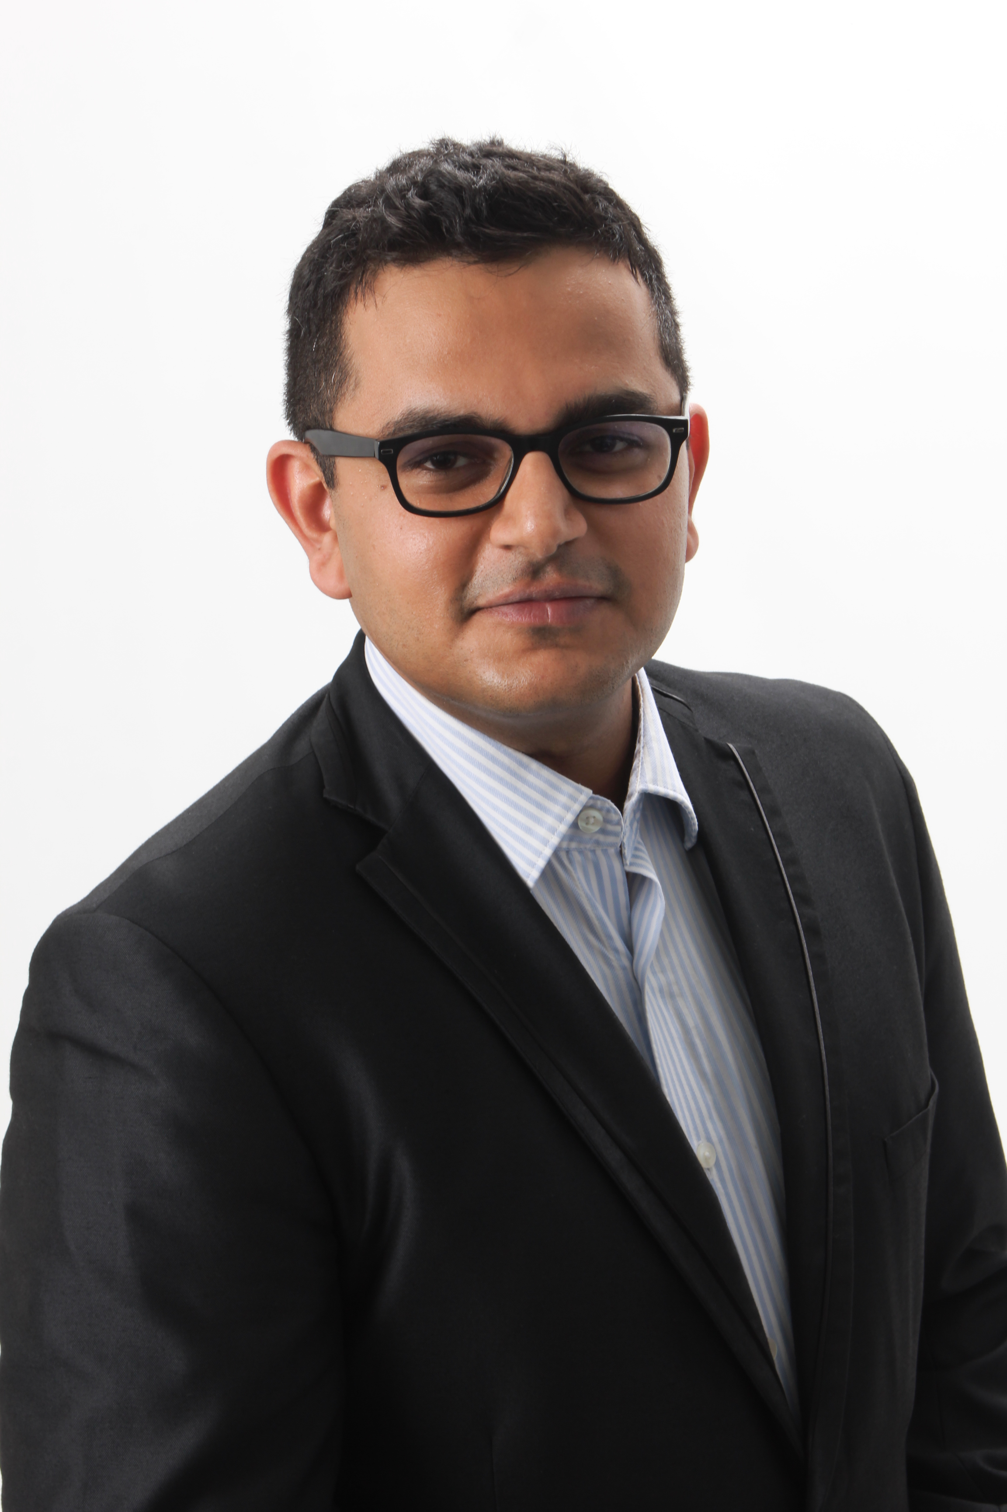
Speakers
Maharshi Mehta, CIH, CSP, FAIHA
President, International Safety Systems, Inc.
Ankit Sharma CIH LFOH, Associate Director
International Safety Systems, Inc.

Slide 3
AGENDA
Intent of surrogate monitoring
Planning
  Confirming Occupational Exposure Band (OEB) of API
  Detailing unit operation/ process for which a surrogate will be used
  Containment Performance Target (CPT)
  Selection of surrogate
  Need for Factory Acceptance Test (FAT)
  Coordination with containment and quality team
Factory Acceptance Test (FAT)
Site Acceptance Test (SAT)
Lessons Learned – Result Profiles of Unit Operations

Slide 4
Lessons Learned from..
5000 + surrogate air and wipe monitoring samples conducted
100 + pharmaceutical and containment equipment manufacturing sites
25+ countries
Statistical analysis of surrogate monitoring results

Slide 5
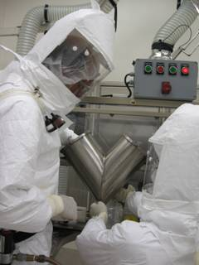
Intent
Particulate Containment Verification
Determine effectiveness of particulate containment
Surrogate results for exposure estimate for similar activities
Estimate API exposure from surrogate monitoring results
Determine need for additional exposure controls based on surrogate monitoring results
Estimate API exposure by conducting surrogate monitoring when (a) validated sampling and analytical method is not available for API or (b) when the method is not sensitive

Slide 6
Surrogate monitoring-Planning
Surrogate Selection
  Lactose, Naproxen sodium, Mannitol
Determine API details for which surrogate will be used
  OEL – OEB Classification
  Unit operation (e.g., weighing, dispensing)
  Weight and task duration
  % of API in blend
  API characteristics
Determine Containment Performance Target (CPT)
Consult
  Quality if selected surrogate can be used and potential contamination concerns
  Process team
  Design and engineering team
Process safety – dust explosion potential

Slide 7
Surrogate Selection
Partner with quality
International Society for Pharmaceutical Engineers (ISPE) provides overview on surrogate selection
Particle characteristics
  Similar dustiness, particle size of APIs
  Vendor provide right particle size distribution (PSD) and certification or perform size reduction (e.g., milling, sieving, etc.) in house and perform (PSD) analysis
Certificate of Analysis and lab analysis of bulk samples
Analytical sensitivity appropriate for CPT / DEL
  Naproxen sodium (0.05 ng or 0.2 ng) preferred/needed for OEB 5 v/s Lactose/Mannitol (2 -2.5 ng)
Limited handling of surrogate at facility to avoid background contamination
  Lactose and mannitol readily available, but are often used in formulations
Availability
Cost considerations
Notes:
Why particle size and dustiness is so important, so we understand once we assess with APIs did the surrogate likely behave like API
No or limited handling of surrogate at facility to avoid background contamination leading to inability to discern background from containment failure
Excipient vs. API
Naproxen sodium is considered as API in Europe which presents challenges, quality prefer non-API

Slide 8
Comparison of critical surrogate parameters
 | SURROGATE (AIR)
 | Lactose | Acetaminophen (Paracetamol) | Naproxen | Riboflavin | Mannitol
Sensitivity (nanograms/sample) | 1/ 2 | 0.5 | 0.05/0.2 | 5.0 | 1
Relative Material Cost | Lowest | Low | High | Moderate | Low
Active Pharmaceutical Ingredient | No | Yes | Yes | Yes | No
Specificity | High | Moderate | High | High | High
Readily available pre-milled into a variety of particle sizes | Yes | No | No | No | No
Water Solubility and Cleanability Availability as a salt | High | Slight | High In Sodium Form | Moderate | High
 | NA | No | Yes | Yes | NA
Containment challenge | High | Moderate | High | Moderate | High
Risk of significant process contamination | Very Low | Moderate | Moderate | Low | Very Low

Slide 9
Containment Performance Target (CPT)
Develop User Requirements Specification (URS) and include containment performance target (CPT) and/or design exposure limit (DEL) and criteria for success
CPT (Emissions) vs. DEL (Operator Exposure)
Airborne
  OEL
  AOEL
  1/10 of OEL
Wipe
  Wipe Limit
  1/10 of Wipe Limit
Statistical Analysis Considerations

Slide 10
Containment Verification (CV) Protocol
Identify CPT/DEL, surrogate and media requirements.
List of supplies for IH for CV
List of supplies for operations to perform CV
Include detailed steps for each task
  Include technique reminders, especially around cleaning
Utilize protocol for training prior to CV
List air and wipe sample locations.
Include drawings with sample locations.
Define the number of iterations.

Slide 11
Laboratory Considerations
Use an accredited and experienced lab in surrogate analysis
Analytical errors are less with Naproxen sodium than with mannitol and lactose
Turnaround time
Cost
Review of lab analytical data
In-situ extraction

Slide 12
Method
Utilize industry recognized practice and agree on data evaluation criteria
  ISPE Assessing the Particulate Containment Performance of Pharmaceutical
  Equipment (Second Edition, May 2012)
Background, Personal Breathing Zone (PBZ) air, area positional air and blank samples
Task based and short-term
Wipe sampling – critical to determine if containers and surfaces are contaminated to the extent it effects surrogate results during CV
Three to six repeat iterations at minimum for collecting representative data.
Do not reuse surrogate once surrogate bag is opened
Factory Acceptance test and Site Acceptance test

Slide 13
Containment Verification –
Air monitoring and wipe sampling
Air samples
  Personal Breathing Zone (PBZ) air samples
  Area air samples at typically connection or transfer points (potential for leakage or fugitive emissions)
Wipe samples for Containment Verification:
  Outside containment device only
  Material movement steps from containment to outside containment, most common source for spread of contamination
  Care needed- to determine if surface contamination is due to containment performance v/s work practices
  Surfaces such as rapid transfer ports, equipment door handles, bagged materials removed from containment devices
Wipe samples for cleaning validation / effectiveness purposes
  Not representative of containment performance
  Do not sample inside containment device
Background air and wipe sampling needed to ensure no prior surrogate contamination which could bias containment verification data.

Slide 14
Factory Acceptance Test (FAT)
Primary purpose- Testing containment equipment capabilities at manufacturer’s site before equipment is shipped to site
Avoid Containment manufacturer conducting CV
Partner with procurement while selecting a vendor
Opportunity to
  Predict likelihood of containment performance success or failure
  Design changes to meet CPT
  Introduce workers to containment, train and develop best working practices
Important to recognize deviations from actual use are likely during FAT:
  Actual end users at sites may not be able to travel to factory location
  Simulation of site conditions may not be possible at vendor location
  Final assembly planned at destination site
  Need to align FAT as close as feasible to future site conditions.
Different surrogate during FAT and SAT
Critical to consider that surrogate selected has minimum potential for prior contamination at the factory

Slide 15
Site Acceptance Test (SAT)
Before make mock up and have employee tryout
Performed after receipt and installation of equipment at the site.
Normally conducted with a surrogate
Lessons learnt on sampling locations from FAT to be implemented during SAT.
Typically, more focus on end user training and developing best work practices prior to SAT (as compared to FAT).
Dry run/ dummy run prior to SAT is important
  With a non-surrogate material (UV irradiated material preferred to train employees)
Critical to develop detailed/ step-wise cleaning protocol prior to conducting SAT.

Slide 16
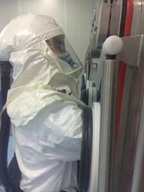
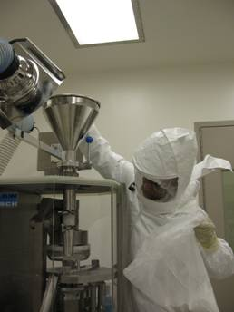
Surrogate Monitoring
– Personal Breathing Zone Air Samples

Slide 17
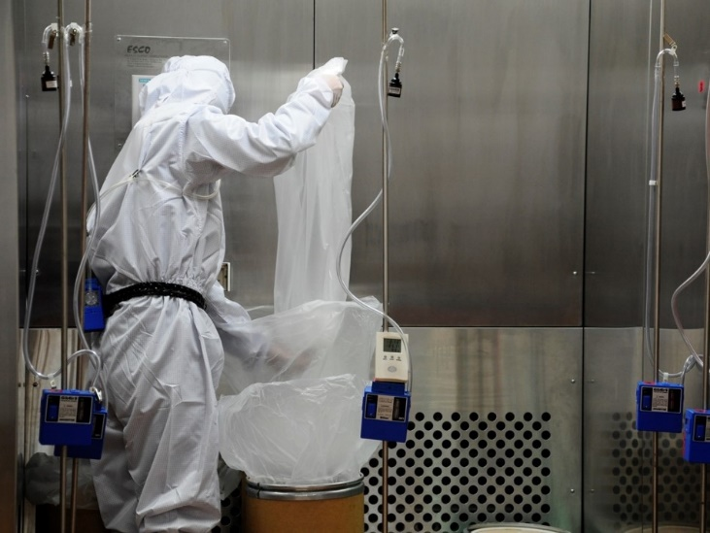
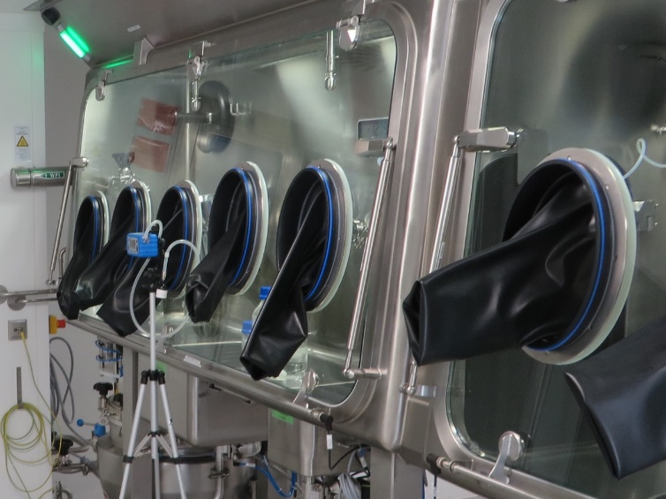
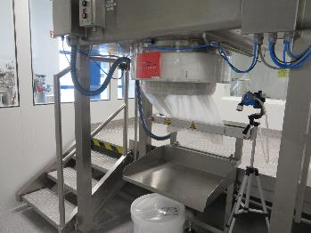
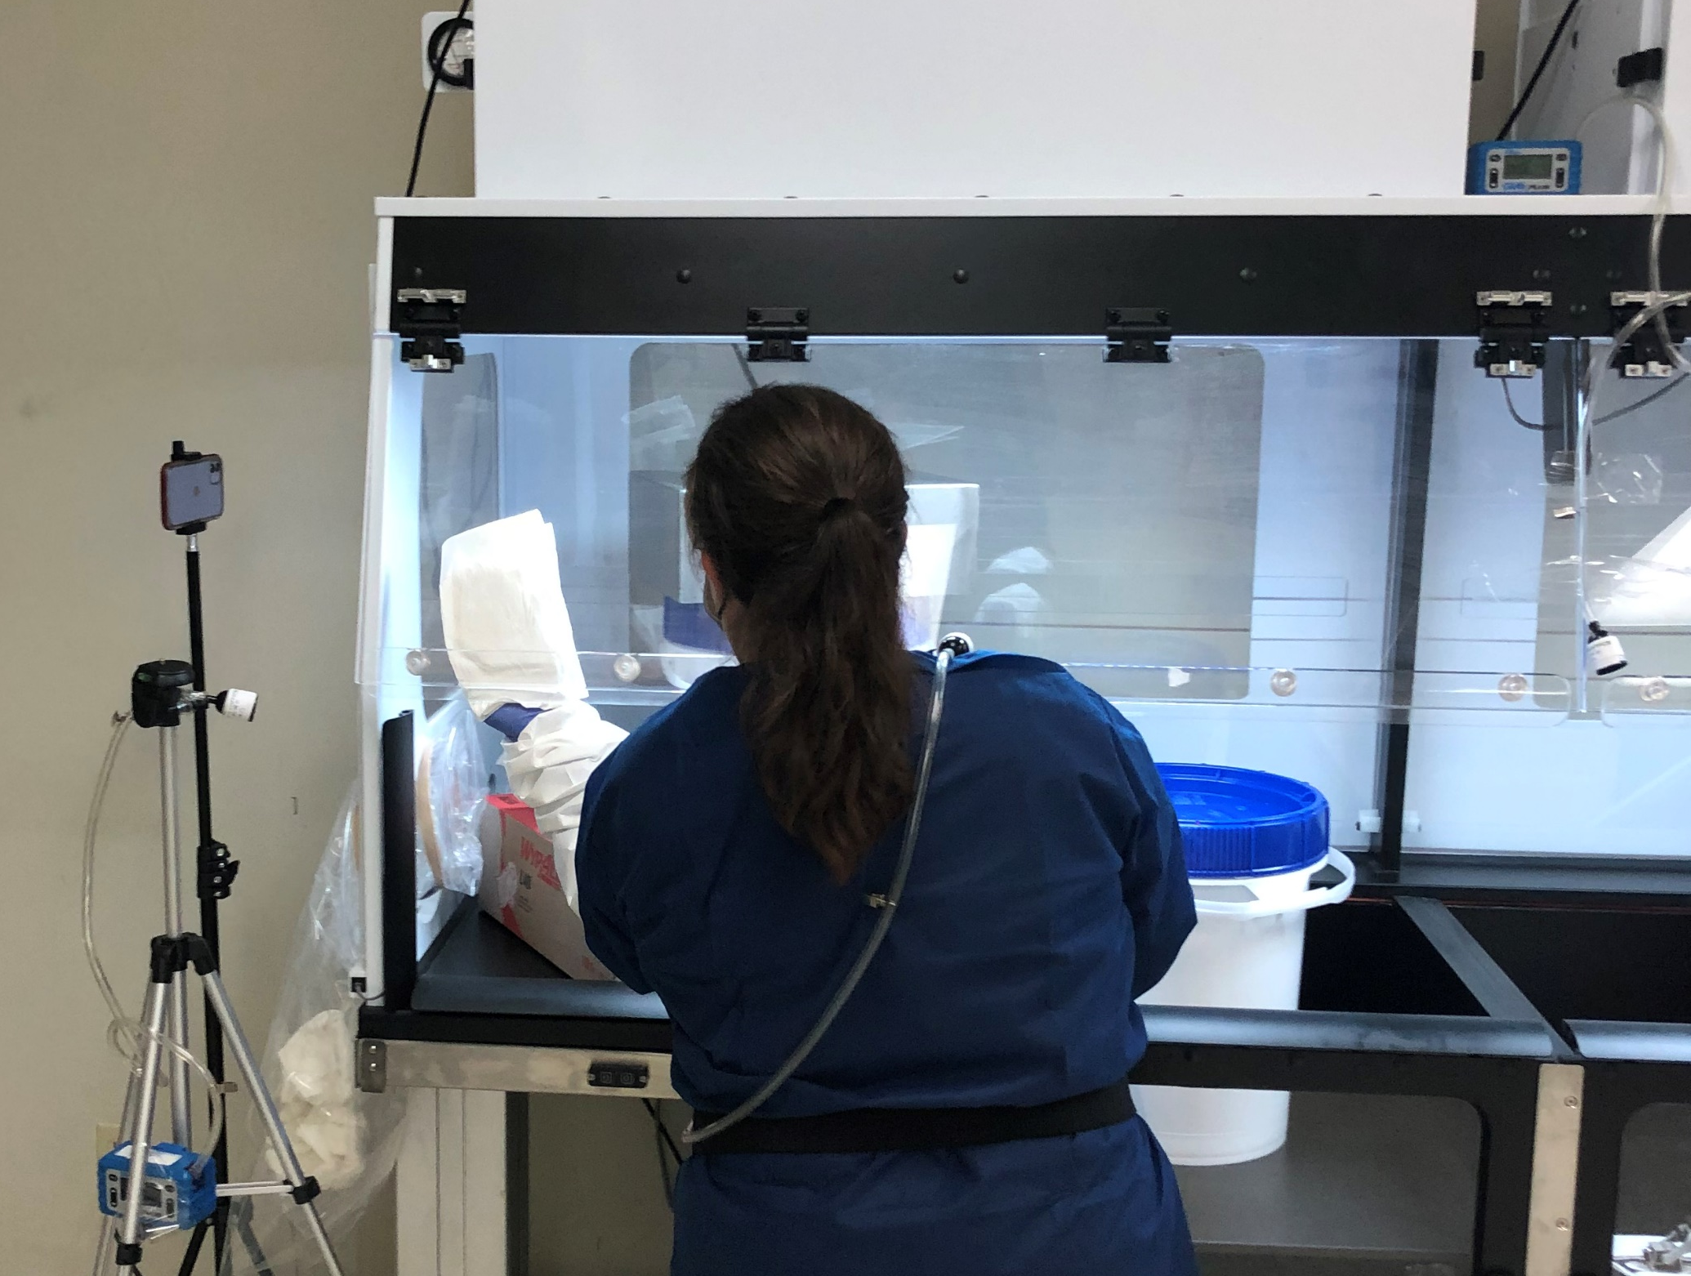
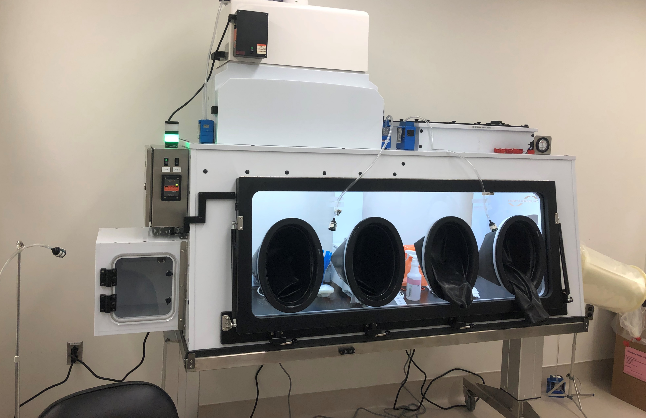
Containment Verification- Area air sampling

Slide 18
Containment Validation Results Evaluation
Review lab results carefully and consult lab if needed
Review background and blank samples
Compare results with CPT
Data Analysis (typical data analysis):
  95th Percentile Point Estimate
  Bayesian Decision Analysis,
  EN-689:2018
Most critical : Personal Breathing Zone air and Area air monitoring data.
Review wipe data to differentiate between containment performance and work practices/ cleaning.
Identify a breach of containment and contributory factor
Ensure periodic follow-up monitoring/ verification with actual API is conducted after initial FAT/SAT with surrogate

Slide 19
Caution: Surrogate monitoring v/s API monitoring
Surrogate monitoring is indicative and not confirmative of the API particulate containment and exposures. Depends:
  Surrogate particle size distribution, airborne potential, moisture content, bulk density and other parameters- similarity with API
  Surrogate selection dependent if surrogate is already part of the formulation
  Surrogate % selection in blend
  Surrogates typically have better cleanability than APIs, hence wipe results may not be representative.
Surrogate monitoring is not substitute for API monitoring - After surrogate monitoring, API exposure monitoring has to be done

Slide 20
Lessons Learnt
Ensure competent professionals are conducting surrogate monitoring, evaluating results and arriving at conclusions
Ensure surrogate meets bulk density, particle size characteristics
Buy surrogate as needed – do not buy large quantity
Once a surrogate bag is opened, do not reuse
Do not perform surrogate subdivision in n the same where FAT/SAT is planned.
Ensure HVAC is not bringing surrogate in to test area
Do not use any parts/equipment/tools and PPE/gowning previously contaminated with surrogate.
Ensure test suites are thoroughly cleaned with appropriate cleaning agent for the specific surrogate prior to CV.
During FAT/SAT
  Use disposable PPE and change after each iteration during CV.
  Do not change / ease work practices/PPE between API and surrogate just because surrogate is ‘less hazardous’ than API.

Slide 21
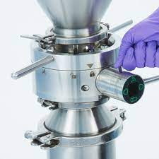
Area Samples: Closed Charging with Split Butterfly Valve (SBV)
(weight range: 15 Kg – 60 Kg)
Sample size: 44
Results range: 0.032 – 21.6 μg/m³
Sample Duration: 30 – 90 minutes
Sample Weight 15 kg – 60 kg
Geometric Standard Deviation (GSD): 3.7
95th %ile estimate: 3.53 μg/m³
Split Butterfly Valves with built-in vacuum extraction system more suitable for potent compounds transfer.
Cleaning procedures essential to reduce contamination (HEPA vacuuming on SBV faces upon disconnection, wet wiping with suitable solvent)

Slide 22
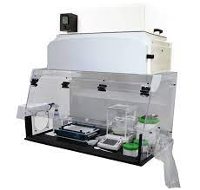
Ventilated Balance Enclosure
(material transfer to single use bag)
Surrogate used: Lactose OEB 3 compounds
Weight range: 30-40 kg
CPT – 10 µg/m³
Sample size 3-5
Result Range:
FAT Material Transfer < 0.03 µg/m³ - 0.05 µg/m³, Cleaning 95th%ile estimate: 2.58 µg/m³
SAT Material Transfer 95th%tile 5.739 µg/m³, Cleaning VBE <0.056-0.066 µg/m³
Lessons:
  SAT provided more real-world representation with actual transfer containers.
  Site made improvements and performed repeat SAT with more improved air and wipe results, before use of actual API

Slide 23
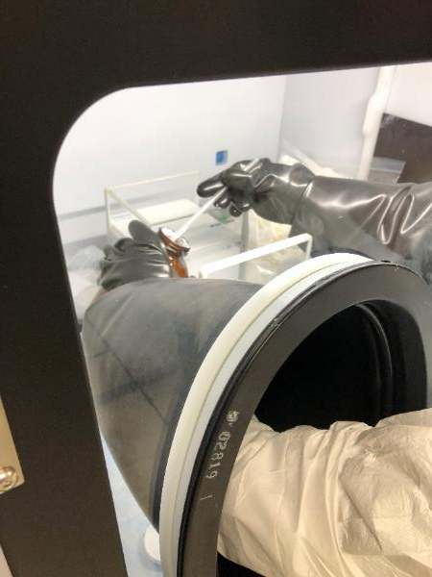
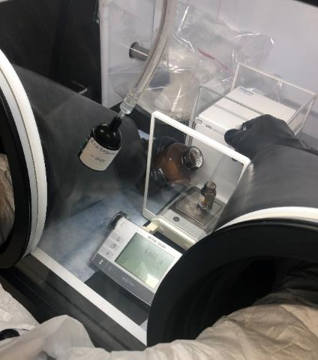
Isolator for weighing / subdivision- Lab Scale
Surrogate used: Naproxen sodium OEB 5 compounds
CPT- 10 ng/m³
Sample size: 6 (FAT), 12 (SAT at multiple locations)
Result range:
FAT:
Weigh and subdivide: < 0.770 ng/m³,
Isolator cleaning and material transfer: <0.975 ng/m³
Waste removal through a continuous liner < 1.82 ng/m³
SAT:
Weigh and subdivide: < 0.843 ng/m3,
Isolator cleaning and material transfer: <0.581 ng/m³
Waste removal through a continuous liner < 1.84 ng/m³
Lessons Learnt:
High containment achievable through detailed SOP, thorough cleaning essential for containment success for highly potent APIs, ‘buddy’ system helpful when handling/task is infrequent

Slide 24
Tablet Compression Press
Surrogate used: Mannitol (FAT) and Lactose (SAT)
CPT- 10 µg/m³
Sample size: 3
Result range:
FAT-Compression 95th%ile estimate: 52.8 µg/m³, Cleaning 95th%ile estimate: 7640.4 µg/m³ (GSD 12.7)
SAT-Compression 95th%ile: 1.6 µg/m³,Cleaning 95th%ile estimate: 30.4 µg/m³
Lessons:
  FAT results are not representative since Mannitol was used and tablets were brittle in nature.
  Changed surrogate during SAT and fixed minor leaks which were identified during FAT.

Slide 25
Process Isolator for Sampling & Dispensing
Surrogate used: Mannitol OEB 4 compounds
CPT- 1 µg/m³
Sample size: 3
Result range:
FAT Sampling 95th%ile estimate: 0.039 µg/m³ | SAT Sampling 95th%ile estimate: 0.012 µg/m³
FAT Dispensing 95thile: 0.047 µg/m³|SAT Dispensing 95th%ile estimate : 0.131 µg/m³
Lessons:
  FAT and SAT results were representative, however Mannitol was detected in blank samples and background samples.

Slide 26
Roller Compaction Isolator
Surrogate used: Mannitol OEB 4 compounds
CPT- 1 µg/m³
Sample size: 3
Results range:
FAT Roller Compactor 95th%ile estimate: 0.041 µg/m³ and FAT WIP Cleaning 95th%ile estimate: 0.153 µg/m³
SAT Roller Compactor : < 0.00237 - 0.0107 µg/m³ and SAT WIP Cleaning : < 0.00127 - < 0.00167 µg/m³
Lessons:
  Process Isolation typically has been most robust containment strategy.

Slide 27
Conclusions
Surrogate monitoring is the most effective and safe method for particulate containment verification
Carefully crafted strategy and experience is needed
FAT is needed to ensure a containment equipment provides CPT and to address any breach of containment at manufacturers site
Trying out equipment is critical before SAT starts
Flowability/dustiness is also critical for representative surrogate monitoring
Finally, do not conclude on API exposure based on surrogate results

Slide 28

To ask questions, please use the ‘Chat’ or ‘Q&A’ function on the right-hand side of your screen

