Slide 1
Webinar: Establishing Predicted Environmental Concentrations for API Loss from Pharmaceutical Manufacturing
PSCI PiE/AMR Topic Team
Arcadis
14 October 2021

Slide 2



Speakers
Jason Rushing
PE, Principal Engineer and PiE Subject Matter Expert
Arcadis
Elizabeth C. Girardi-Schoen
Global Environmental Sustainability Leader
Pfizer
Nolan Chase
EIT, Consultant and PiE Specialist
Arcadis

Slide 3
Special Thanks
Special thanks to the members of the PSCI team who developed this detailed guidance:
Ann Lee-Jeffs (Teva)
Elizabeth Girardi-Schoen (Pfizer)
Jeffrey Brenchley (Merck)
Jonathan Stanway (GSK)
Neil Parke (Eli Lilly)
Todd Davidson (Bristol Myers Squibb)
Vincent Parker (Elanco)
And to the members of external consultancy Arcadis:
Jason Rushing
David Riedel
Nolan Chase

Slide 4

Introduction
Pharmaceuticals in the Environment (PiE) is an increasing public concern.
While manufacturing losses represent a small percentage of API entering the environment, the pharmaceutical industry and PSCI have committed to addressing the risk of API losses from manufacturing.
Many companies are requiring that their facilities, and their suppliers, estimate mass losses from manufacturing to determine the predicted environmental concentration (PEC).
The industry-accepted method for estimating API mass loss is to follow a mass balance approach, where inputs, outputs, and losses are accounted for to determine the mass entering wastewater.
PSCI has developed a set of detailed guidance documents on how to perform a PiE mass balance calculation. This presentation is intended to provide an overview of the process.

Slide 5
Other PSCI PiE Presentations and Reference Files
5- part webinar series on PiE, AMR, and best effluent managing practices
Part 1 - Managing APIs in manufacturing effluent
Part 2 - Managing APIs in manufacturing effluent
Part 3 - Managing APIs in manufacturing effluent
Part 4 - Managing APIs in manufacturing effluent
Part 5 - Antimicrobial resistance
AMR Industry Alliance – Best Practices for Managing Antibiotic Waste
Link
Guidance for Calculating Dilution Factors considering Mixing Zones
Link
PSCI PEC:PNEC Calculator Tool
Link

Slide 6
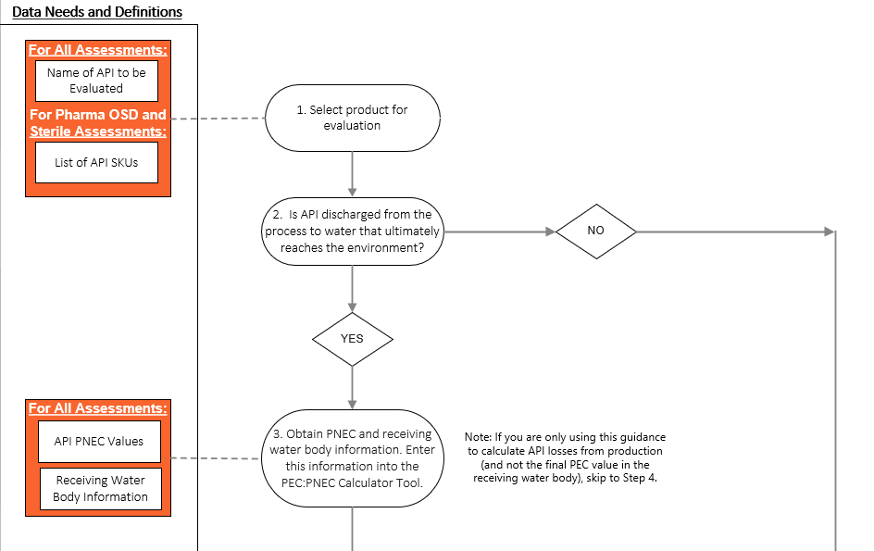
Goal of this Presentation
Provide an overview of the mass balance approach for estimating API losses from manufacturing to determine the Predicted Environmental Concentration (PEC) and Risk Quotient (RQ).
The following documents will be available on the PSCI website.
This presentation (with audio recording)
Mass balance process decision tree / flow chart
Detailed guidance presentation for different types of manufacturing: OSD, Sterile, API Chemical Synthesis
Example calculations and reporting template
Example Section of Detailed Guidance Flowchart

Slide 7
Terminology and Acronyms
eMax – Estimated maximum mass of API discharged to the environment during a 24-hour period. The goal of this guidance is to calculate and refine the eMax value.
PEC – Predicted Environmental Concentration of an API in the receiving water body (µg/L).
PNEC – Predicted No Effect Concentration of an API (µg/L).
Several values – chronic environmental toxicity is normally the lowest.
RQ – Ratio of PEC/PNEC. If RQ >=1, indicates there is risk associated with the discharge of API.

Slide 8
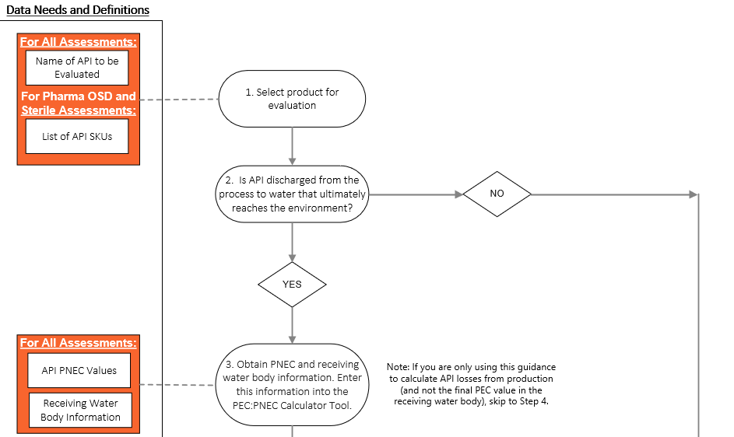
Mass Balance Process Overview – Background Information
The detailed guidance contains 8 steps. Steps increase in complexity as you go.
Step 1: Select the product and specific SKU for
evaluation.
Step 2: Determine if API Losses can be discharged to the environment.
If possible, continue with assessment.
If not possible, skip to documentation.
Step 3: Obtain PNEC and River Flow Information
Select values based on company and/or PSCI guidance.
Not necessary to perform mass balance – optional step.

Slide 9
Mass Balance Process Overview – Background Information
The detailed guidance contains 8 steps. Steps increase in complexity as you go.
Step 1: Select the product and specific SKU for
evaluation.
Step 2: Determine if API Losses can be discharged to the environment.
If possible, continue with assessment.
If not possible, skip to documentation.
Step 3: Obtain PNEC and River Flow Information
Select values based on company and/or PSCI guidance.
Not necessary to perform mass balance – optional step.

Slide 10
Mass Balance Process Overview – Background Information
The detailed guidance contains 8 steps. Steps increase in complexity as you go.
Step 1: Select the product and specific SKU for
evaluation.
Step 2: Determine if API Losses can be discharged to the environment.
If possible, continue with assessment.
If not possible, skip to documentation.
Step 3: Obtain PNEC and River Flow Information
Select values based on company and/or PSCI guidance.
Not necessary to perform mass balance.

Slide 11
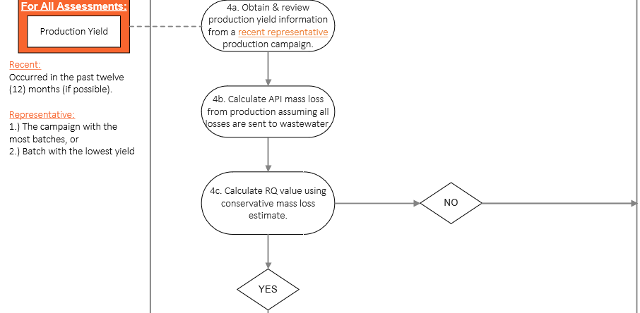
Mass Balance Process Overview – Conservative Assessment
Step 4a: Obtain batch record information for selected product.
Step 4b: Use batch record information to calculate eMax.
Assume all losses go to wastewater.
Conservative, easy to calculate.
Step 4c: Calculate PEC/PNEC (RQ) value using eMax.
If RQ < 1, skip to documentation.
If RQ > 1, proceed to Step 5 to refine mass loss estimate.

Slide 12
Mass Balance Process Overview – Conservative Assessment
Step 4a: Obtain batch record information for selected product.
Step 4b: Use batch record information to calculate eMax.
Assume all losses go to wastewater.
Conservative, easy to calculate.
Step 4c: Calculate PEC/PNEC (RQ) value using eMax.
If RQ < 1, skip to documentation.
If RQ > 1, proceed to Step 5 to refine mass loss estimate.

Slide 13
Mass Balance Process Overview – Conservative Assessment
Step 4a: Obtain batch record information for selected product.
Step 4b: Use batch record information to calculate eMax.
Assume all losses go to wastewater.
Conservative, easy to calculate.
Step 4c: Calculate PEC/PNEC (RQ) value using eMax.
If RQ < 1, skip to documentation.
If RQ > 1, proceed to Step 5 to refine mass loss estimate.

Slide 14
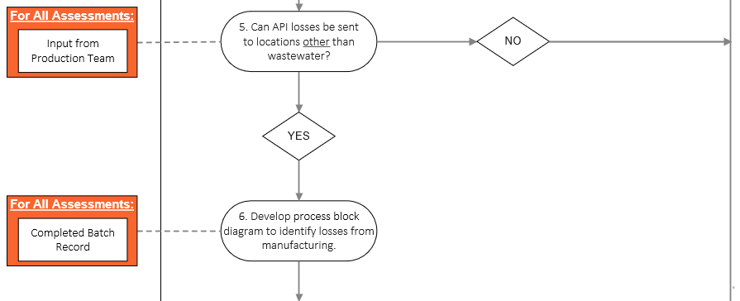
Mass Balance Process Overview – Refine Assessment (1/2)
Step 5: Determine other locations where losses occur.
Dust losses
Solvent disposal
Cleaning removal
QA/QC samples
If there are no other loss locations, then document results from Step 4.
Step 6: Develop a block diagram to track losses associated with production.

Slide 15
Mass Balance Process Overview – Refine Assessment (1/2)
Step 5: Determine other locations where losses occur.
Dust losses
Solvent disposal
Cleaning removal
QA/QC samples
If there are no other loss locations, then document results from Step 4.
Step 6: Develop a block diagram to track losses associated with production.

Slide 16
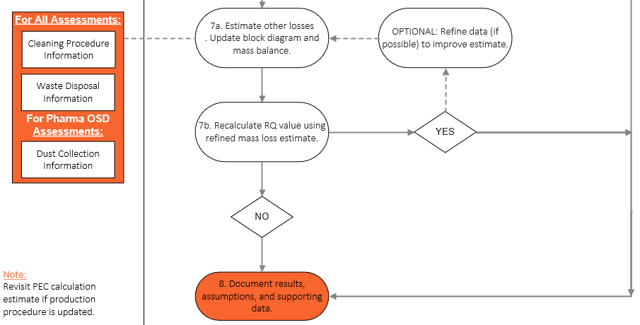
Mass Balance Process Overview – Refine Assessment (2/2)
Step 7a: Populate block diagram with process loss information.
Dust losses
Solvent disposal
Cleaning removal
Step 7b: Recalculate RQ value using new mass loss estimate.
If RQ > 1 and further refinement is possible, return to step 7a.
Step 8: Document results and assumptions using standardized template.

Slide 17
Mass Balance Process Overview – Refine Assessment (2/2)
Step 7a: Populate block diagram with process loss information.
Dust losses
Solvent disposal
Cleaning removal
Step 7b: Calculate new eMax, RQ values
If RQ > 1 and further refinement is possible, return to step 7a.
Step 8: Document results and assumptions using standardized template.

Slide 18
Mass Balance Process Overview – Refine Assessment (2/2)
Step 7a: Populate block diagram with process loss information.
Dust losses
Solvent disposal
Cleaning removal
Step 7b: Calculate new eMax, RQ values
If RQ > 1 and further refinement is possible, return to step 7a.
Step 8: Document results and assumptions using standardized template.

Slide 19

To ask questions, please use the ‘Chat’ or ‘Q&A’ function on the right-hand side of your screen

Slide 20
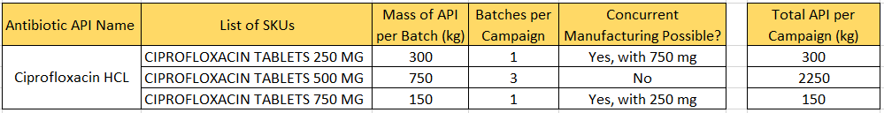
Step 1: Select a Product for Evaluation
1. Select product for evaluation
Example of Product Selection:
Choose product with the highest potential eMax
In this case, 500 MG tablet product has highest API/campaign
Factors to consider when selecting a product for evaluation:
Mass of API per batch
Number of batches per campaign
Concurrent manufacturing
Purpose:
There may be multiple products made at your facility which contain the same API.
Carefully select the product(s) being assessed so PEC estimate will be conservative.

Slide 21

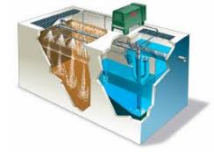

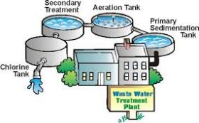
Step 2: Determine if API Losses are Discharged to the Environment via Wastewater
2. Is API discharged from the process to water that ultimately reaches the environment?
What happens to your facility’s liquid waste?
Sent directly to a water body.
Sent to an offsite WWTP, which discharges into a water body
Purpose:
Determine if the selected product can discharge API to the environment via water.
If yes, proceed with assessment.
If no, PEC value is 0. Document results.
Your Facility
Onsite WW Treatment
Municipal WW Treatment
Receiving Water Body
If your facility’s liquid waste does not go to environment, confirm the following…
No process wastewater discharged onsite or offsite
All API-containing wastewater incinerated or sent to a closed-loop zero-liquid discharge (ZLD) system.
Offsite incineration facilities are licensed and audited.
If wastewater is sent to a closed-loop ZLD system, no residual water discharged or used onsite or offsite.
  Note: this includes water used for irrigation.

Slide 22
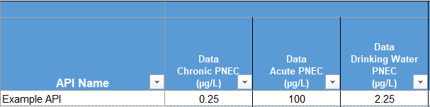
Step 3: Obtain PNEC Information
3. Obtain PNEC and receiving water body information. Enter this information into the PEC:PNEC Calculator Tool.
You may need to determine the Risk Quotient (RQ), which is the ratio of PEC/PNEC.
The PSCI PEC:PNEC Calculator tool is designed to calculate Risk Quotient values automatically.
Input relevant Predicted No Effect Concentration (PNEC) value(s)
Purpose:
Gather information necessary to calculate PEC/PNEC ratio.
PNEC information can come from several sources.
WET Center
AMR Industry Alliance
Original innovator of API
Requester of PEC assessment may provide
Calculator Tool Interface for Entering PNEC Information
If PNEC data is not available, the eMax and PEC can still be determined.

Slide 23

Step 3: Obtain Water Body Information
PEC is a measure of the concentration of API in the water body receiving API from manufacturing wastewater. This is typically a river, stream, lake or ocean.
PEC will depend on the type, flow, and size of the dilution/mixing zone in the receiving water body.
Policies for establishing dilution volume vary by company.
3. Obtain PNEC and receiving water body information. Enter this information into the PEC:PNEC Calculator Tool.
Purpose:
Gather water body information necessary to calculate PEC value.
For River or stream – typically low flow value used:
10th percentile, 5th Percentile, Q710
Data may be available from local environmental agencies
If detailed flow data not available, fraction of average flow
Calculator Tool Interface for Entering Water Body Information
For Ocean or Lake:
Dilution volume chronic ≈ 10x average wastewater flow
Dilution volume acute ≈ 2x average wastewater flow
Water body specific mixing zone information
If water body data is not available, the PEC can still be determined.

Slide 24
Step 4: Gather Production Yield Information
4a. Obtain & review production yield information from a recent, representative production campaign
First-pass mass loss estimate can be established using yield data, where all losses are assumed to go to wastewater.
Note – this is the theoretical worst-case scenario since it assumes all losses (e.g., dust, cleaning, samples, etc.) from the campaign are sent to wastewater at the end of campaign. Requires little effort, simple approach used to determine if PEC/PNEC > 1 is possible.
Purpose:
Generate an initial, conservative mass loss estimate (eMax). Use PEC:PNEC Calculator tool to determine if further evaluation is warranted.
Obtain completed batch record for recent, representative production campaign.
“Recent” = Completed within the past 12 months.
“Representative”
  If the product is produced in multi-batch campaigns, use campaign with the highest number of batches.
  If the product is produced in single batch campaigns, use campaign with lowest production yield.

Slide 25
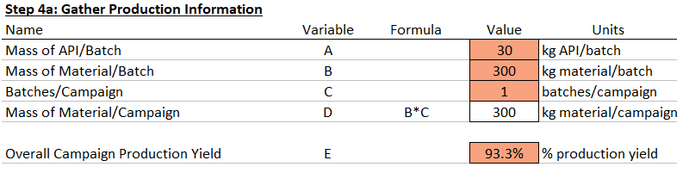
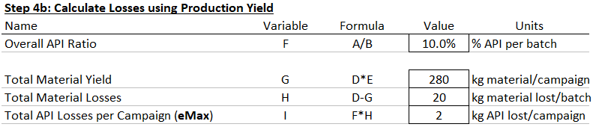
Step 4: Gather Production Yield Information
4a. Obtain & review production yield information from a recent, representative production campaign
First-pass mass loss estimate can be established using yield data, where all losses are assumed to go to wastewater.
Note – this is the theoretical worst-case scenario since it assumes all losses (e.g., dust, cleaning, samples, etc.) from the campaign are sent to wastewater at the end of campaign. Requires little effort, simple approach used to determine if PEC/PNEC > 1 is possible.
Purpose:
Generate an initial, conservative mass loss estimate (eMax). Use PEC:PNEC Calculator tool to determine if further evaluation is warranted.
Mass of API per batch * batches/campaign * (1- Production Yield) = Total Losses = eMax

Slide 26
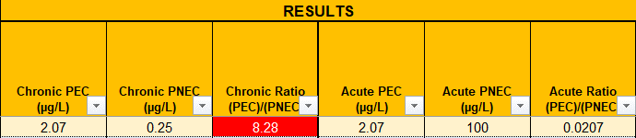
Step 4: Use eMax to Calculate PEC Value
4a. Obtain & review production yield information from a recent, representative production campaign
With eMax, PNECs, and receiving water data, we can calculate an initial RQ (PEC/PNEC) value.
PSCI has released a calculator tool to automate calculation of RQ values.
Purpose:
Generate an initial, conservative mass loss estimate (eMax). Use PSCI PEC:PNEC Calculator tool to determine if further evaluation is warranted.
Because at least one RQ value is greater than 1, we will refine the assessment further.
This will be done by accounting for known losses.

Slide 27

Step 5: Compile List of API Loss Locations
5. Can API losses be sent to locations other than wastewater?
Create a list of locations where API is lost during production and cleaning.
Wastewater
Dust collection
Solvent streams
Cleaning material sent to hazardous waste (rags, mops, etc.)
Reject and samples sent to hazardous waste
This will require the input of process experts from your facility.
Purpose:
Check if API losses can be sent to locations other than wastewater.

Slide 28
Step 6: Develop a Process Block Diagram
6. Develop process block diagram to identify losses from manufacturing.
A block diagram will help you understand and account for losses of material in each step.
We will add numbers to the diagram in the next step.
Purpose:
Create a block diagram that shows the production process.
Production
Yield 1
(e.g., Mixing)
Production
Yield 2
(e.g., Filling)
Material Input
Material Output
Material Output
API Input (A₁)
Excipient Input (B₁)
API Output (A₂)
Excipient Output (B₂)
API to Product (A₃)
Excipient to Product (E₃)
Losses to Solid Disposal (C₁)
Losses to Wastewater
System (D₁)
Losses to Solid Disposal (C₂)
Losses to Wastewater
System (D₂)

Slide 29
Step 7: Populate Balance with Known/Estimated Losses
7a. Estimate other losses. Update block diagram and mass balance.
From the batch record, obtain the following data on accountable losses.
Purpose:
Use batch records to update block diagram with accountable loss information.
Residual Mass
Washed to Drain
Never Accounted for
in Batch Records
Central Dust
Collection Mass
Total Material into Yield 1
kg excipient/campaign
kg API/campaign
Dry Cleaning Mass
Step 1
Sometimes Accounted
for in Batch Records
Waste/Rejected Mass
Sample Mass
Always Accounted for
in Batch Records
Product Mass

Slide 30
Step 7: Populate Balance with Accountable Losses
7a. Estimate other losses. Update block diagram and mass balance.
Production
Yield 1
(Mixing)
Production
Yield 2
(Filling)
Material Input
Material Output
Material to Product
Purpose:
Use batch records to update block diagram with accountable loss information.
Losses to Waste Disposal
Losses to Waste Disposal
Losses to Wastewater System
Losses to Wastewater System

Slide 31
Step 7: Populate Balance with Accountable Losses
7a. Estimate other losses. Update block diagram and mass balance.
Production
Yield 1
(Mixing)
Production
Yield 2
(Filling)
Material Input
Material Output
Material to Product
Purpose:
300 kg material/campaign
30 kg API/campaign
285.0 kg material/camp.
28.5 kg API/campaign
280.0 kg material/camp.
28.0 kg API/campaign
Use batch records to update block diagram with accountable loss information.
Losses to Waste Disposal
Losses to Waste Disposal
Losses to Wastewater System
Losses to Wastewater System
1. Production Yield
Mass moving from step to step

Slide 32
Step 7: Populate Balance with Accountable Losses
7a. Estimate other losses. Update block diagram and mass balance.
Production
Yield 1
(Mixing)
Production
Yield 2
(Filling)
Material Input
Material Output
Material to Product
Purpose:
300 kg material/campaign
30 kg API/campaign
285.0 kg material/camp.
28.5 kg API/campaign
280.0 kg material/camp.
28.0 kg API/campaign
Use batch records to update block diagram with accountable loss information.
10.0 kg material/campaign
1.0 kg API/campaign
2.5 kg material/campaign
0.3 kg API/campaign
Losses to Waste Disposal
Losses to Waste Disposal
Losses to Wastewater System
Losses to Wastewater System
1. Production Yield
Mass moving from step to step
2. Accountable Losses
Known losses in each step

Slide 33
Step 7: Populate Balance with Accountable Losses
7a. Estimate other losses. Update block diagram and mass balance.
Production
Yield 1
(Mixing)
Production
Yield 2
(Filling)
Material Input
Material Output
Material to Product
Purpose:
300 kg material/campaign
30 kg API/campaign
285.0 kg material/camp.
28.5 kg API/campaign
280.0 kg material/camp.
28.0 kg API/campaign
Use batch records to update block diagram with accountable loss information.
10.0 kg material/campaign
1.0 kg API/campaign
2.5 kg material/campaign
0.3 kg API/campaign
5.0 kg material/campaign
0.5 kg API/campaign
2.5 kg material/campaign
0.3 kg API/campaign
Losses to Waste Disposal
Losses to Waste Disposal
Losses to Wastewater System
Losses to Wastewater System
1. Production Yield
Mass moving from step to step
2. Accountable Losses
Known losses in each step
3. Losses to Wastewater
Calculate by difference

Slide 34
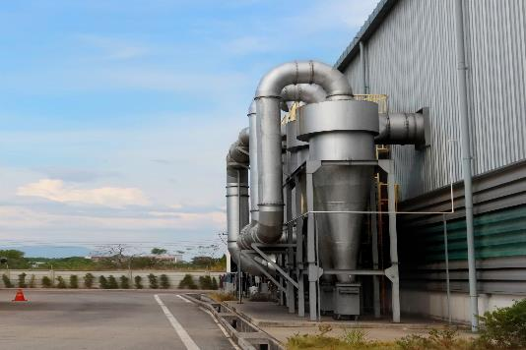
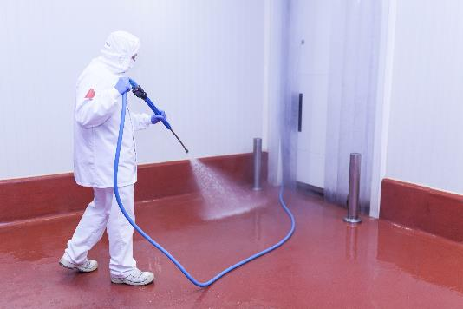
Step 7: Differences for Oral Solid Dose (OSD) Products 1/2
7a. Estimate other losses. Update block diagram and mass balance.
OSD products (such as capsules and tablets) typically have dust losses which are rarely accounted for in batch records.
Overhead dust collection
Dry cleaning equipment – vacuums, rags, etc.
Purpose:
Estimating overhead dust losses – 3 Methods
Dust collection experiment
Estimate aggregate dust factor using waste records.
If 1 and 2 are not possible, estimate removal percentage.
Estimating dry cleaning losses
Measure collected material during campaign
Existing cleaning efficiency data
If there is not sufficient data, do not assume API removal via cleaning.
Overview of estimating losses for OSD production.

Slide 35
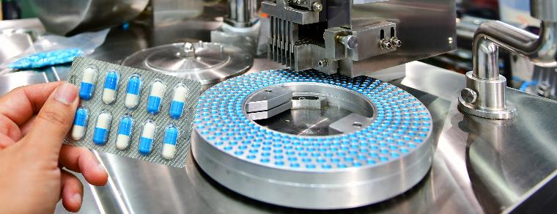
Step 7: Differences for Oral Solid Dose (OSD) Products 2/2
7a. Estimate other losses. Update block diagram and mass balance.
Loss calculation for OSD should be done on a per campaign basis.
Track accumulating losses from batch to batch during a campaign.
When estimating losses from OSD production, consider cleaning schedule.
Minor cleaning between batches – typically minor dry cleaning
Final major clean with water will contain accumulated losses from several batches.
If your minor cleaning procedure significantly reduce the losses in the production room, it may be possible to perform calculation on a per batch basis.
Rinses of production equipment
Vacuuming of equipment and surrounding room
Purpose:
Effects of multi-batch campaign production for OSD products.

Slide 36
Step 7: Differences for Oral Solid Dose (OSD) Products
7a. Estimate other losses. Update block diagram and mass balance.
Losses to Dust Collection System
Losses to Dust Collection System
Purpose:
Production
Yield 1
(Granulation)
Production
Yield 2
(Encapsulation)
Material Input
Material Output
Material to Product
Effects of multi-batch campaign production for OSD products.
Losses to Waste Disposal (C₁)
Losses to Waste Disposal (C₂)
Losses to Wastewater System (D₁)
Losses to Wastewater System (D₂)

Slide 37
Step 7: Differences for Oral Solid Dose (OSD) Products
7a. Estimate other losses. Update block diagram and mass balance.
Losses to Dust Collection System
Losses to Dust Collection System
Purpose:
Production
Yield 1
(Granulation)
Production
Yield 2
(Encapsulation)
Material Input
Material Output
Material to Product
Effects of multi-batch campaign production for OSD products.
200.0 kg API/batch
600.0 kg API/campaign
180.0 kg API/batch
540.0 kg API/campaign
175.0 kg API/batch
525.0 kg API/campaign
Losses to Waste Disposal (C₁)
Losses to Waste Disposal (C₂)
Losses to Wastewater System (D₁)
Losses to Wastewater System (D₂)
1. Production Yield
Mass moving from step to step

Slide 38
Step 7: Differences for Oral Solid Dose (OSD) Products
7a. Estimate other losses. Update block diagram and mass balance.
Losses to Dust Collection System
Losses to Dust Collection System
Purpose:
Production
Yield 1
(Granulation)
Production
Yield 2
(Encapsulation)
Material Input
Material Output
Material to Product
Effects of multi-batch campaign production for OSD products.
200.0 kg API/batch
600.0 kg API/campaign
180.0 kg API/batch
540.0 kg API/campaign
175.0 kg API/batch
525.0 kg API/campaign
2.0 kg API/batch
6.0 kg API/campaign
1.0 kg API/batch
3.0 kg API/campaign
Losses to Waste Disposal (C₁)
Losses to Waste Disposal (C₂)
Losses to Wastewater System (D₁)
Losses to Wastewater System (D₂)
1. Production Yield
Mass moving from step to step
2. Accountable Losses
Known losses in each step

Slide 39
Step 7: Differences for Oral Solid Dose (OSD) Products
7a. Estimate other losses. Update block diagram and mass balance.
Losses to Dust Collection System
Losses to Dust Collection System
9.0 kg API/batch
27.0 kg API/campaign
1.5 kg API/batch
4.5 kg API/campaign
Purpose:
Production
Yield 1
(Granulation)
Production
Yield 2
(Encapsulation)
Material Input
Material Output
Material to Product
Effects of multi-batch campaign production for OSD products.
200.0 kg API/batch
600.0 kg API/campaign
180.0 kg API/batch
540.0 kg API/campaign
175.0 kg API/batch
525.0 kg API/campaign
2.0 kg API/batch
6.0 kg API/campaign
1.0 kg API/batch
3.0 kg API/campaign
Losses to Waste Disposal (C₁)
Losses to Waste Disposal (C₂)
Losses to Wastewater System (D₁)
Losses to Wastewater System (D₂)
1. Production Yield
Mass moving from step to step
2. Accountable Losses
Known losses in each step
3. Dust Losses
Estimate via 1 of 3 methods

Slide 40
Step 7: Differences for Oral Solid Dose (OSD) Products
7a. Estimate other losses. Update block diagram and mass balance.
Losses to Dust Collection System
Losses to Dust Collection System
9.0 kg API/batch
27.0 kg API/campaign
1.5 kg API/batch
4.5 kg API/campaign
Purpose:
Production
Yield 1
(Granulation)
Production
Yield 2
(Encapsulation)
Material Input
Material Output
Material to Product
Effects of multi-batch campaign production for OSD products.
200.0 kg API/batch
600.0 kg API/campaign
180.0 kg API/batch
540.0 kg API/campaign
175.0 kg API/batch
525.0 kg API/campaign
10.0 kg API/batch
30.0 kg API/campaign
3.0 kg API/batch
9.0 kg API/campaign
Losses to Waste Disposal (C₁)
Losses to Waste Disposal (C₂)
Losses to Wastewater System (D₁)
Losses to Wastewater System (D₂)
1. Production Yield
Mass moving from step to step
2. Accountable Losses
Known losses in each step
3. Dust Losses
Estimate via 1 of 3 methods
4. Cleaning Information
Via dry cleaning experiment

Slide 41
Step 7: Differences for Oral Solid Dose (OSD) Products
7a. Estimate other losses. Update block diagram and mass balance.
Losses to Dust Collection System
Losses to Dust Collection System
9.0 kg API/batch
27.0 kg API/campaign
1.5 kg API/batch
4.5 kg API/campaign
Purpose:
Production
Yield 1
(Granulation)
Production
Yield 2
(Encapsulation)
Material Input
Material Output
Material to Product
Effects of multi-batch campaign production for OSD products.
200.0 kg API/batch
600.0 kg API/campaign
180.0 kg API/batch
540.0 kg API/campaign
175.0 kg API/batch
525.0 kg API/campaign
10.0 kg API/batch
30.0 kg API/campaign
3.0 kg API/batch
9.0 kg API/campaign
1.0 kg API/batch
3.0 kg API/campaign
0.5 kg API/batch
1.5 kg API/campaign
Losses to Waste Disposal (C₁)
Losses to Waste Disposal (C₂)
Losses to Wastewater System (D₁)
Losses to Wastewater System (D₂)
1. Production Yield
Mass moving from step to step
2. Accountable Losses
Known losses in each step
3. Dust Losses
Estimate via 1 of 3 methods
4. Cleaning Information
Via dry cleaning experiment
5. Losses to Wastewater
Calculate by difference

Slide 42
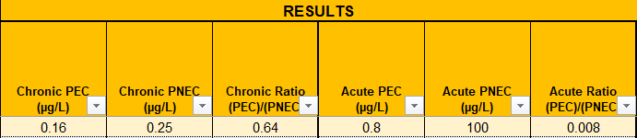
Step 7: Recalculate PEC/PNEC Ratio
Purpose:
Return to calculator tool with new eMax value.
7b. Recalculate RQ value using refined mass loss estimate.
Calculate PEC/PNEC ratio using PSCI calculator tool.
Updated RQ (PEC/PNEC) ratio is < 1. No further refinement is required.
Proceed to Step 8 to document results and assumptions.

Slide 43
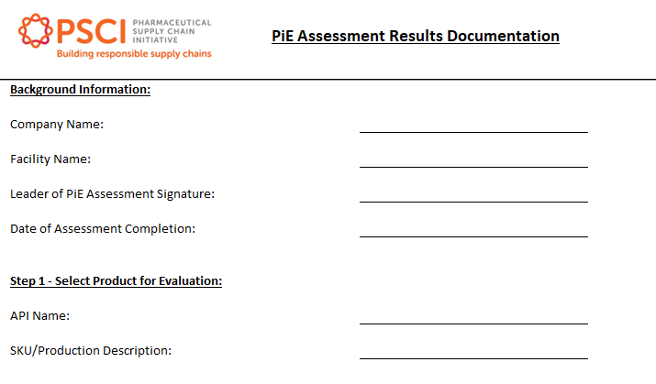
Step 8: Document Results, Assumptions, and Supporting Data
Purpose:
Steps to Complete Documentation:
Save assessment files in a single location. Make sure to include…
  PNEC values for the selected API (as well as their source)
  Data used to calculate receiving water body dilution volume.
  Mass balance calculation
  Batch record information
  Documentation to justify loss values to dust, cleaning, etc.
Complete the “Documentation” tab of the “PSCI Example Calculation” Excel file.
8. Document results, assumptions, and supporting data.
Record the results of the PEC assessment, along with the assumptions and supporting data.

Slide 44
To ask questions, please use the ‘Chat’ or ‘Q&A’ function on the right-hand side of your screen

